Slide 1
Towards A Better Understanding Of The Snail-Trematode-Microbiome Interactions Driving Schistosome Transmission In Senegal
Ruben Schols
Notes:
Hi, I am Ruben Schols and I’ll be discussing why bacteria matter in schistosoma transmission

Slide 2
Conflict of Interest
X | No, Nothing to disclose
 | Yes, please specify
Company / Name | Honoraria / Expense | Consulting / Advisory Board | Funded Research | Royalties / Patent | Stock Options | Ownership / Equity Position | Employee | Other (Please specify)

Slide 3
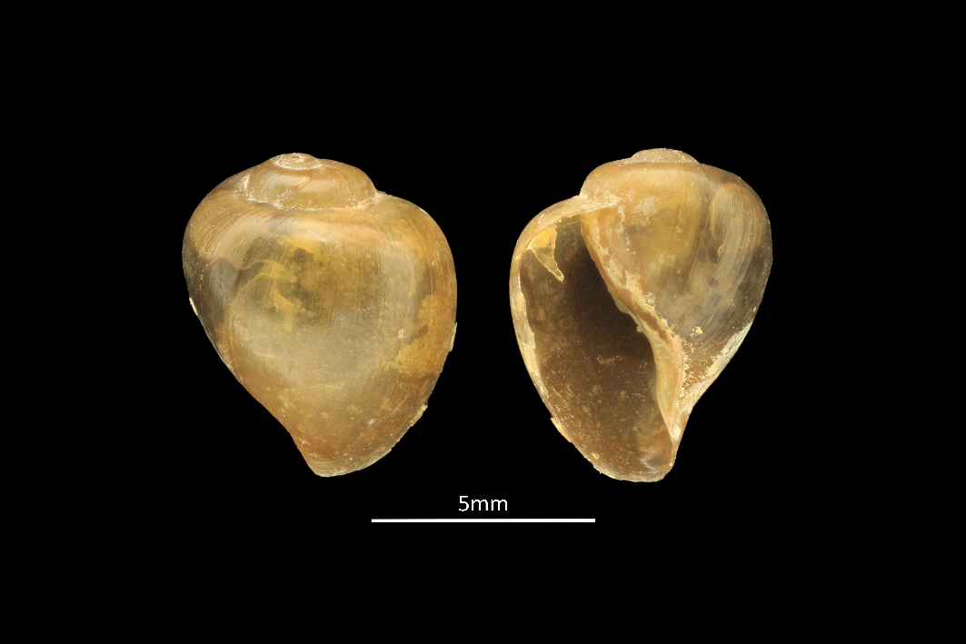
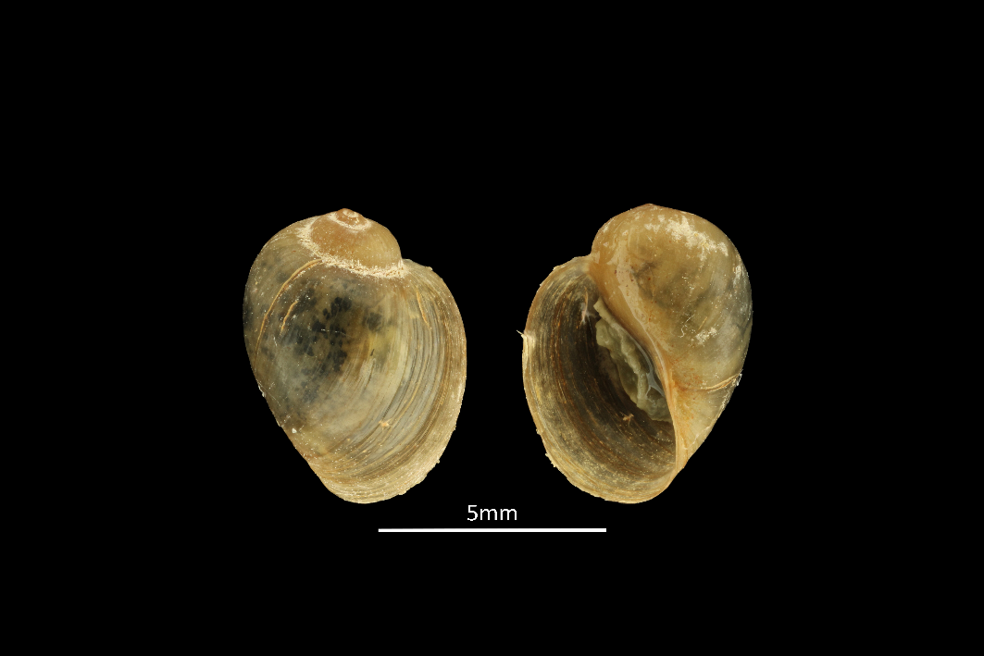
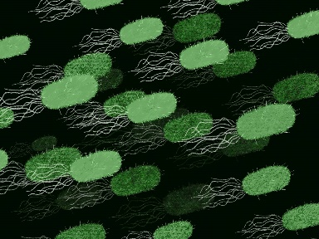
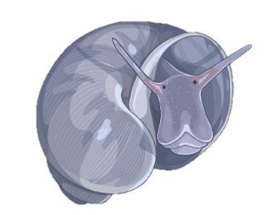
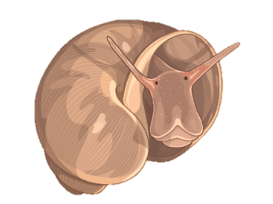
Created with BioRender.com
Notes:
Imagine you are collecting snails in the field. You are out there in the blistering sun, gummy boots full of your own sweat, scooping for snails as if your life depended on it. It turns out that there is two snail species present. Besides a few external differences, They are quite closely related, have more or less the same size, and their major activities include eating and reproducing. There are worse ways to spend your days. (pause) How is it then that snail number 1 transmits a deadly human parasite, while snail number 2 is harmless and does whatever snails do best? Moreover, something crazy happens, If you would go and collect snails from that same waterbody a few miles upstream, you would be surprised to find out that the tables have turned. Now snail 2 transmits the deadly parasite while snail 1 became harmless.
I wish I could tell I was creative enough to come up with this story on my own. But I am not, this is what is happening in the Senegal River Basin! Snail number 1 is B. globosus, Snail number 2 is B. truncatus and the deadly disease I am speaking of is of course schistosomiasis.
To this day researchers are still uncertain what might be causing this pattern. Could the microbiome have been the missing link?
like me having dark hair, you having blond hair and others having no hair.

Slide 4
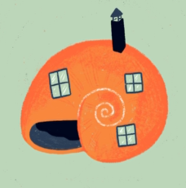
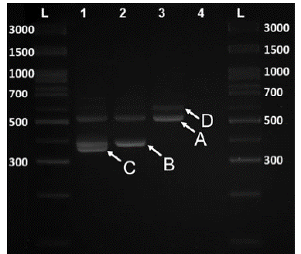
Methodology
Sanger Sequencing
UNINFECTED
High-Throughput
Amplicon Sequencing
INFECTED
ALL
Shedding Experiment
Infection Diagnostic PCRs
16S Metabarcoding
Schols et al., 2019
Notes:
In an attempt to resolve this mystery, we went out to collect snails across the SRB, tested for infection in a shedding experiment. Then 24 specimens/site were tested with infection diagnostic PCRs to determine infection status of each individual snail. And based on this information we selected snails for microbiome characterization, so we had schisto infected, non-schisto trematode infected and uninfected snails. Uninfected snails are characterized through sanger sequencing and infected snails through the High Throughput amplicon sequencing approach described in Hammoud last year. This protocol allows to characterize snails and all their co-infecting trematodes simultaneously.

Slide 5
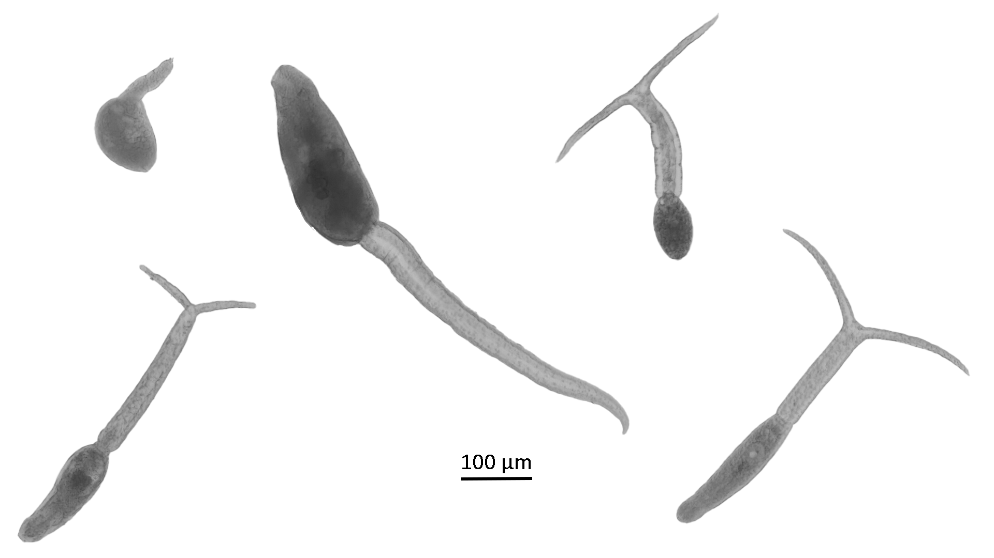
Results
UNPUBLISHED DATA – DO NOT COPY OR DISTRIBUTE
20% >95%
Notes:
Over 2000 snails were collected but only 700 were tested in shedding experiments due to time and resource restrictions. 20% of the snail released cercariae. About half of these snails released schisto cercariae and 13 snails released two types of cercariae simultaneously. Five types of cercariae were identified. The rapid diagnostic PCRs showed an even higher infection prevalence of over 95%. We have not yet obtained the output from the HTAS approach, providing us with additional information on co-infections and snail and parasite genetics.
We do have the microbiome output. I selected this figure from the output where we can see a clear pattern in the RDA plot where B. globosus and B. truncatus have their own unique communities. We can also see that the microbiome differs significantly between B. truncatus collected in the lower valley compared to those in the middle valley.
Bacterial genera of the phyla Firmicutes (2) and Proteobacteria (6) overrepresented in infected snails compared to non-infected snails, while 13 additional Phyla (138 genera) showed the opposite pattern. However, very small sample size for uninfected specimens.
, including human and animal schistosomes. A) Xiphidiocercaria, B) Schistosoma sp., C) Echinostome, D) Brevifurcate-apharyngeate distome and E) longifurcate-pharyngeate distome

Slide 6
Conclusions
Acknowledgements
References:
Schols, R., Carolus, H., Hammoud, C., Mulero, S., Mudavanhu, A., & Huyse, T. (2019). A rapid diagnostic multiplex PCR approach for xenomonitoring of human and animal schistosomiasis in a “One Health” context. Transactions of the Royal Society of Tropical Medicine and Hygiene, 113(11), 722–729.
Hammoud, C., Mulero, S., Van Bocxlaer, B., Boissier, J., Verschuren, D., Albrecht, C., & Huyse, T. (2022). Simultaneous genotyping of snails and infecting trematode parasites using high-throughput amplicon sequencing. Molecular Ecology Resources, 22(2), 567–586.
Co-authors: Cyril Hammoud, Ruben Put, Arthur Piot, Tim Maes, Bruno Senghor, Ellen Decaestecker, Tine Huyse
Funding:
Notes:
To conclude: The microbiome differs between B. globosus and B. truncatus and to the snails a few miles upstream. Why does one transmit the parasite while the other does not? Perhaps the microbiome, but have to await additional data from the HTAS approach to provide a conclusive answer since parasite-parasite and parasite-snail interactions could be major drivers as well.
So hopefully our sweat filled gummy boots will eventually result in a potential explanation for this mystery, perhaps leading to a solution.

