Slide 1
New 1 / 2,5 million scale Geologic and Mineral Occurrences maps of the Democratic Republic of Congo
M. Fernandez-Alonso¹, J.-F. Mupande², T. Badosa², D. Baudet¹, S. Dewaele¹, H. Kalenga², D. Kampata², V. Kanda-Nkula³, M. Lahmouch¹, P. Lahogue¹,M. Luamba³, H. Mashagiro², P. Mawaya², J. Mpoi³, B. Mwanza², F. Onya²
¹ Royal Museum for Central Africa (RMCA), Tervuren, Belgium; max.fernandez@africamuseum.be
² Ministère des Mines, Kinshasa, R.D. Congo.
³ Centre de Recherches Géologiques et Minières (CRGM), Kinshasa, R.D. Congo.

Slide 2
A first result of the the PROMINES programme Growth with Governance in the Mineral Sector of the DRC
2010 – 2018
Project P106982 / IDA-H589

Slide 3
The geo-data component in a nutshell
PROMINES Components
A. Ensure Access to Resources
B. Build Sector Management Capacity
C. Enhance Transparency and Accountability
D. Build Up Sustainable Development Settings
E. Coordination and Project Management
A.1. Policy, Legal and Regulatory Framework
Adjustment of the Mining Code and other official texts pertaining to the mining sector
Communication, consultation, and information on sector policy and implementation
A.2. Geo-data Infrastructure
Completion of national geodetic / topographic coverage
Assessments of mineral potential of selected areas in the public domain
Regional geophysical and geological surveys over selected areas
Establish a national geological database
Two approaches
At the national level Bring together and update existing public geo-data into present-day paradigms (“update national geological map”) Compile in a national GIS / Database system | At the regional and locale level Improve / Update / Complete for certain target areas: geological knowledge Mineral potential
this presentation ( ended 2015)
ongoing (expected for 2018)
this presentation and ongoing (expected for 2018)

Slide 4
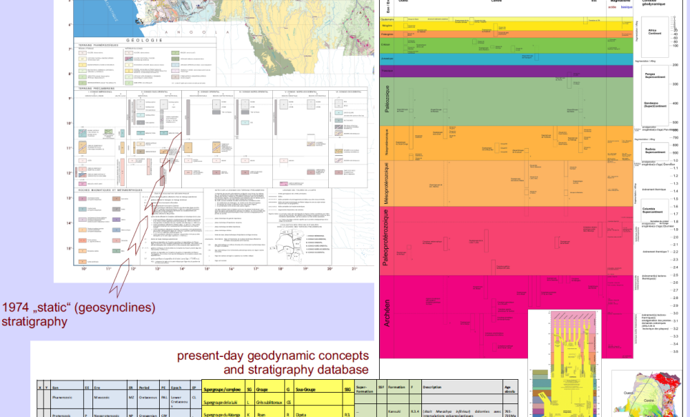
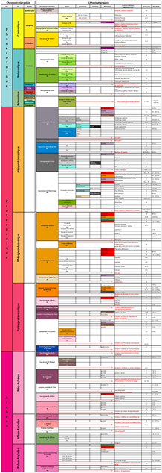
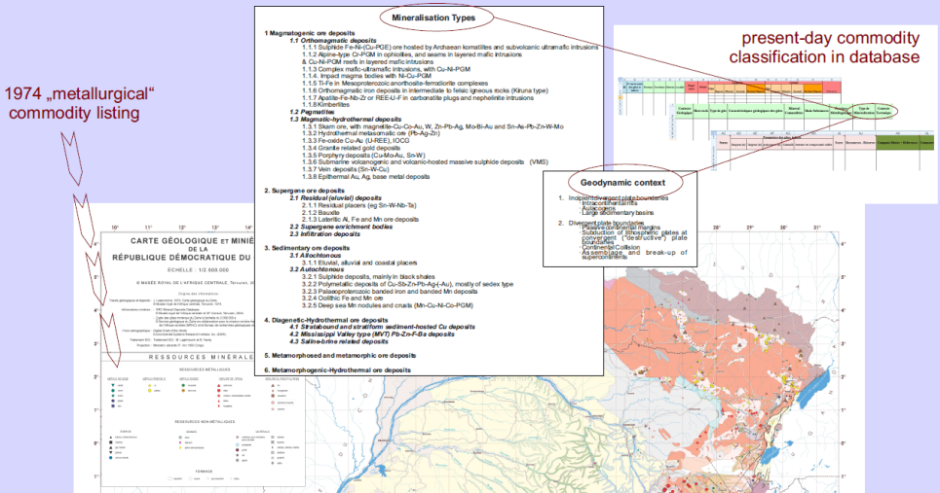
A new national geological (GIS) basemap
Update “static“ national geologic (Lepersonne, 1974) and “descriptive” mineral resources (BRGM,1976) maps that were based on pré-1960 data and paradigms using:
present-day geodynamic and stratigraphic concepts
present-day commodity and deposit-type classifications
(unpublished) works completed since 1974
In practice:
From 1976 „metallurgical“ commodity listing to present-day genetic commodity classification
From 1974 „static“ (geosynclines) stratigraphy to present-day concepts on geodynamics and stratigraphy

Slide 5
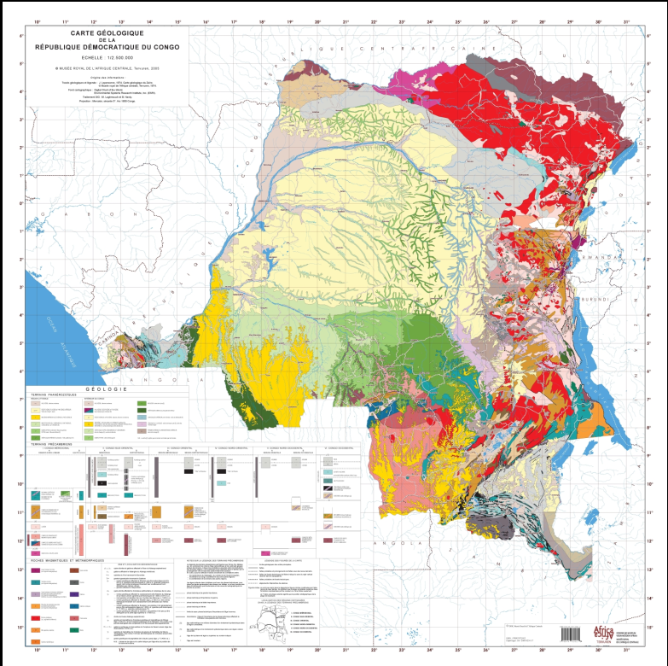
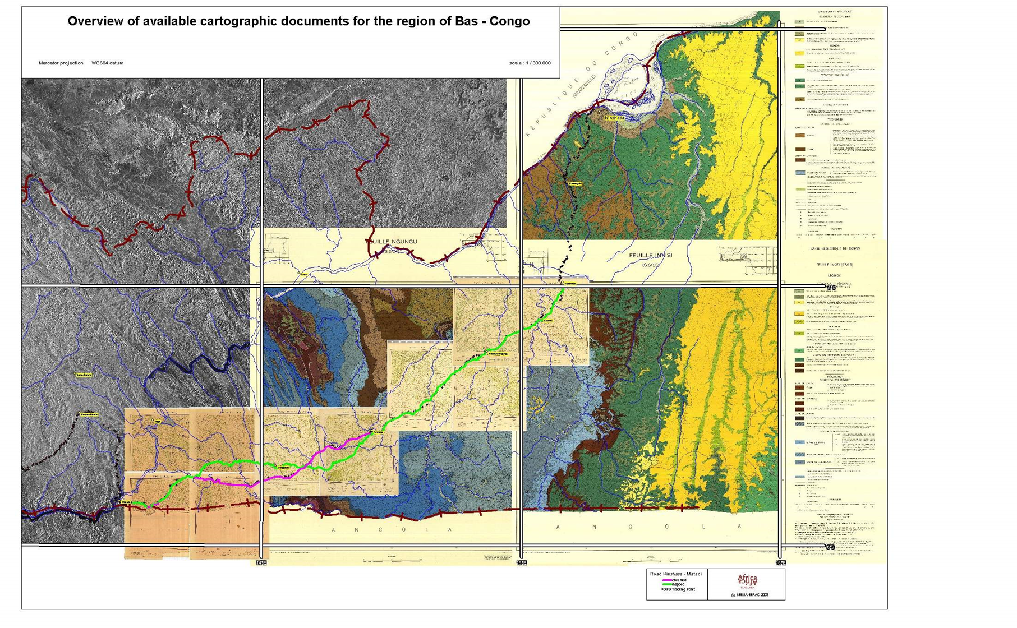
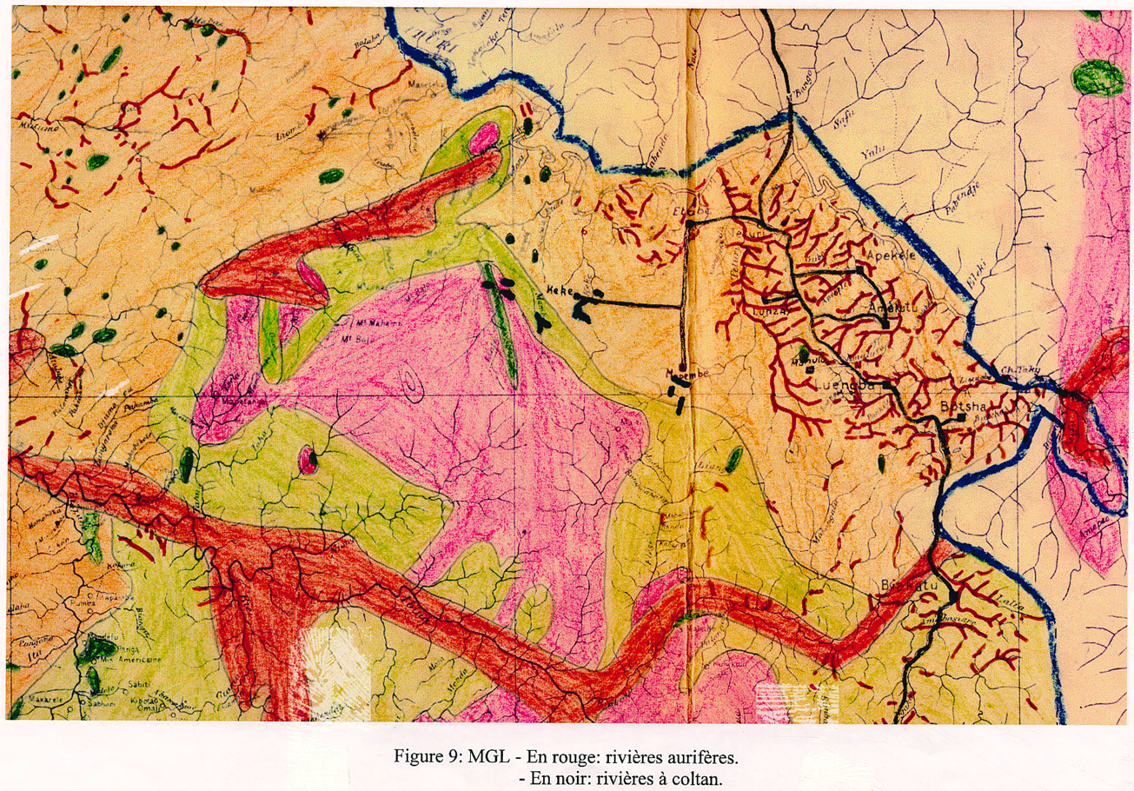
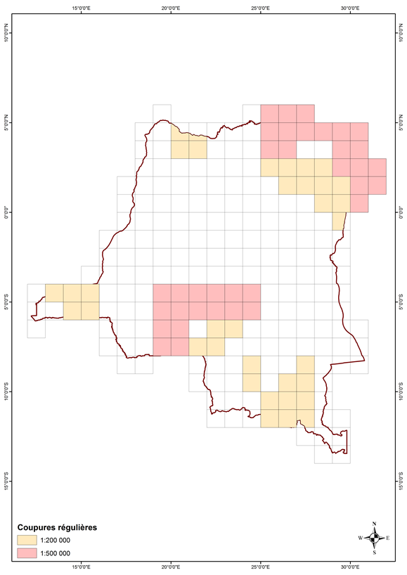
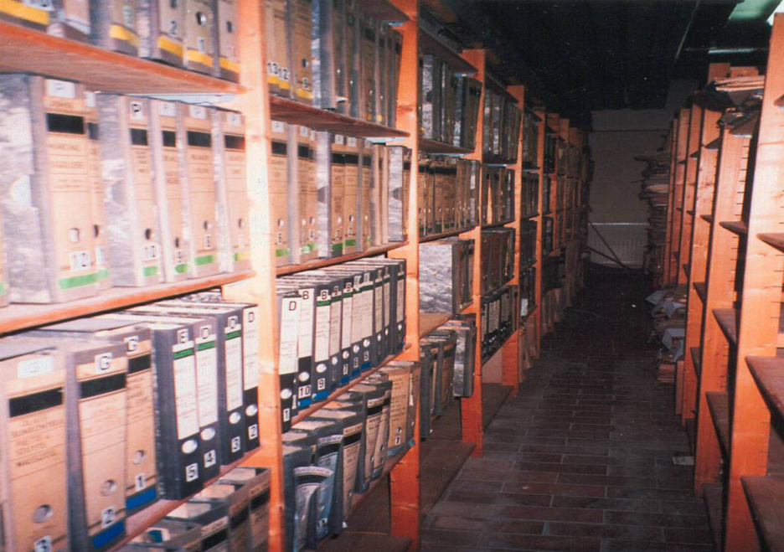
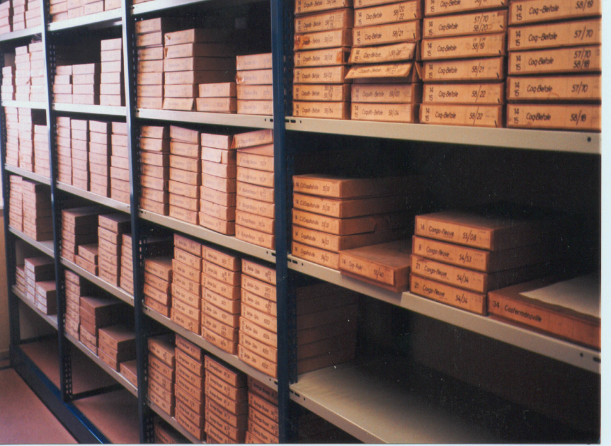
„static“ national geologic (Lepersonne, 1974) and metallogenic (BRGM,1976) maps that were based on pré-1960 paradigms, data ( mineral prospection reports) and techniques (photogeology, early days of geochronology);
Field survey archives
Large-scale coverage finished pre 1974
Full coverage flown 1952-1958 (250.000)
Notes:
What were the available information sources in 1970-ies

Slide 6
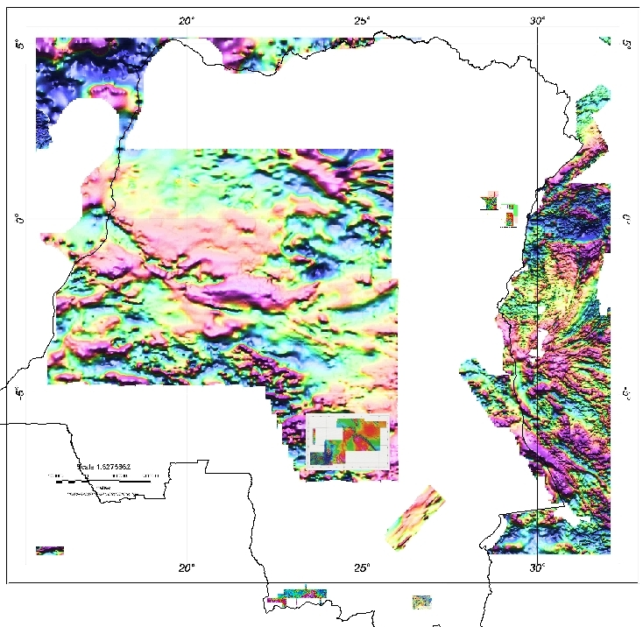
Update „static“ national geologic (Lepersonne, 1974) and metallogenic (BRGM,1976) maps using (unpublished) works completed since 1974
+/- 300 publications in int’l journals
(re)mapped areas at large scale
(airborne) geophysics (mag and gravi)
satellite imagery and DTM
updated inventory or mineral resources
Notes:
What are the sources now...

Slide 7
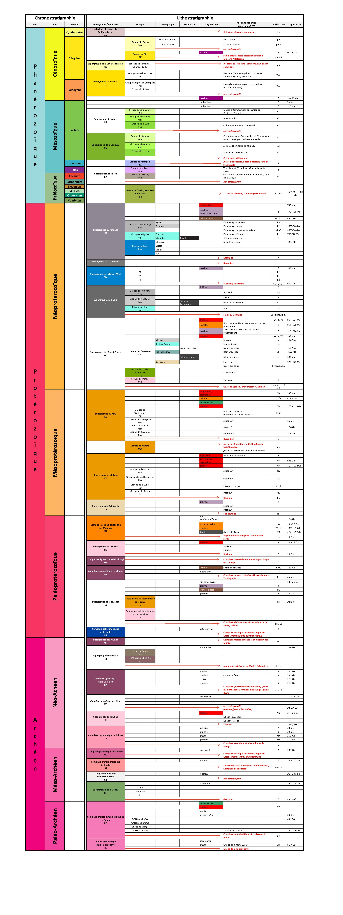
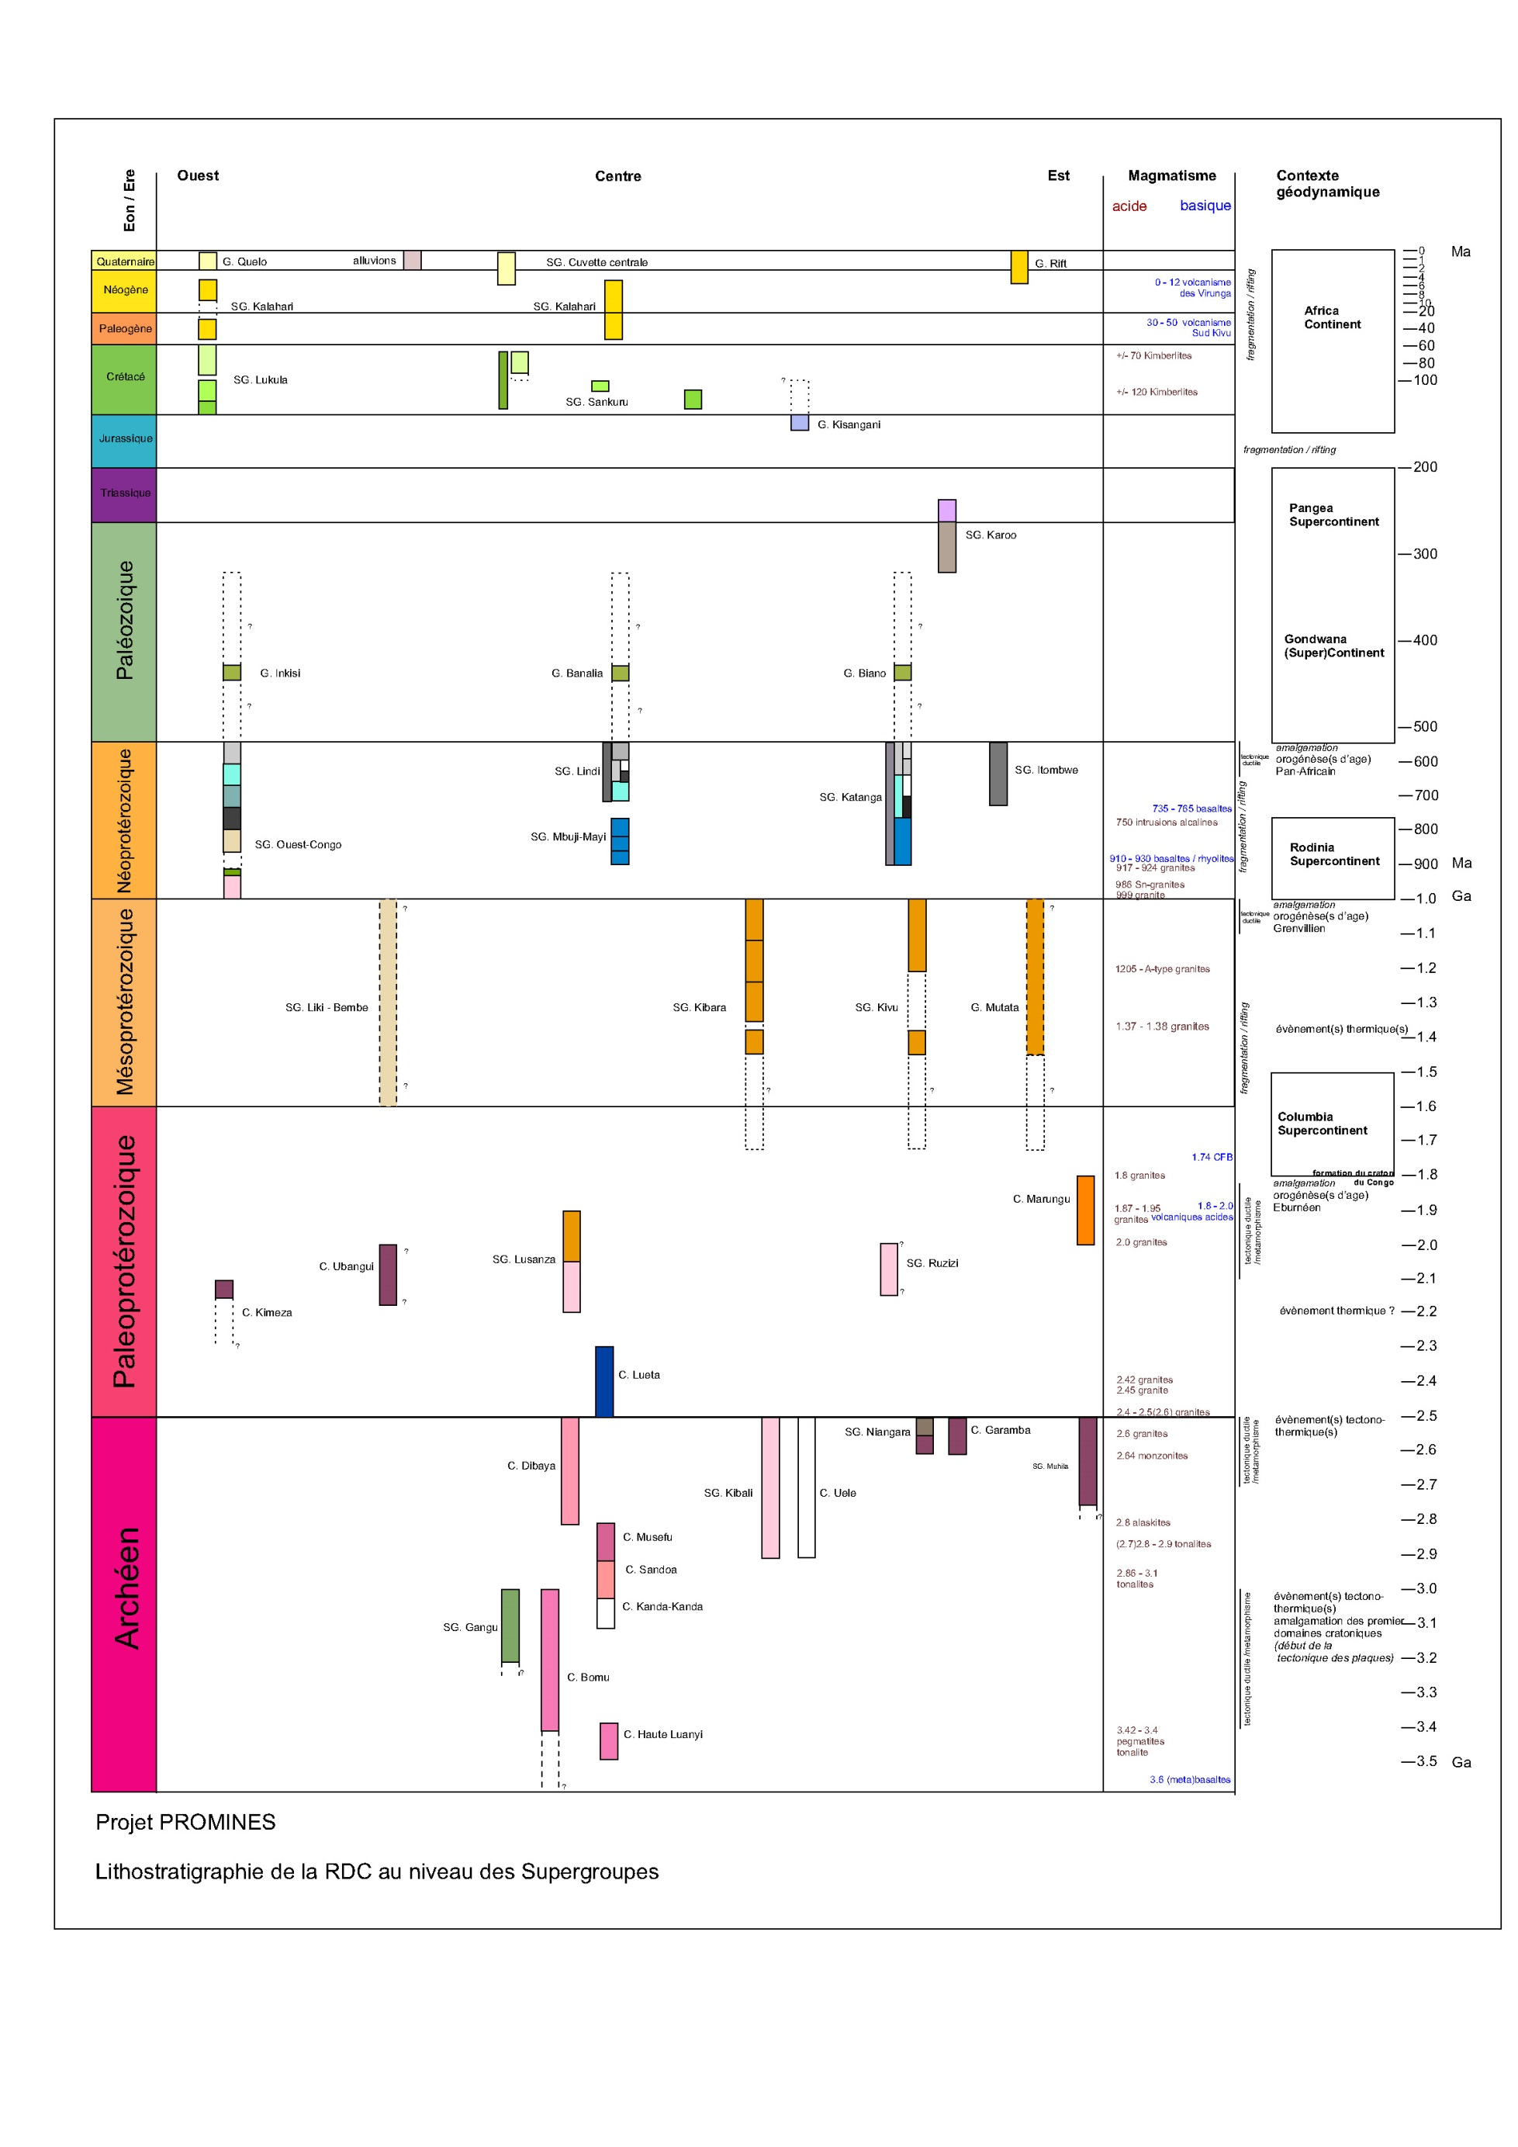
Update „static“ national geologic (Lepersonne, 1974) and metallogenic (BRGM,1976) maps that were based on pré-1960 data and paradigms using present-day geodynamic and stratigraphic concepts
Notes:
First stage: 1/ define geodynamic context (barcoding). And 2/ update (litho)stratigraphy at national level, formalizing units and hierarchy according to IUGS rules.

Slide 8
Update “static“ national geologic (Lepersonne, 1974) and “descriptive” mineral resources (BRGM,1976) maps that were based on pré-1960 data and paradigms using:
present-day geodynamic and stratigraphic concepts
present-day commodity and deposit-type classifications and updated inventories
(unpublished) works completed since 1974
3000 known mineral sites described from estimated 10000
Partie I: Localisation
Partie II: Géologie métallogénie
Partie III: Paramètres du gîte et “status”

Slide 9
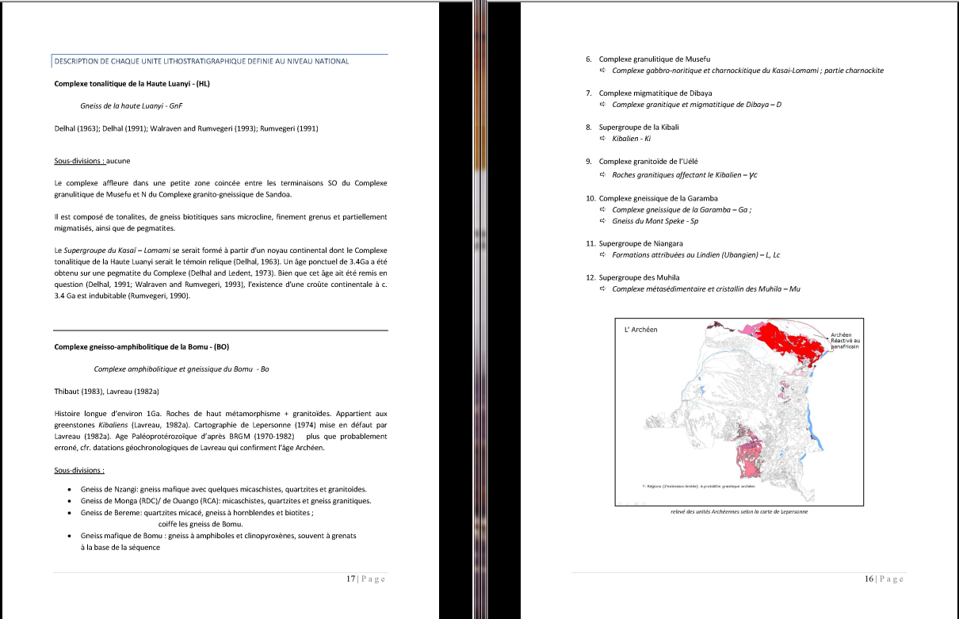
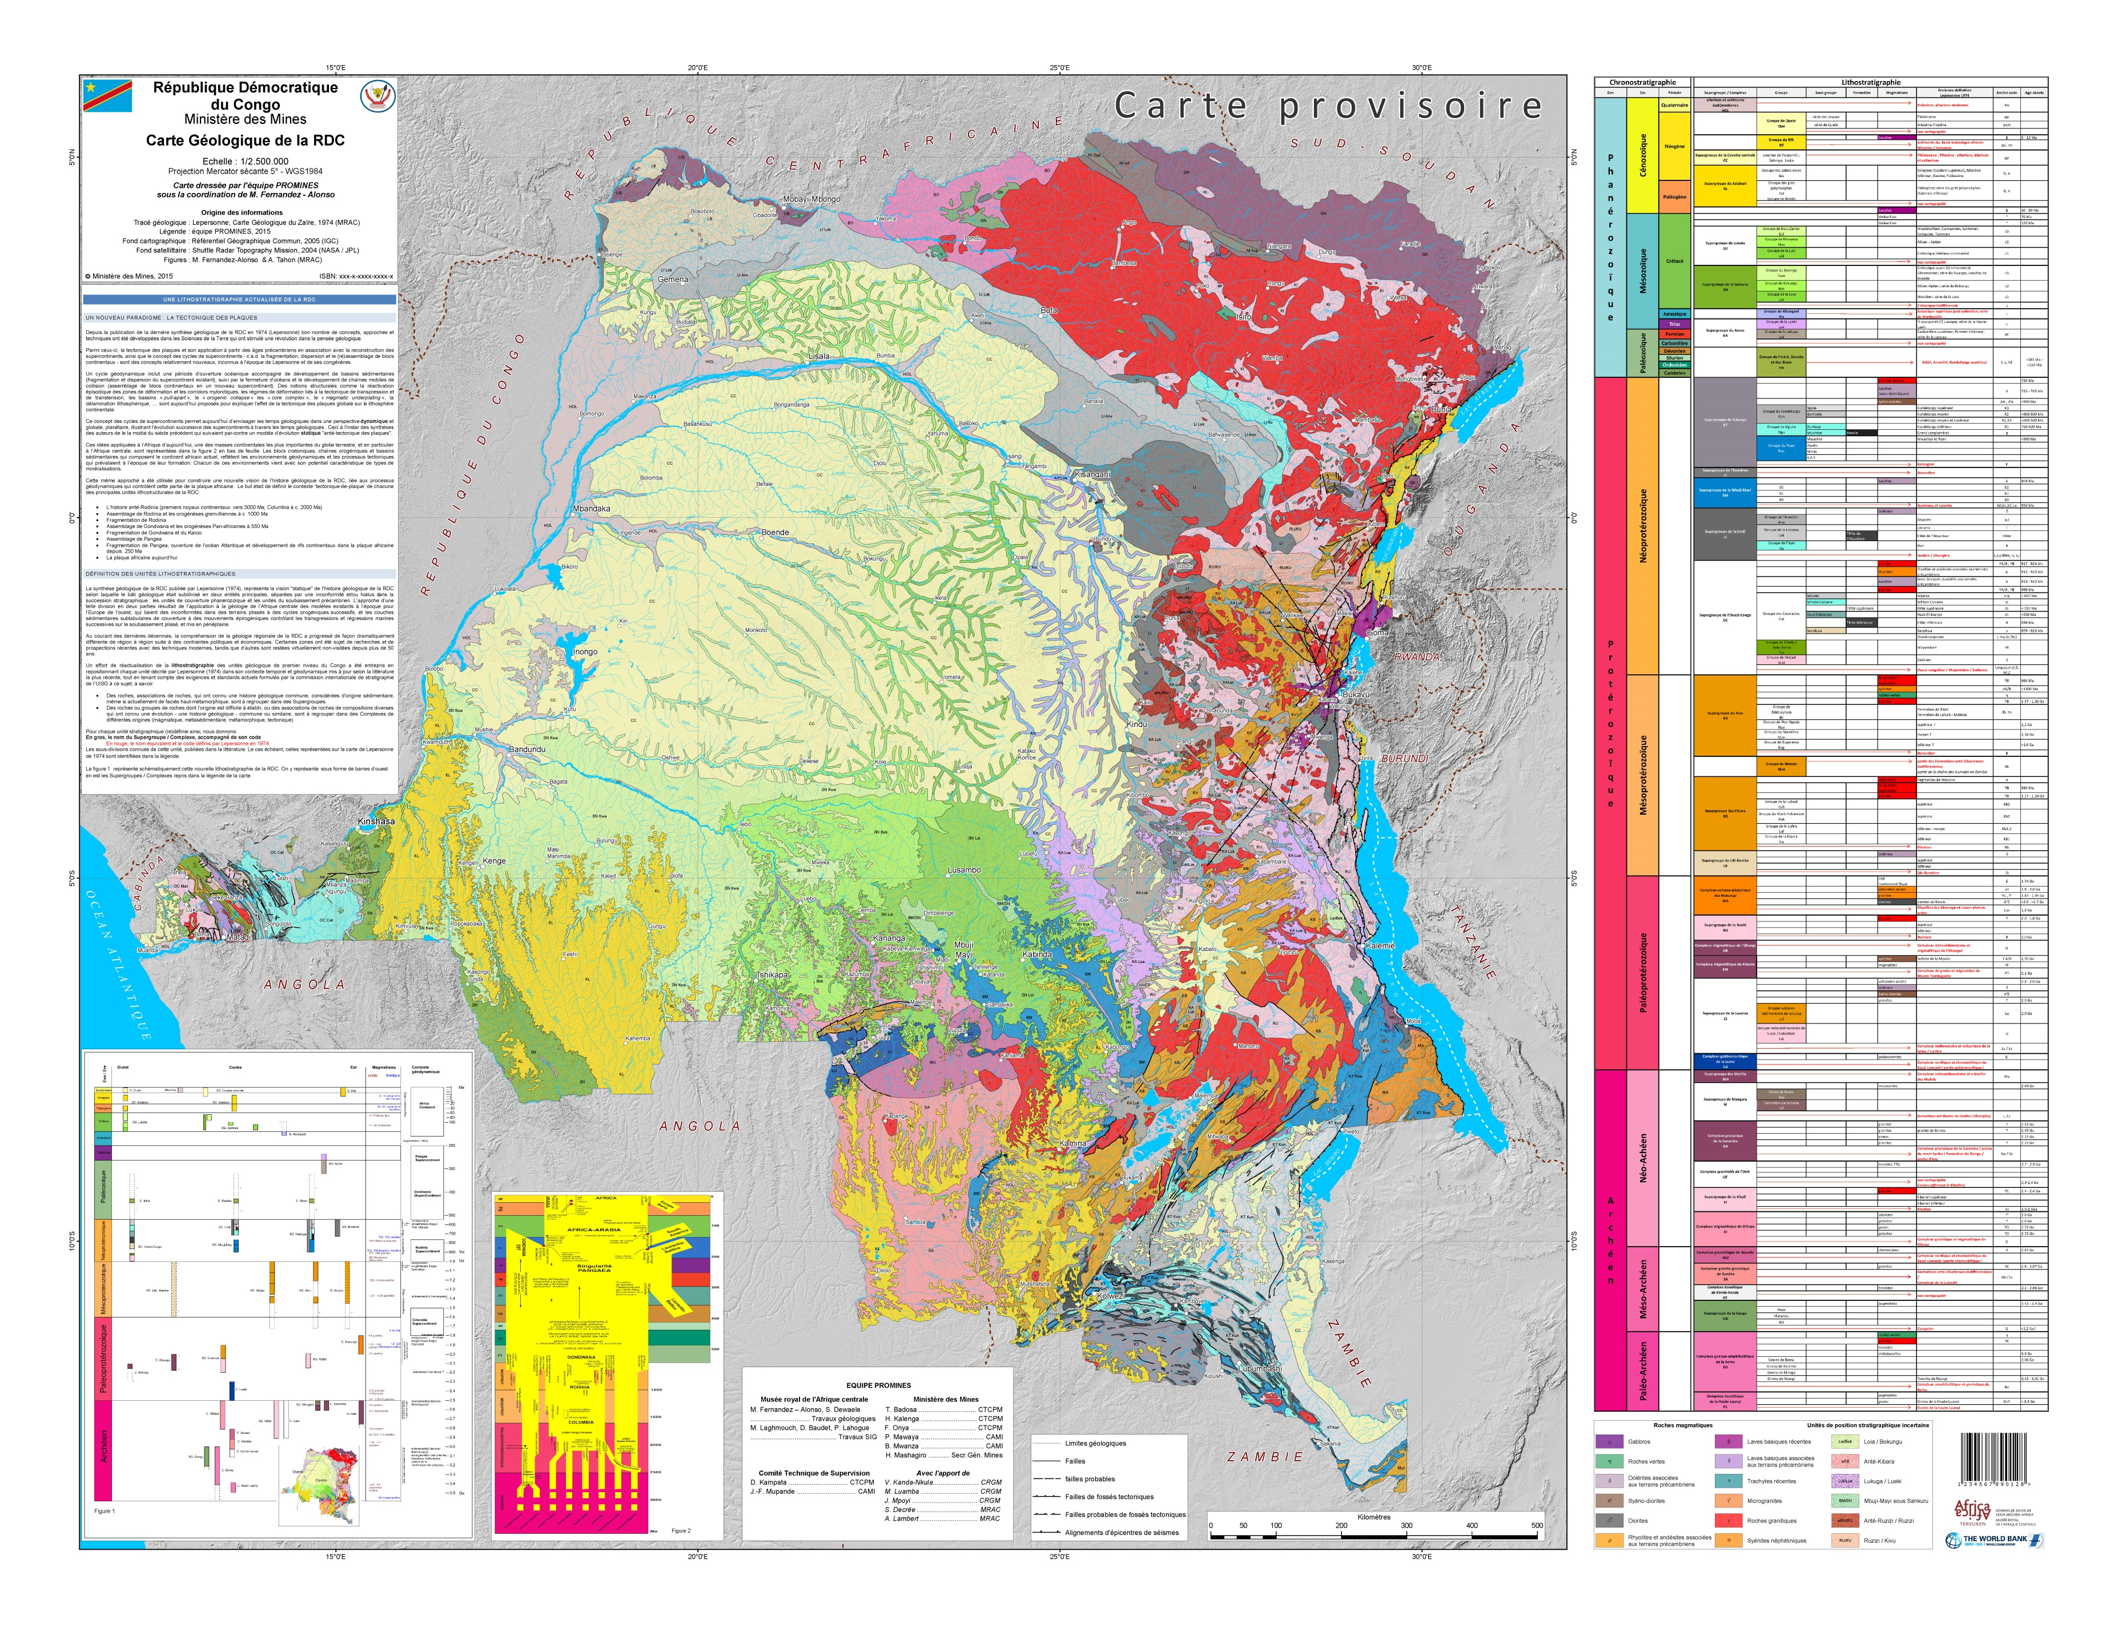
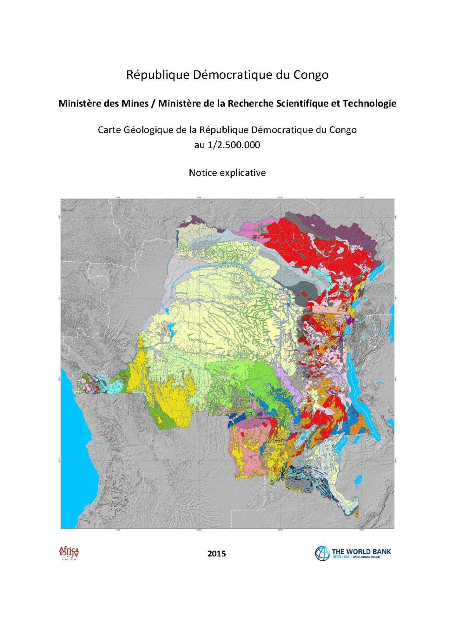

Slide 10
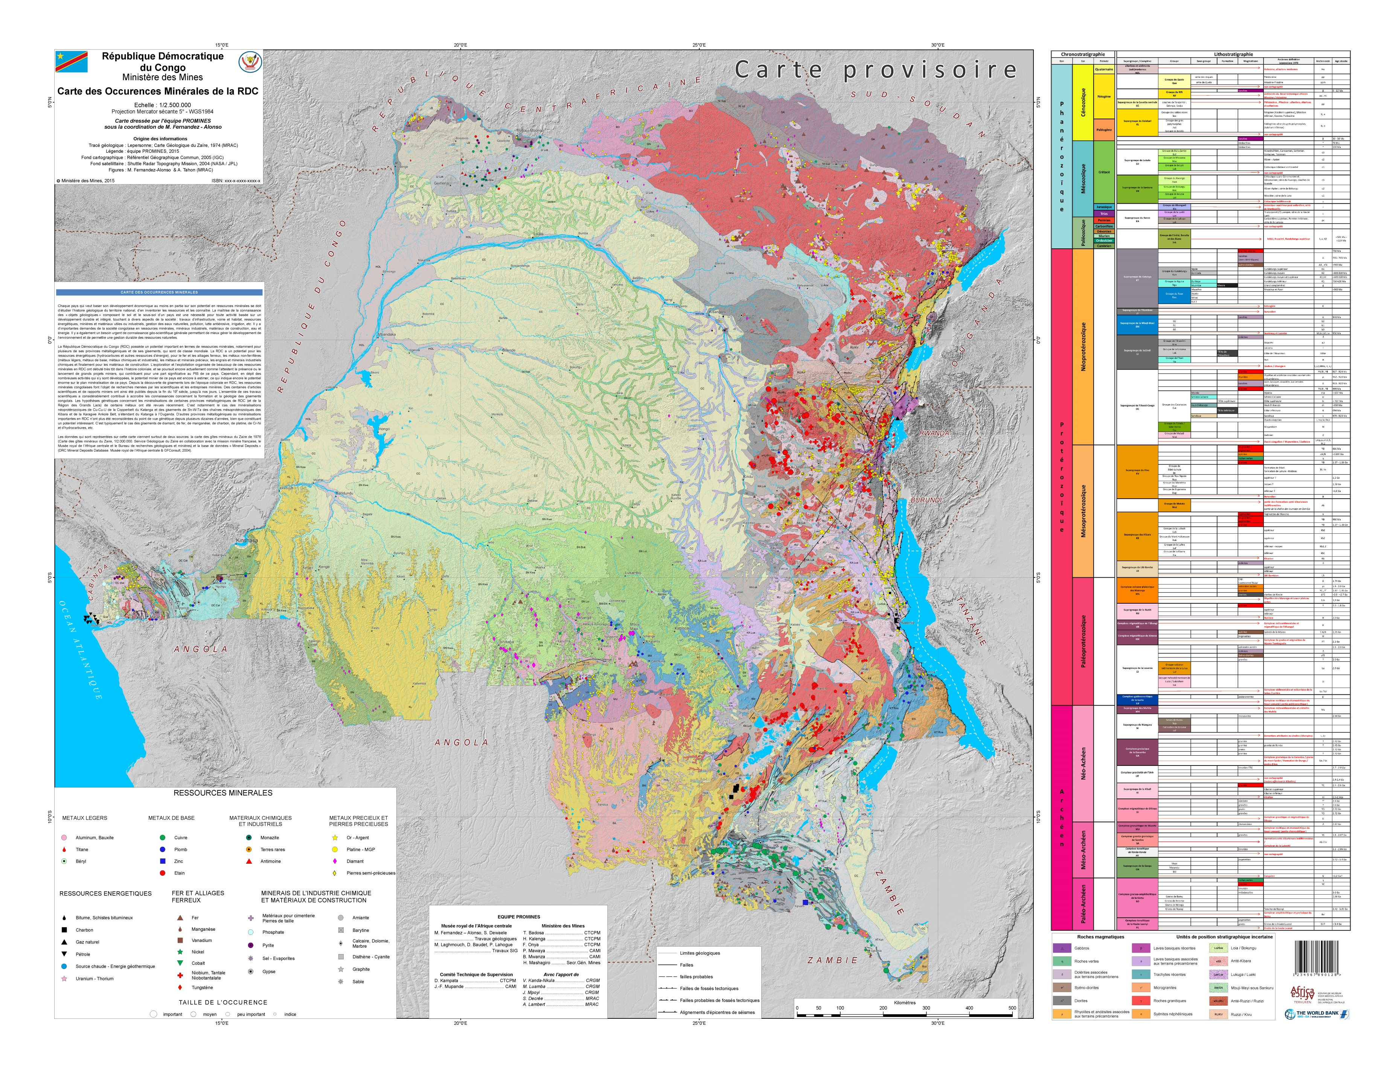

Slide 11
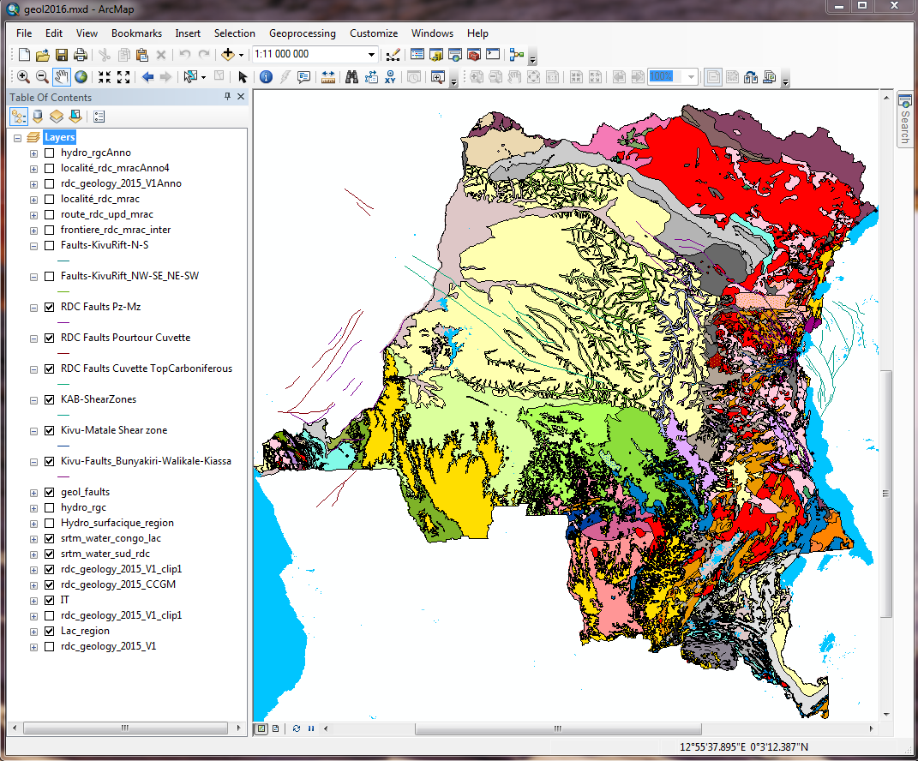
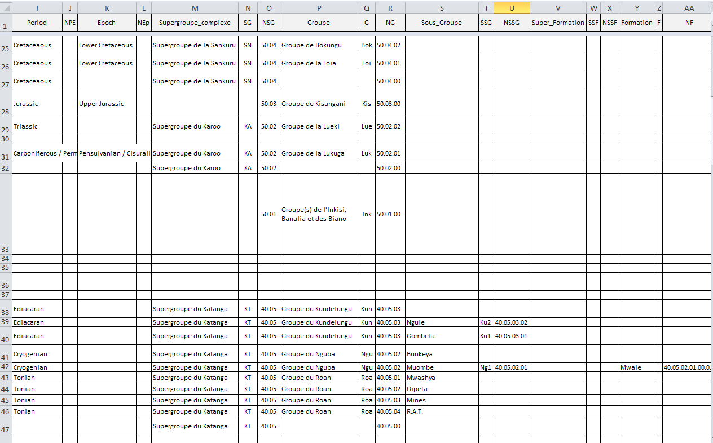
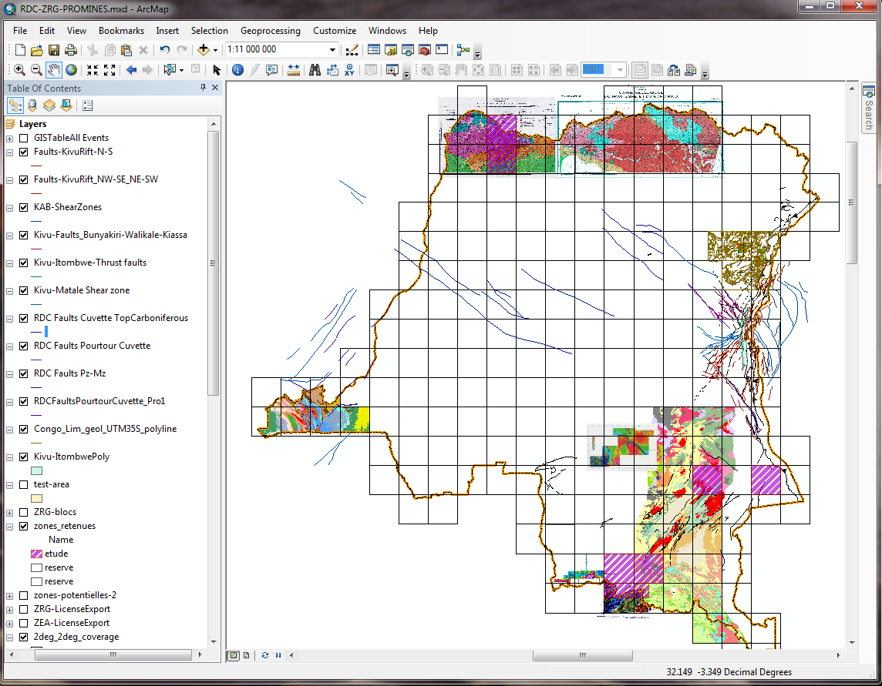
Digital versions
ArcGIS (database)
Easy update
Scale-independent
Update 2015 national map with data from large scale maping works since 1975 ongoing
Produce regional maps at larger scale ongoing
Produce maps “on demand”

Slide 12
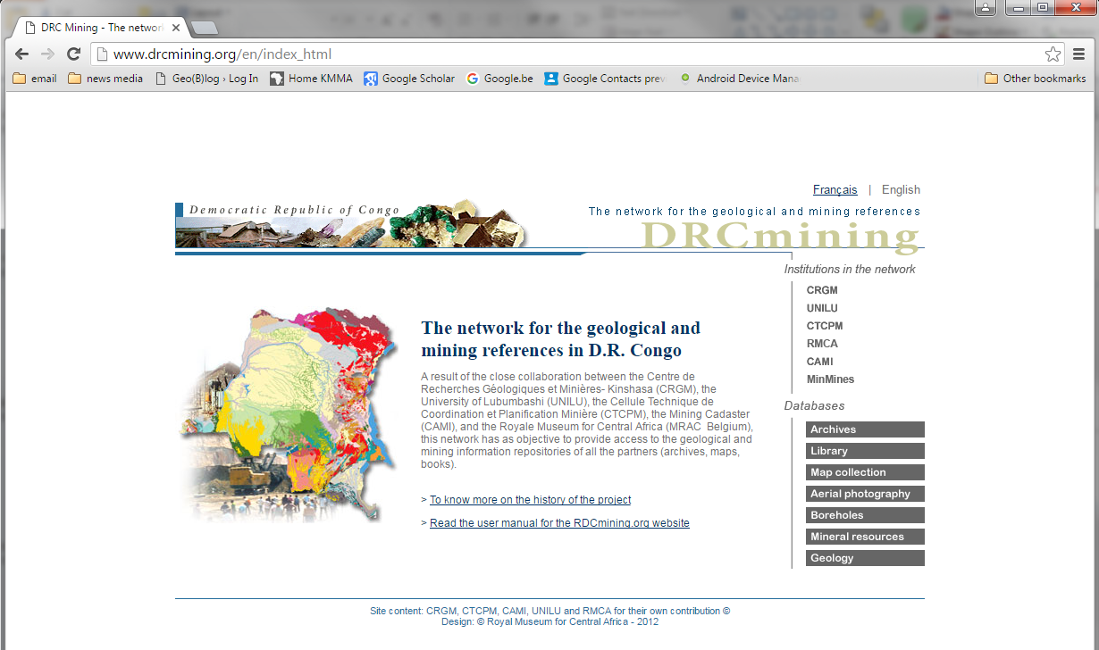
Digital versions
Online service / application

Slide 13
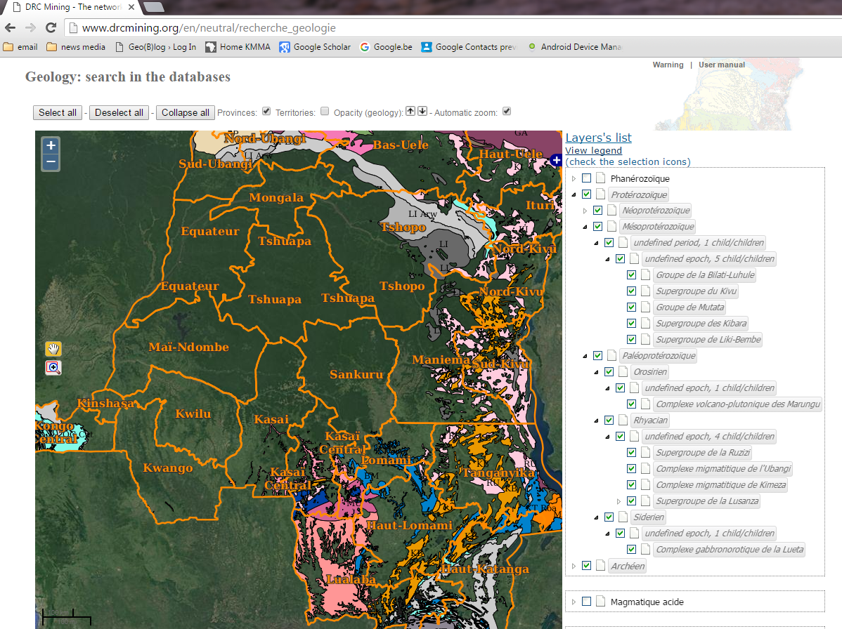

Slide 14
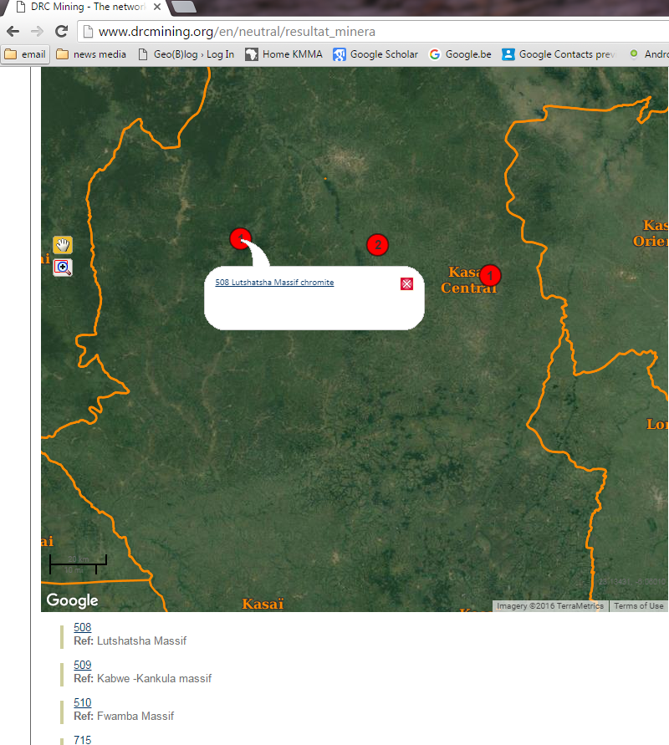
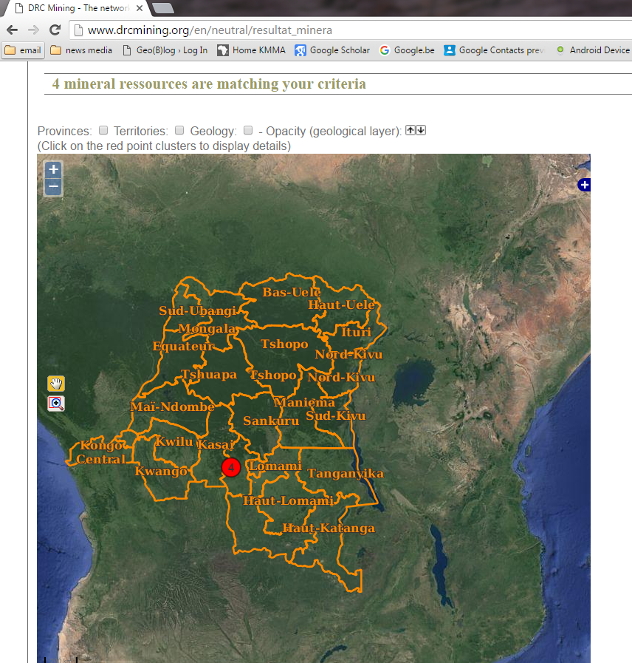
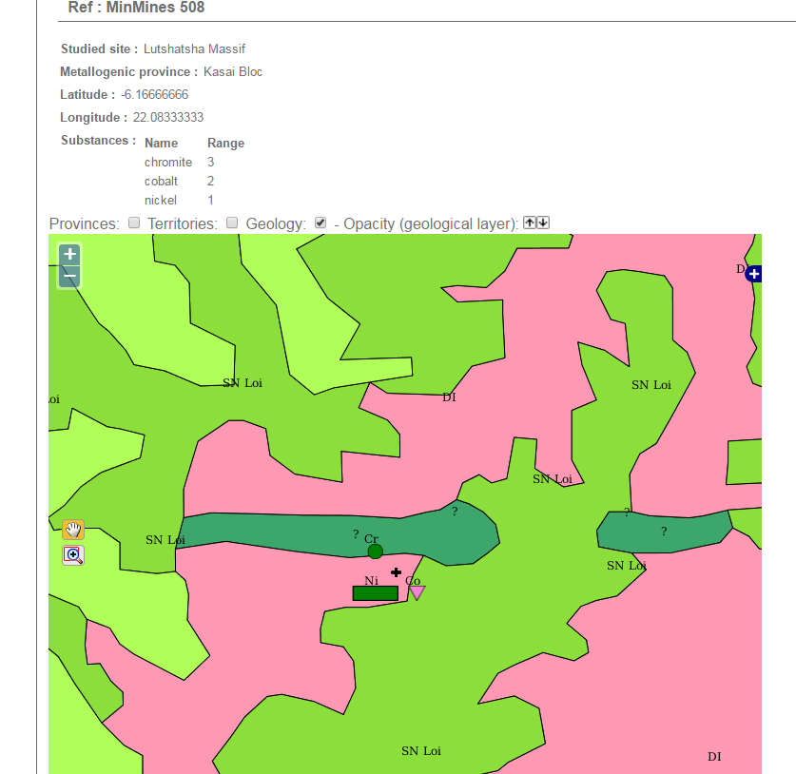
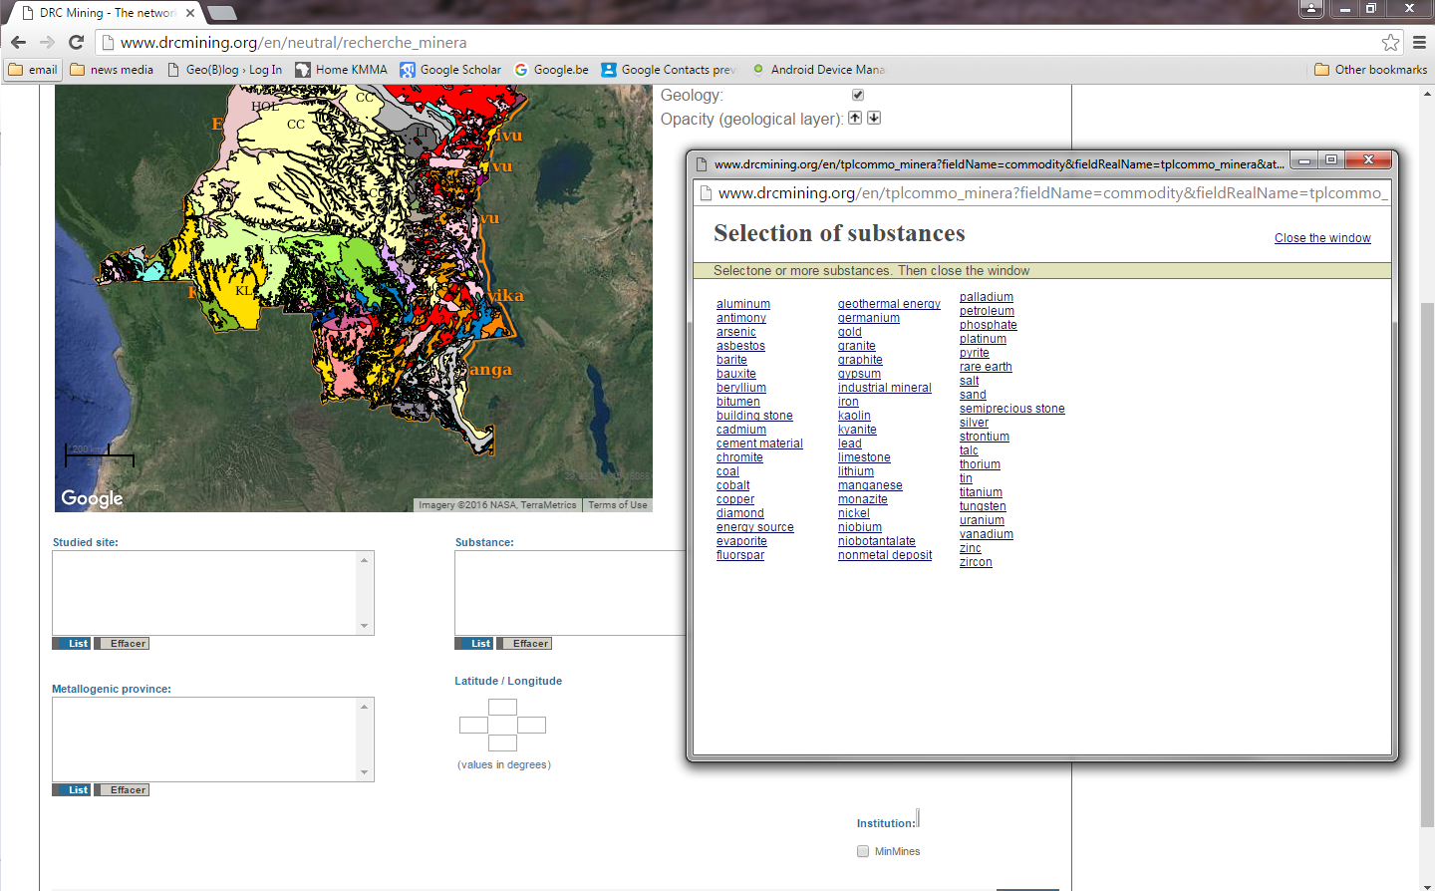

Slide 15
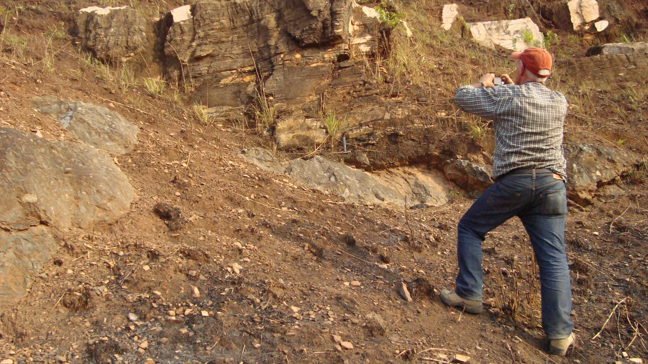
Thank You

