Slide 1
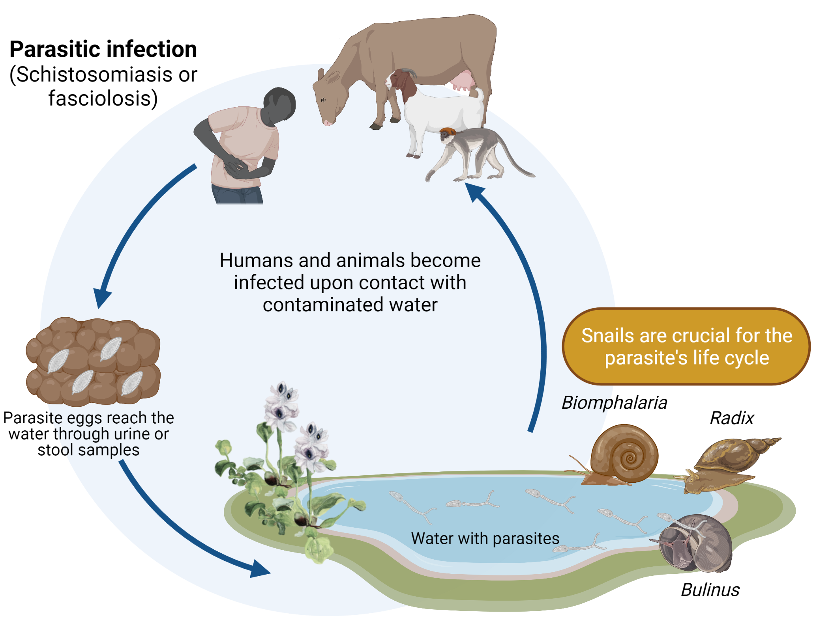
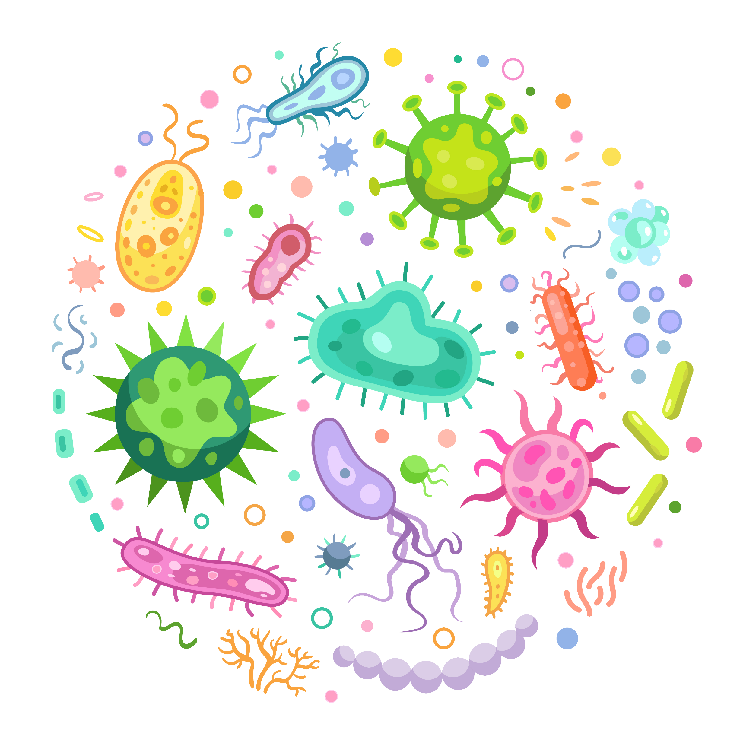
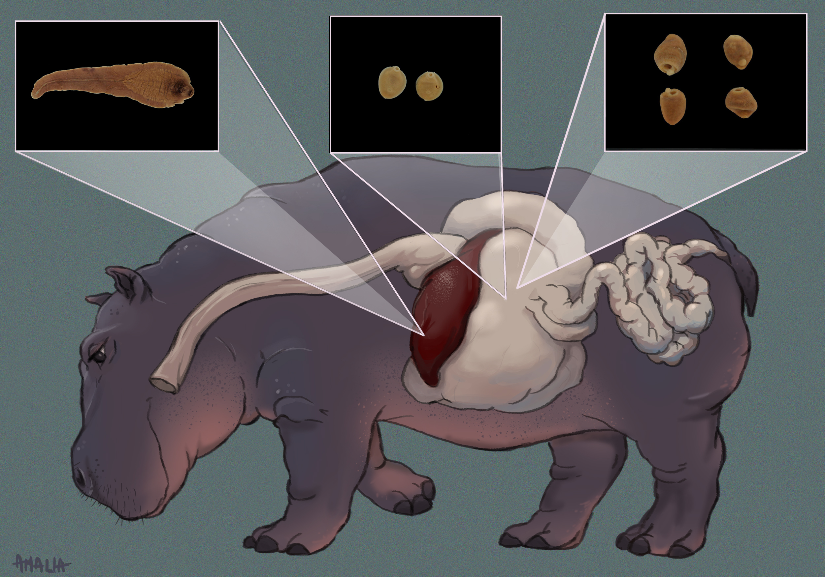
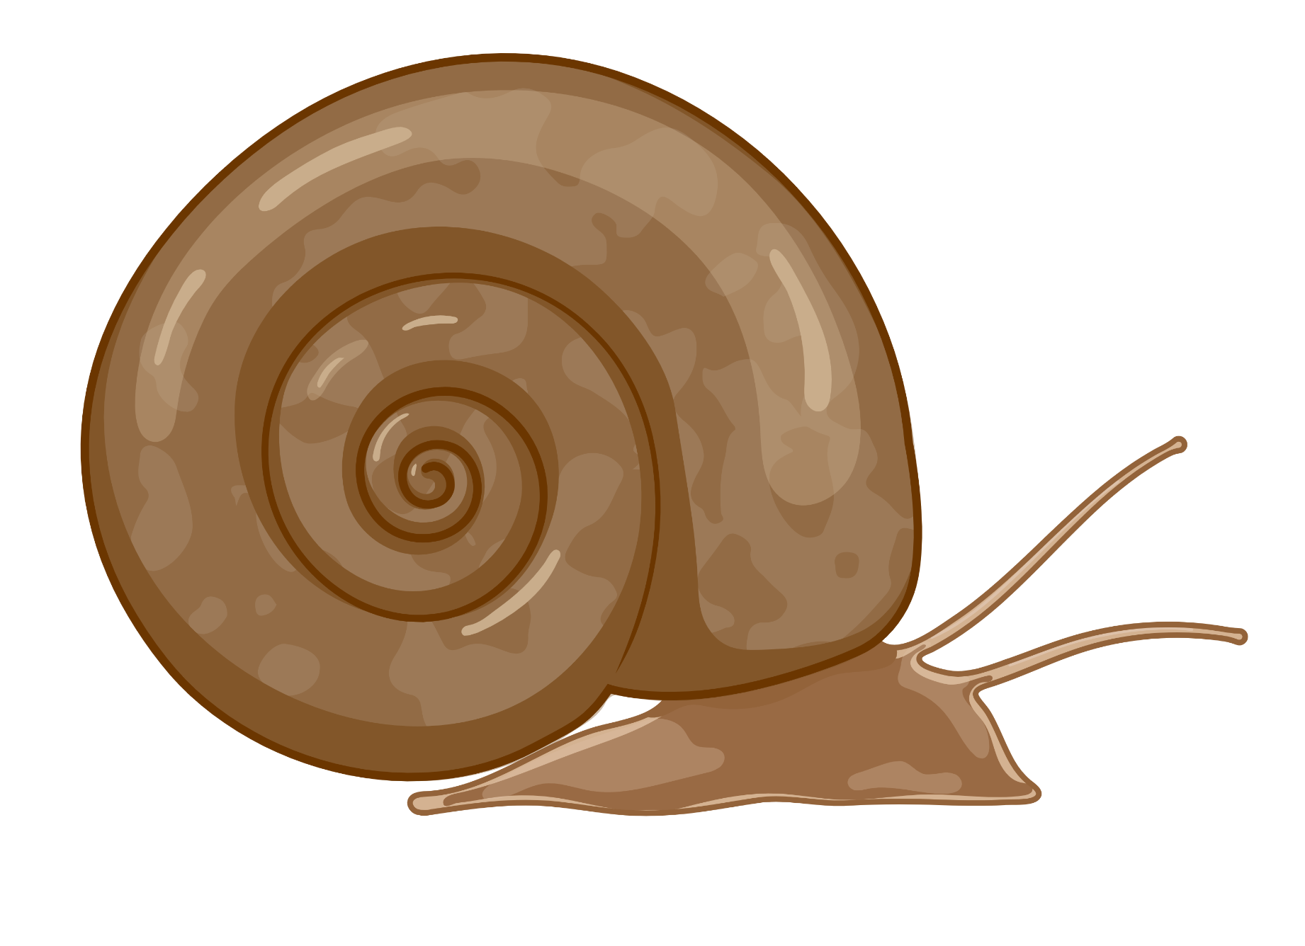
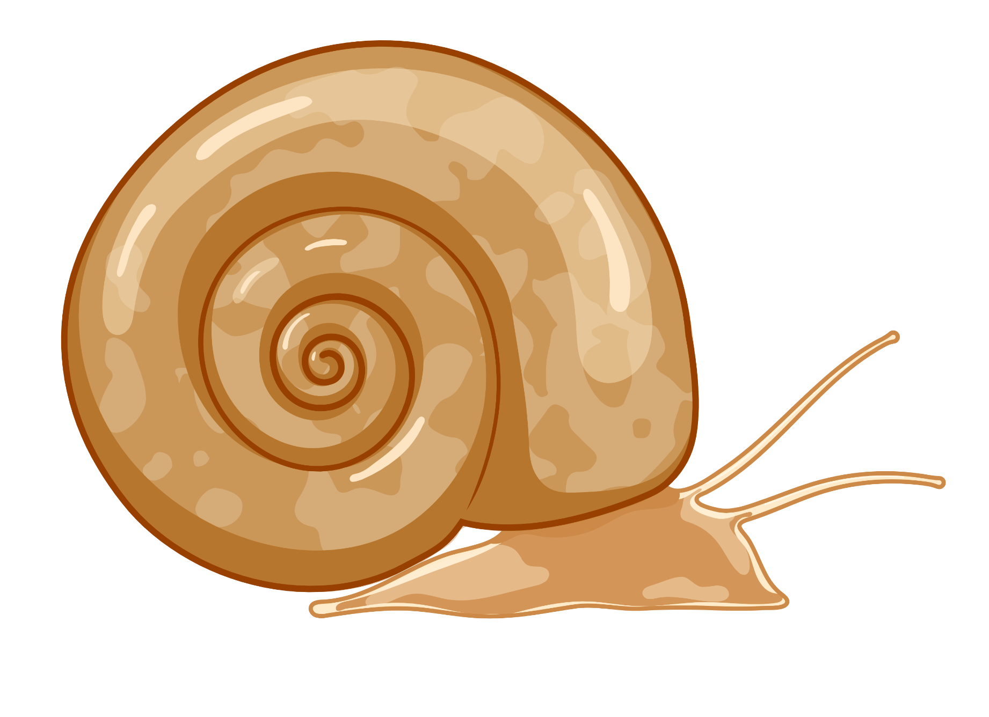
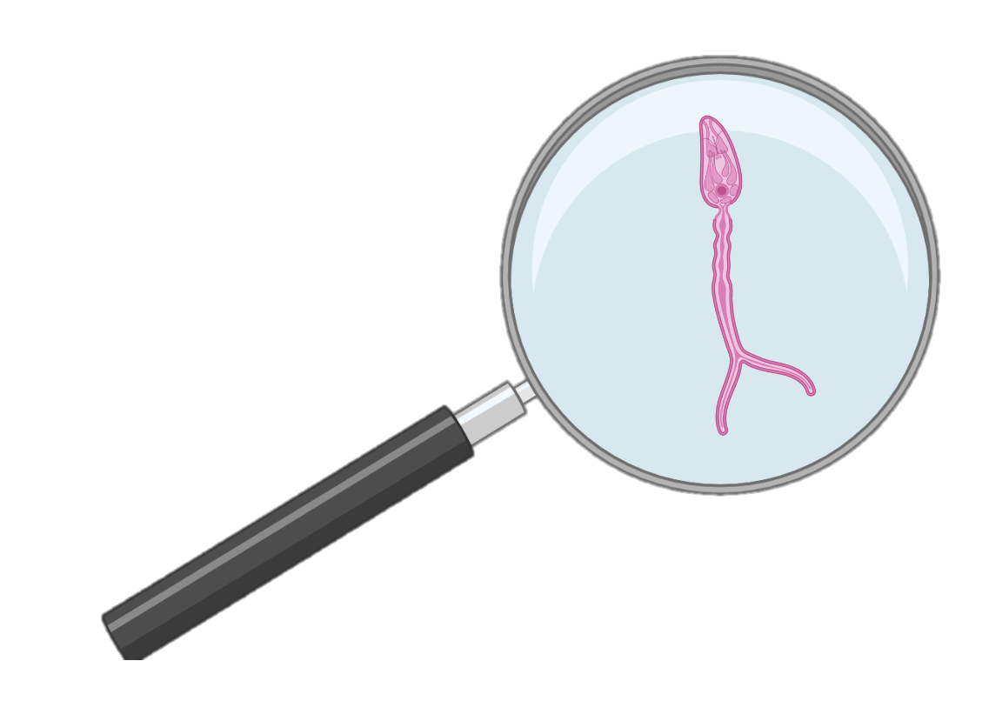
MicroResist
The influence of snail host microbiome in trematode parasite resistance Ruben Schols^{1,2}, Ellen Decaestecker² & Tine Huyse¹
¹The Royal Museum for Central Africa, ²KULeuven-KULAK
What & Why?
Key words
Freshwater snails play a crucial role as vectors in the transmission of trematode parasites. Therefore, illnesses caused by these parasites are also called snail-borne diseases. One of these diseases, schistosomiasis or bilharzia, affects millions of people and animals in Sub-Saharan Africa.
The WHO recommends to complement drug treatment with snail control, but these chemicals harm other aquatic life too. There is proof that bacteria can help interrupt parasite lifecycles. Therefore, the MicroResist project aims to find a sustainable alternative through microbiomics.
Bacteria could help interrupt trematode transmission by making snails resistant to infection.
DNA: a molecule that contains hereditary information.
DNA extraction: Lab procedures are required to isolate DNA and make it accessible for analyses.
PCR: A procedure that multiplies extracted DNA so it is easier to analyse.
Sequencing: A method to visualize the DNA, allowing you to study it.
Microbiomics: all the microorganisms of a given community are investigated together.
How?
Credits to Noelia Valderrama
Snail collection
Parasite isolation
Sample storage
Sample digitalization
DNA extraction
PCR & sequencing
Microbiomics
Preliminary results
Microbiome differs between snail species
Snails with parasites have different bacteria from those without
Even the enigmatic hippo is affected by trematode parasites. Three trematode species were recently isolated from a hippo in Zimbabwe. Could bacteria help the hippo to survive these parasite infections?
ruben.schols@africamuseum.be
MicroResist project:

