Slide 1
Crowdsourcing stories of violence
Citizen scientists
and innovation in the archive
dr. Gert Gielis -
State Archives Belgium

Slide 2
Notes:
In May 1552, one Hendrick Steck stabbed Hans Venstersterre to death during an argument that got out of hand after they had attended a procession here in Uccle. With a severe punishment hanging over his head, Hendrick asked the king for a pardon and remit his punishment.

Slide 3
State Archives Belgium, Account Chambres, nr. 644, f.156v°
Notes:
A copy of the act in which the king granted him that pardon, a so-called pardon letter , is preserved by the State Archives.

Slide 4
30000 pardon files and counting
Notes:
The Belgian State Archives actually keeps thousands of such pardon files in its stacks, scattered in various archival series.

Slide 5
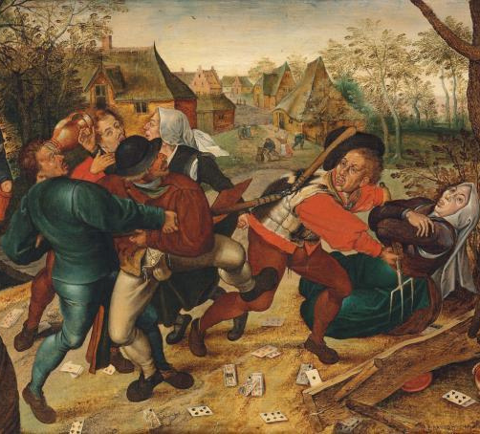
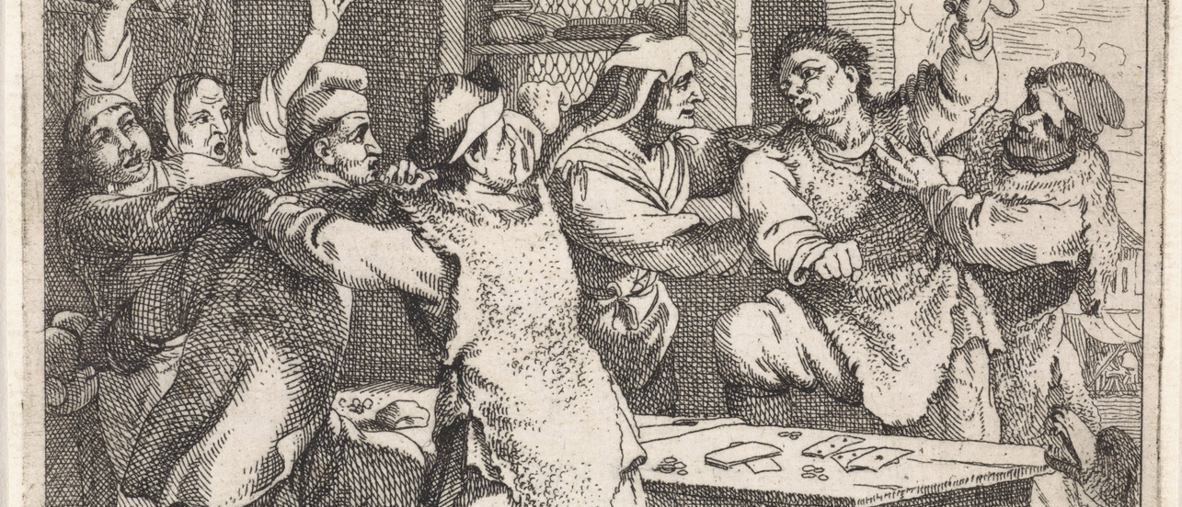
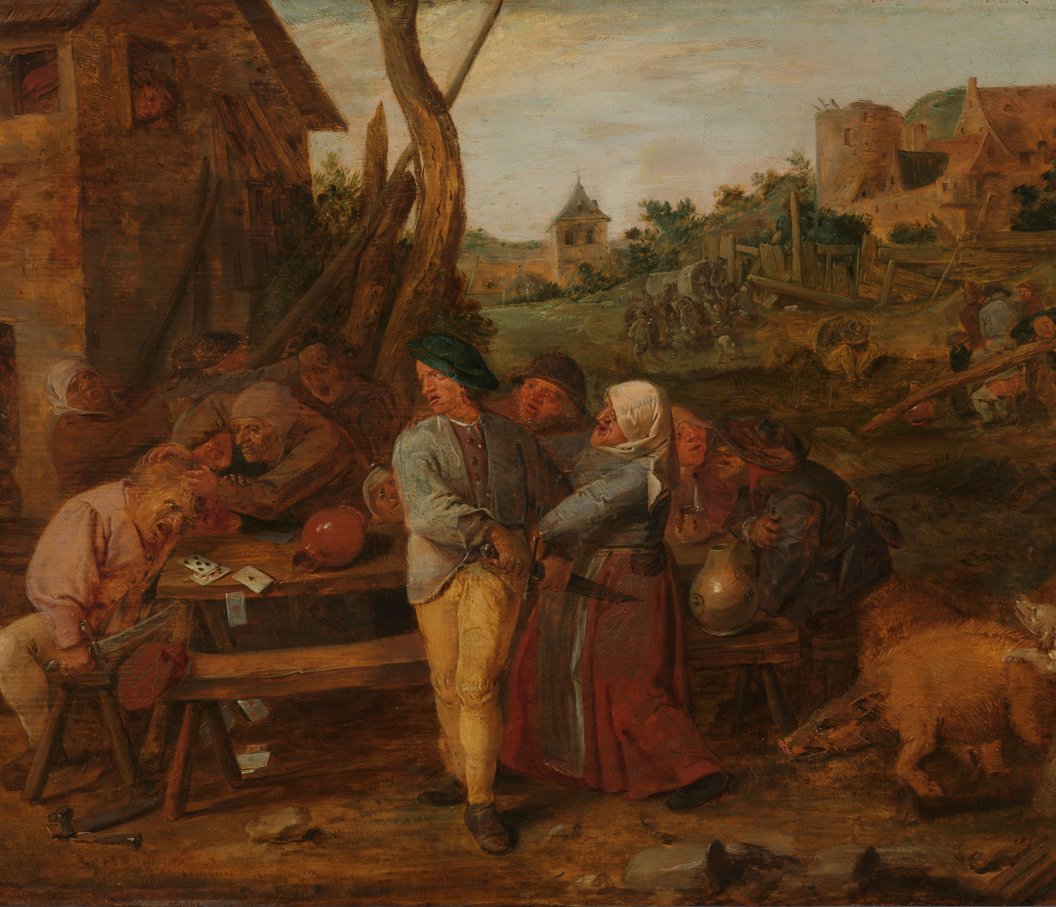
Homicide
Theft
Fraud
Heresy
Rapt
Jailbraking
...
Notes:
They are magnificent historical sources because the letter tells the story of the crime, providing a wealth of historical information for different disciplines.

Slide 6
Project goals
1
Database for navigation and research
2
Full text transcriptions
Notes:
These pardon letters were very poorly accessible, but the PARDONS project is changing that by unlocking these files through a database.
Apart from the data and metadata, the full story is also important. That is why we want to provide transcriptions of as many letters as possible, so that the story is not only readable, but also searchable. .

Slide 7
Notes:
Because even for expert paleographers reading these sources can be hard and time-consuming, and mind-numbing.
Transcribing a couple of thousands files would take a lifetime, so the PARDONS project is also a laboratory for experimenting with handwritten text recognition, a recent and revolutionary innovation which will transform the world of the archives .

Slide 8
Notes:
Transkribus is an AI-powered platform that enables automatic text recognition and the training of proper HTR models, customized to your data.

Slide 9
Digitization and upload
Citizen science
Recruitment
Layout model training
Instruction
Automatic baseline recognition
Manual transcriptions
Input in Transkribus
Follow-up
Correction (‘ground truth’)
HTR model training
Automatic recognition
Post-processing (correction, tagging, edition…)
Notes:
schematic overview of the workflow
most of the white boxes are my job, my responsibility
the blue box is what our citizen scientists do and their help is much appreciated
This is where the citizen scientists enter the project, at first on the level of crowdsourcing: they help us with making transcriptions, which serve as ‘ground truth’ for training a model. The more transcriptions, the better the model will perform on documents it has not seen yet.

Slide 10
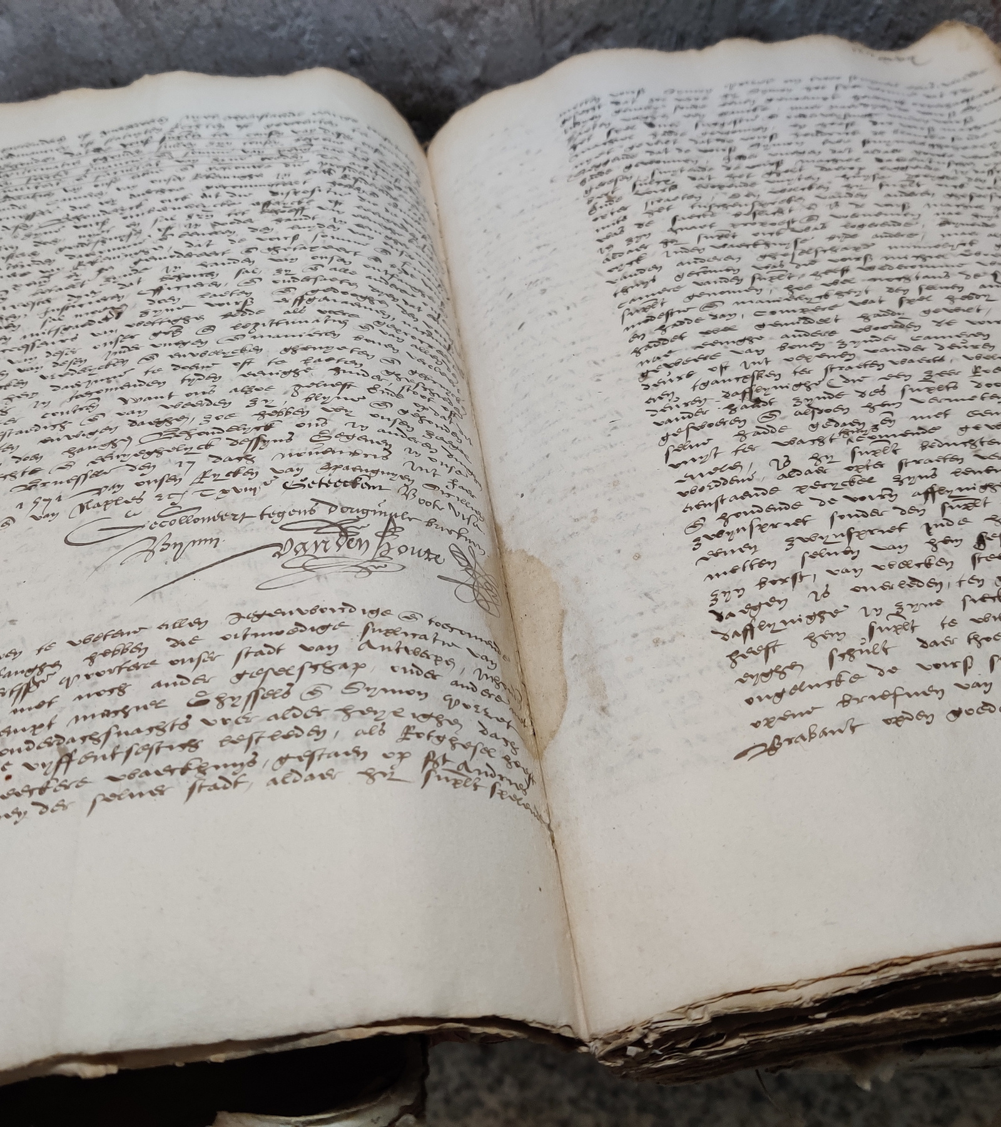
Challenges
Where to find volunteers?
How to train them?
How to organize the workflow?
Introduce novelties?
....
Notes:
That is easier said than done.
1. Difficult paleography: Where to find volunteers?
2. How do you train them?
3. How to organize the workflow of the project?
4. Can we use new technologies or would they deter volunteers from participating?
5. …
Challenges:
difficulty level
bilingual corpus
working remotely
no ‘CS infrastructure’ to manage the project
new technologies evolving quickly

Slide 11
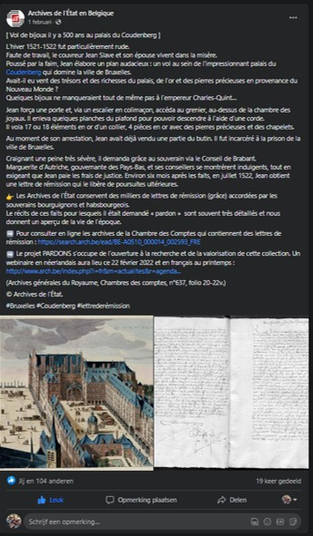
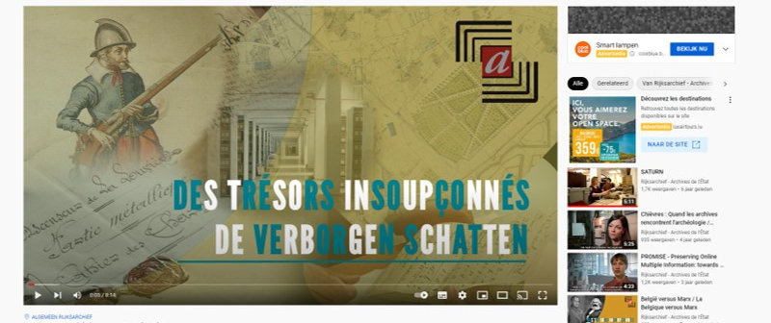
Recruiting citizen scientists
Notes:
I organized a teaser webinar to introduce the sources and the project, made some publicity via social media (and newsletters of different organisations. To broaden our reach, we partnered with Histories vzw, a Flemish organization that supports heritage volunteers and has a large network of local historians and genealogists. There we can find people that are experienced paleographers able to read centuries old documents.
partnership with Histories vzw
‘teaser webinar’: introduction to the project
social media: FB, YouTube
Newsletters
Eos platform

Slide 12
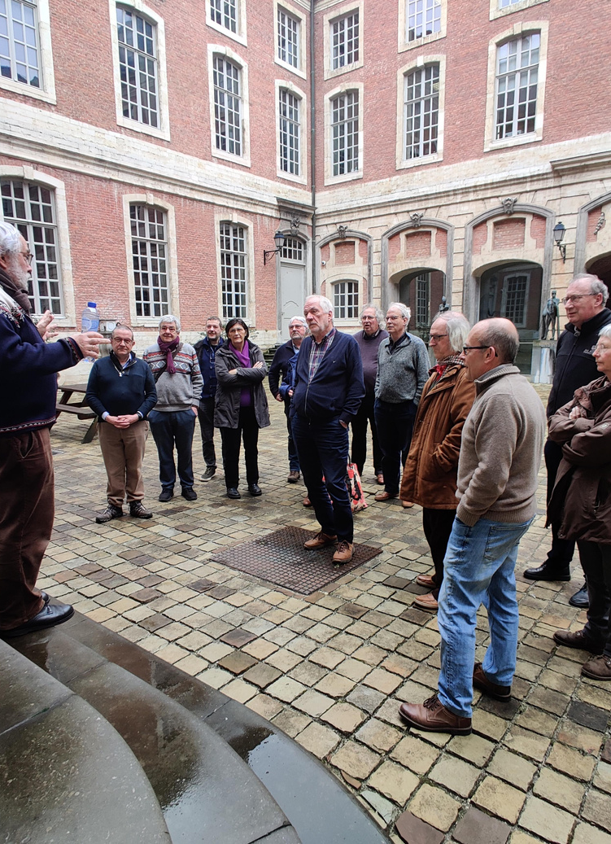
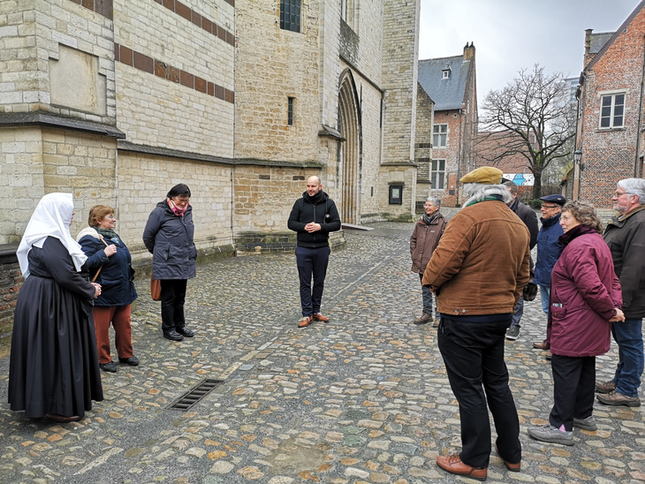
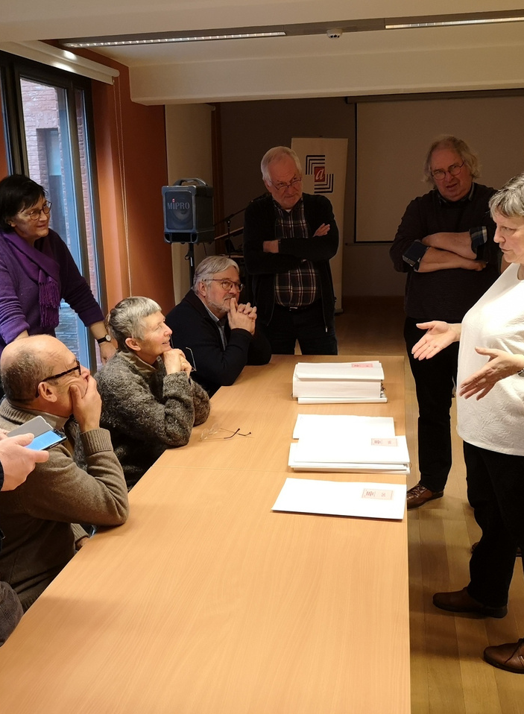
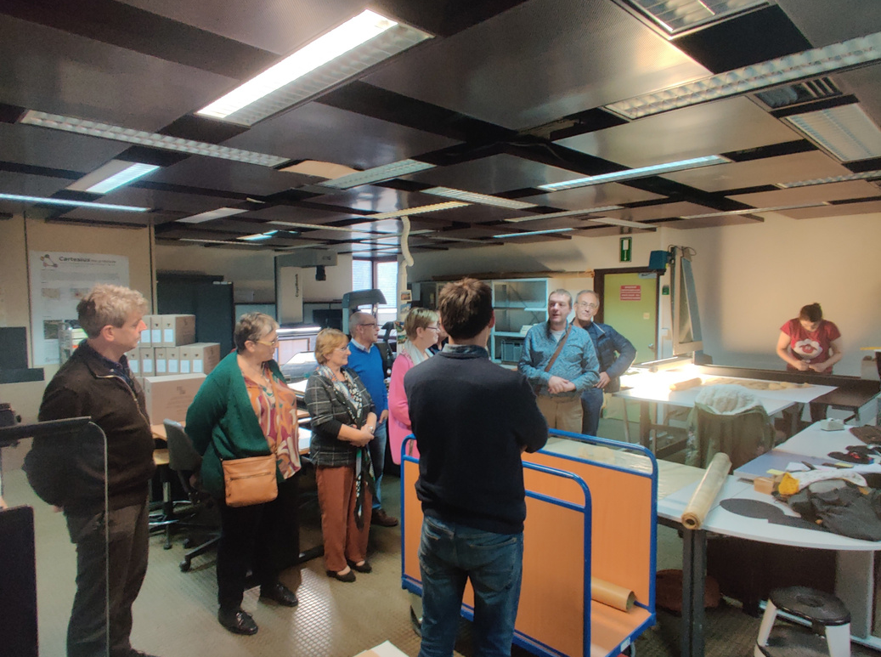
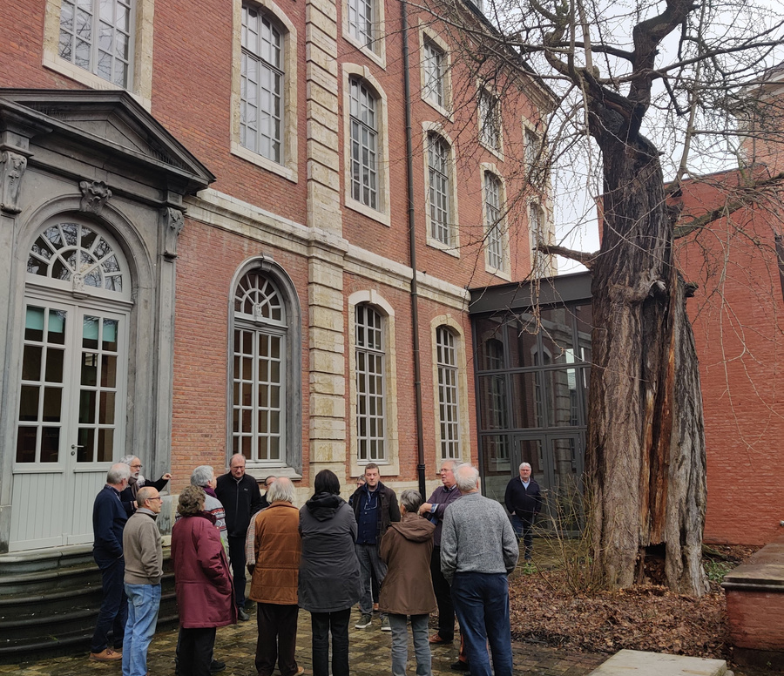
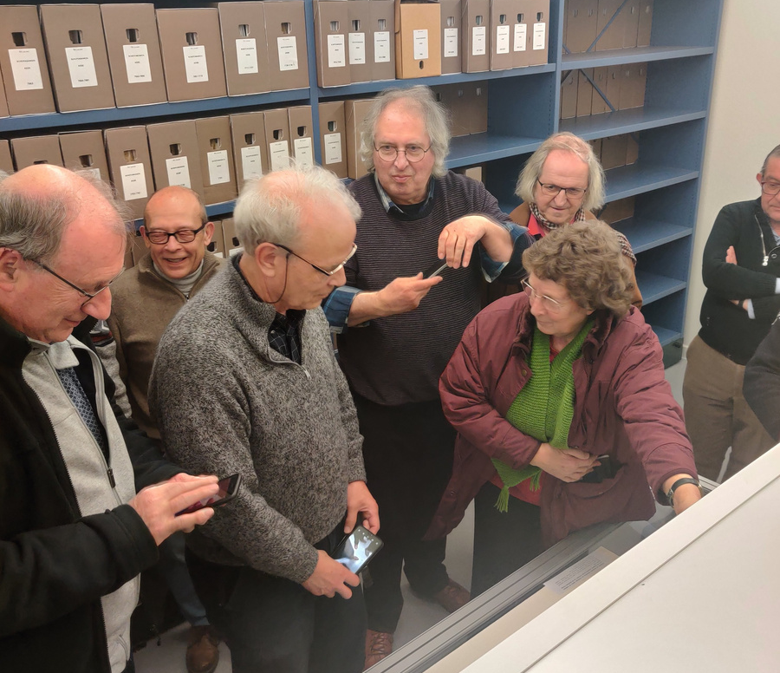
Over 60 citizen scientists
contributed to PARDONS

Slide 13
Notes:
To lower the barrier to participation we wanted people to be able to choose letters of their interest, specifically of
I put up a preliminary database which makes it possible to navigate towards the chosen letter, which was available online on the website of the SA.

Slide 14
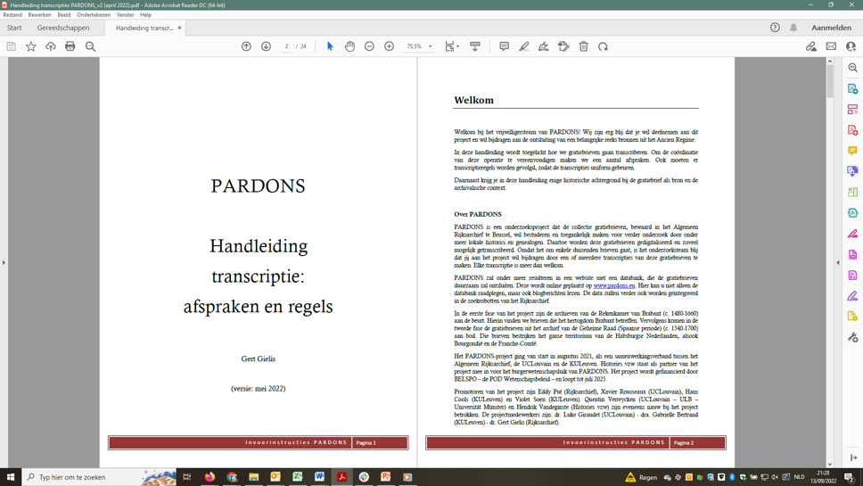
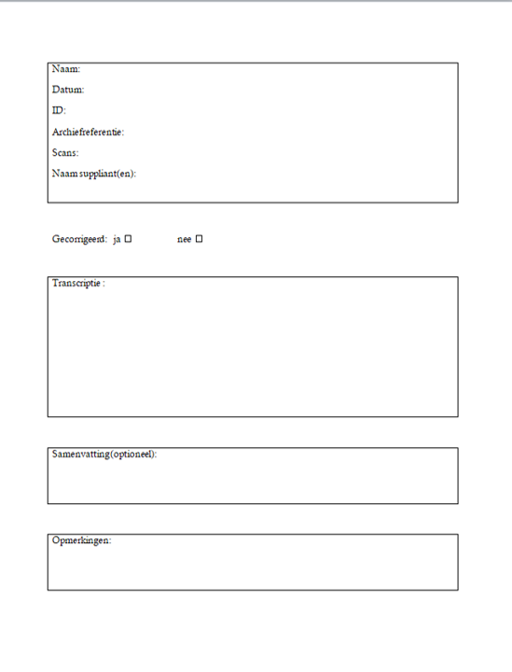
Instructing citizen scientists
Jutermeniente… interniemeute…
interinemente !
nie.. nueyn…
meyninghe !
Notes:
Instruction:
webinar
manual
paleography courses
survey of letters
survey of abbreviations
frequent online transcription meetings
(short instruction movies)

Slide 16
transcriptions and HTR model
gain or improve paleographical skills
knowledge transfer
informal reading groups
contact with archival and historical sciences
inspiration for local project
‘client retention’
results
Notes:
Besides that
paleographical skills
insight in scientific process and all that is involved in unlocking historical documents
transfer of knowledge: some more experienced paleographers teached newbies
communities: people gathering to read and transcribe together

Slide 17
Notes:
I'm going to translate and paraphrase it into English
I'm already stuck.
A word I can't read.
Voila here that word...
Transcribing is basically just retyping old texts into the plain letters of today.
We don't have to understand what it says yet, it's just transcribing literally, letter by letter, in such a way that people who don't know ancient writing can at least read the texts.
To allow people to do research on that.
It's much easier for those people if it's a readable text right away.
Instead of those curls and abbreviations. And all that stuff in it.
‘Venerable’. So probably that's venerable.
Then their research would take much longer.
The first one I thought: bloody hell, I can't read any of that. There's no way. I'm going to have to ask for help. Because I thought that was something for specialists. Being able to read texts like that. But in the end, we are guided by the project manager and also by Hendrik from Histories, who is also there.
We also practice regularly. All together, online.
And I must say: there is an enormous amount of patience. And respect. So much so that people who haven't quite got the hang of it yet feel: I am being supported. I have time, it doesn't all have to go very smoothly. I will be able to evolve. And that's what I loved about it.
You get in touch with the past, but at the level of ordinary people. And that does really interest me. How people lived. What was important to them. It's not just transcribing, it's also interpreting what it says. I do find that fascinating.

Slide 18
Wishlist
An (in-house?) platform for historical CS projects (like just DoeDat, Vele Handen, From the Page...) would save much time, energy and frustration!

Slide 19
PARDONS
Crowdsourcing stories of violence
Citizen scientists
and innovation in the archive
dr. Gert Gielis -
State Archives Belgium

