Slide 1
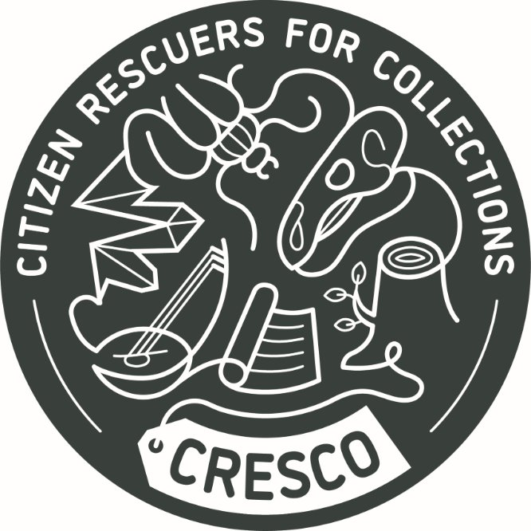
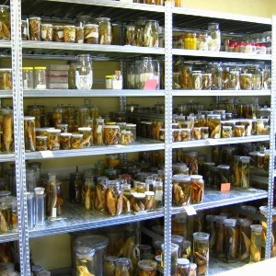
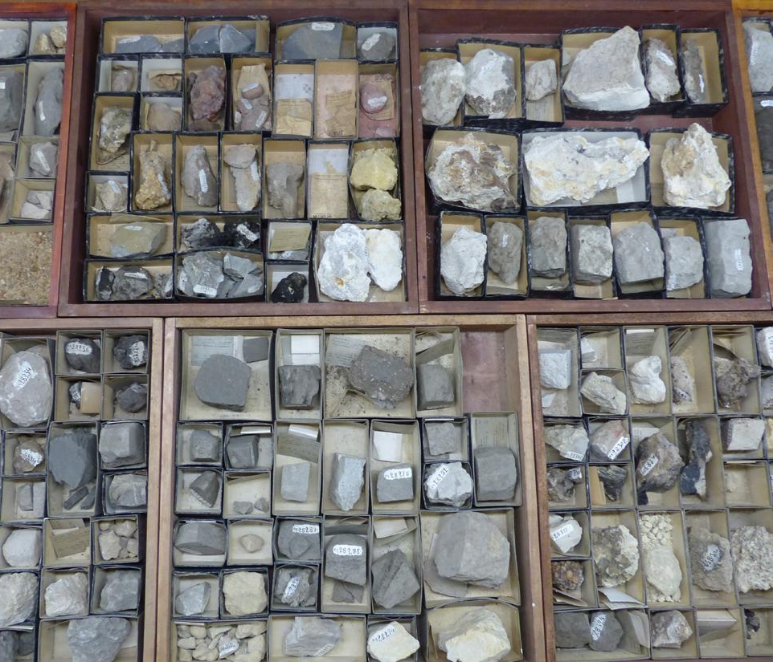
Engaging the public in the study and conservation of biological collections
Larissa Smirnova (RMCA)

Slide 2
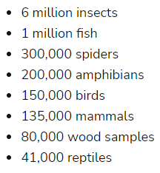

Slide 3
Citizen science vs volunteering?
The practice of “citizen science” involves members of the public (“citizen scientists”) working with professional scientists to complete a research project.
Citizen scientists produce, collect or analyze data (photos, scans, metadata about collections and archives, observations).​​
The data will (sooner or later) be published in open access​.
The data is used in research. There is a research question.​​
Citizen scientists participate in various steps of the research.
Volunteers assist with inventory, collection maintenance or conservation tasks not directly related to research.
​​Volunteers sometimes also produce data. ​​The data is mainly used for internal purposes. ​​
The data is not used in research. There is no research question.
Crowdsourcing, when contributors collect data in isolation and submit findings online, with little training or opportunities for direct social interaction with other citizen scientists

Slide 4
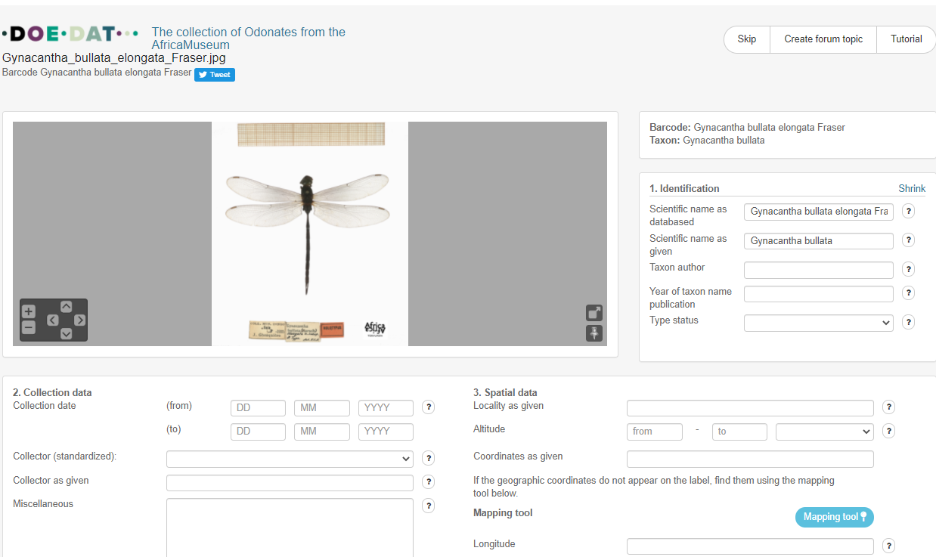
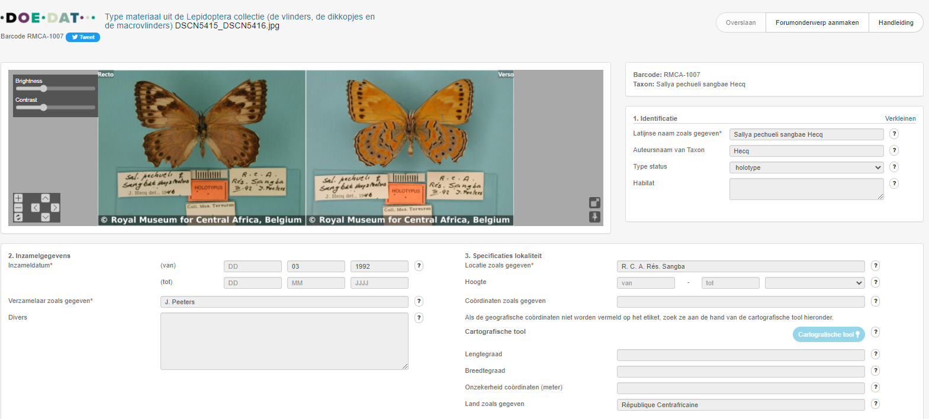
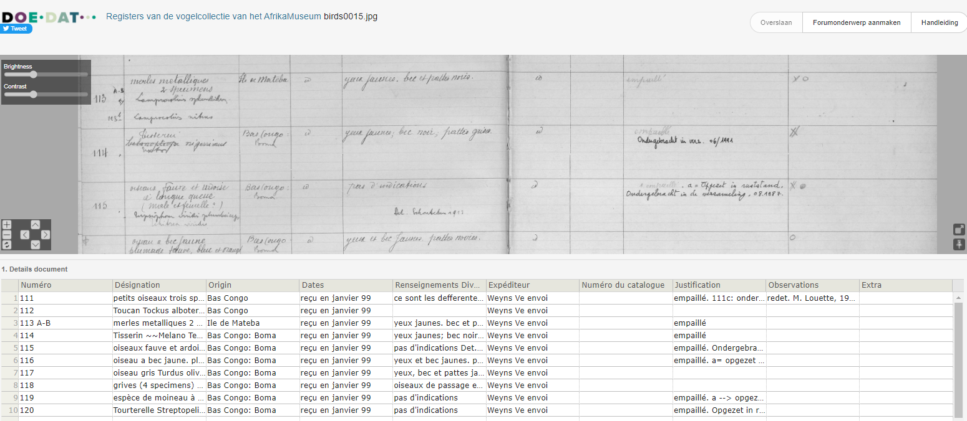
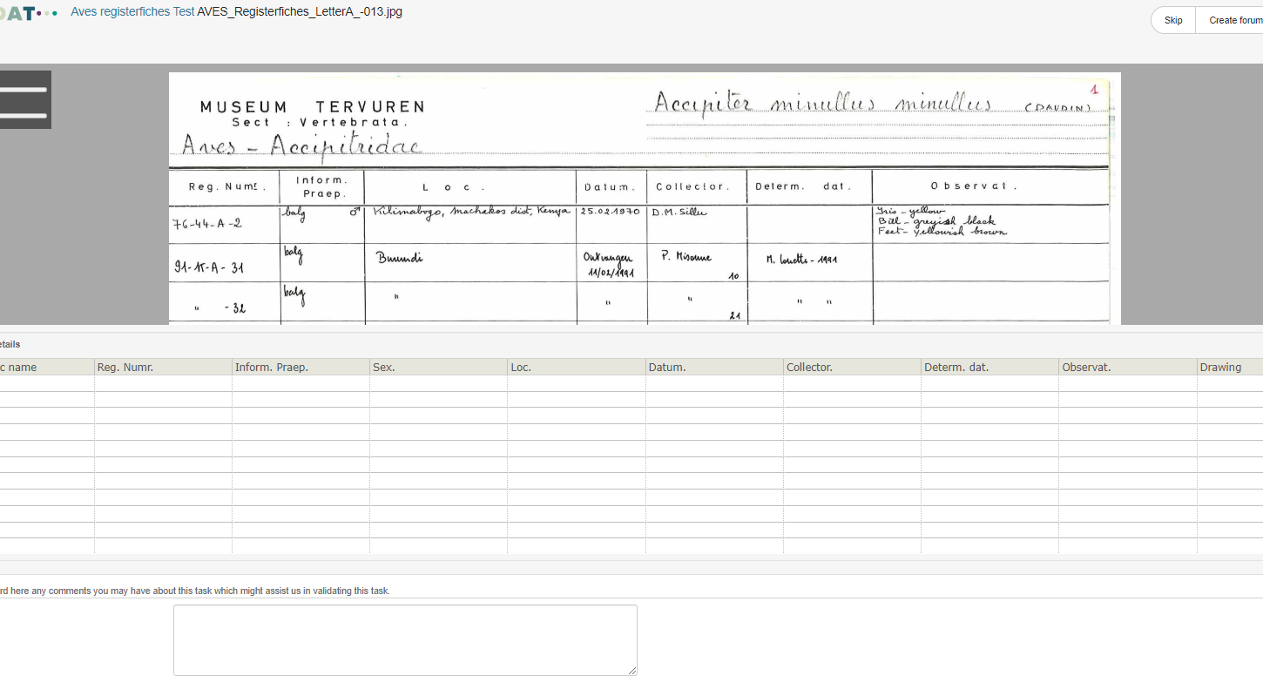
Crowdsourcing projects of AfricaMuseum on DoeDat platform run by Meise Botanic garden (www.doedat.be)
Transcription of labels
Total of 44 projects (completed and running)

Slide 5
Why we need them?
Conservation of the (biological) collections include the following actions:
Maintenance (care): preparation, storage, loans…
Documentation: labeling, verification of existing registers, detection of discrepancies, errors…
Digitization (computerization): databasing, photographing, quality check, standardization…
At every step involvement of citizens is possible and welcome!

Slide 6
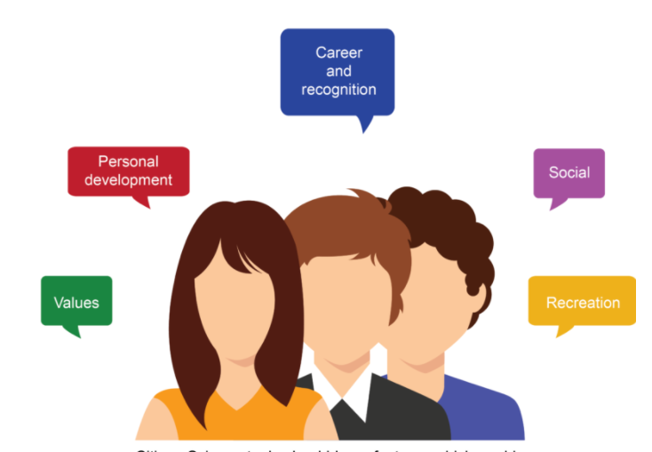
Why they need us?
Self-directed motives*:
Have a personal interest in the topic studied
Desire to learn something new
Desire to discover something new
Desire to spend time in nature
Socializing with like-minded people
Altruistic motives:
Desire to volunteer for a cause
Wish to contribute to science
Feel it is important to help
*Gitte Kragh. They Walk Among Us: The Rise of Citizen Science. 2016

Slide 7
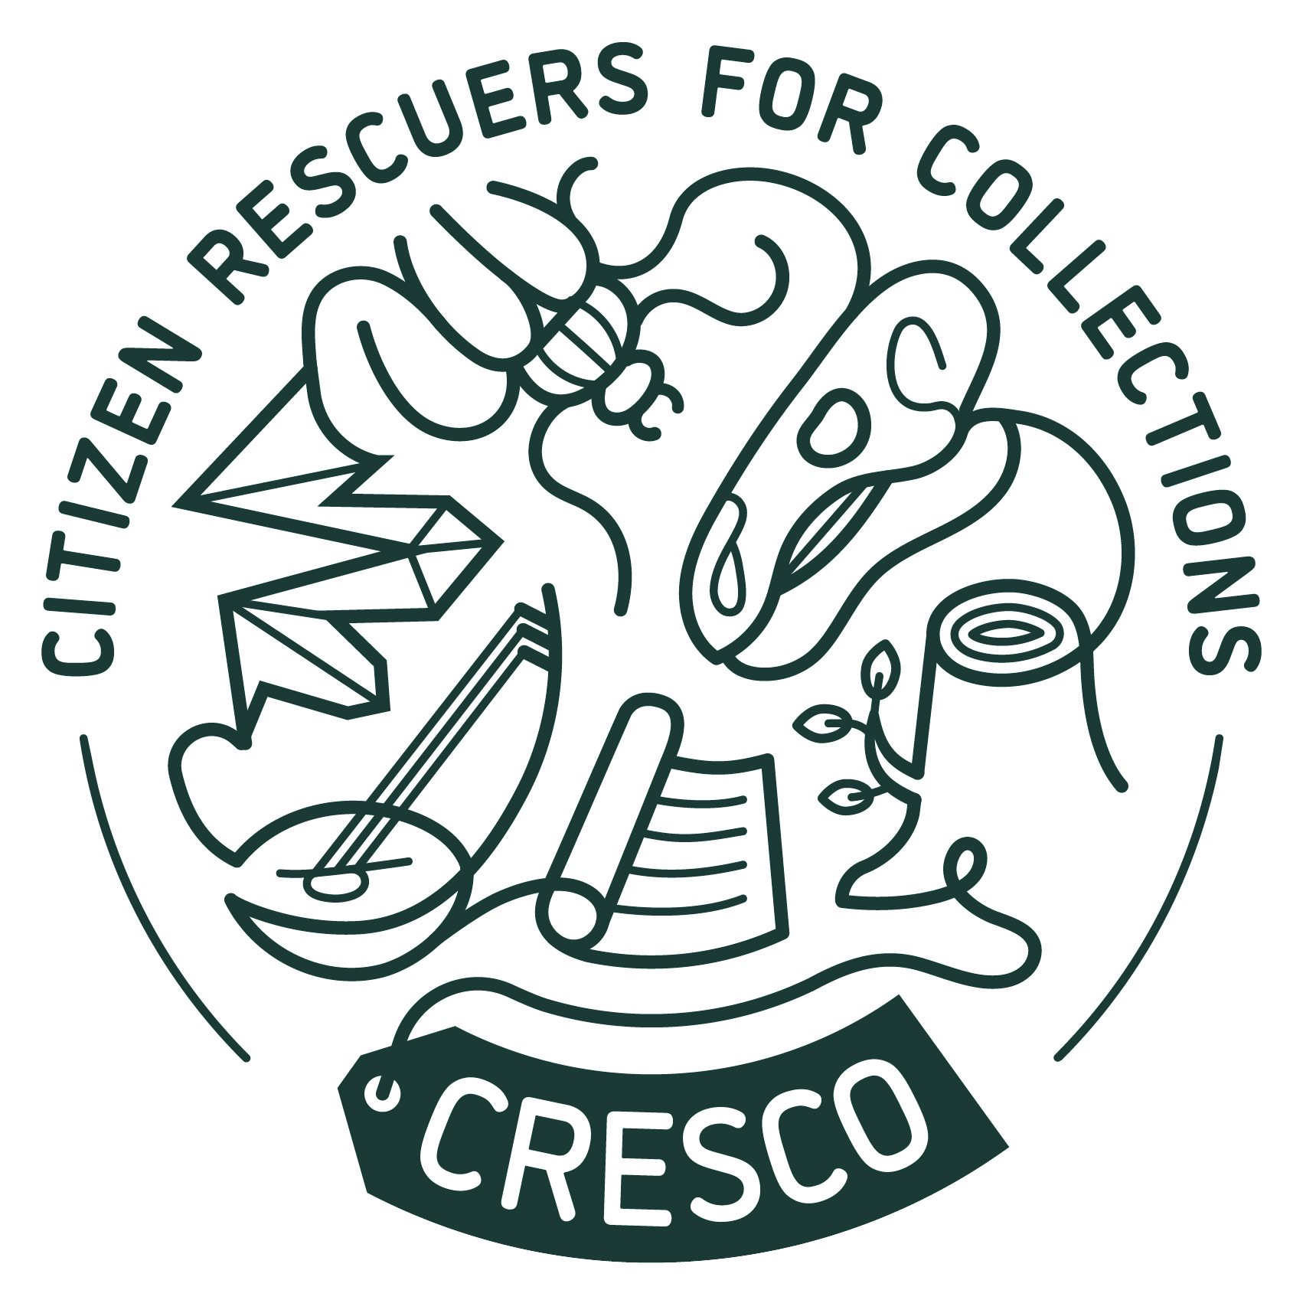
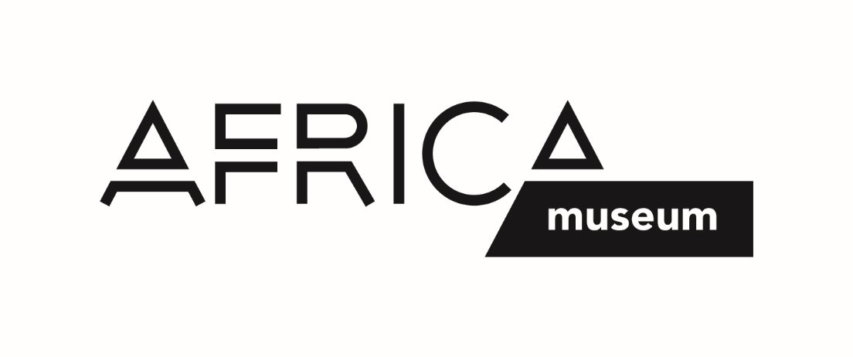
CRESCO
Citizen Rescuers for Collections
Sept – Nov ‘23
CRESCO has received funding from the IMPETUS consortium and is part of the IMPETUS Accelerator for Citizen Science program.
Coordinator: Luiza Mitrache

Slide 8
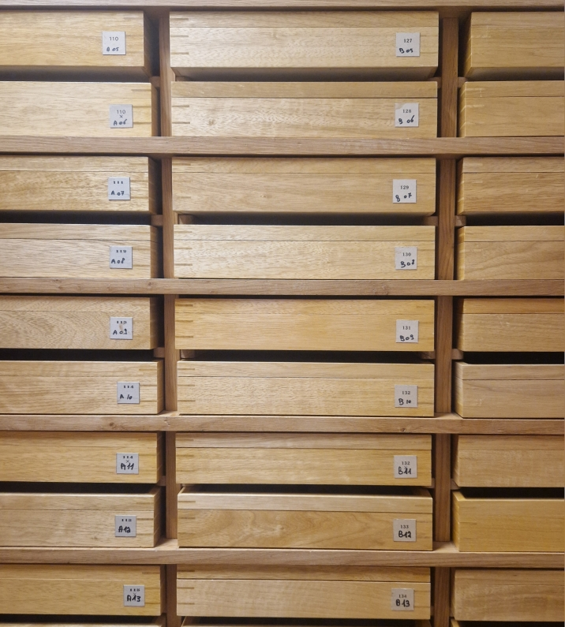
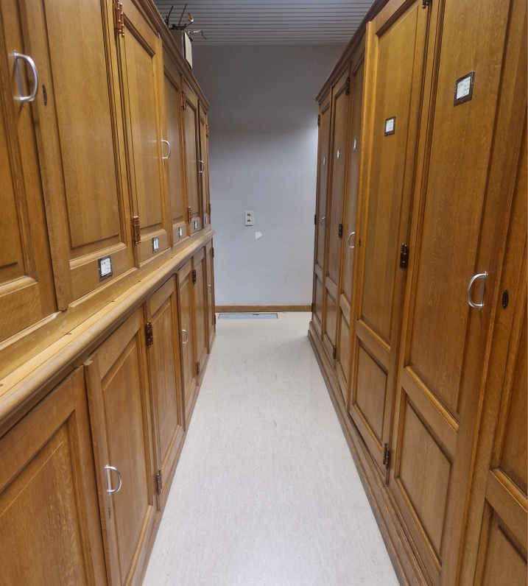
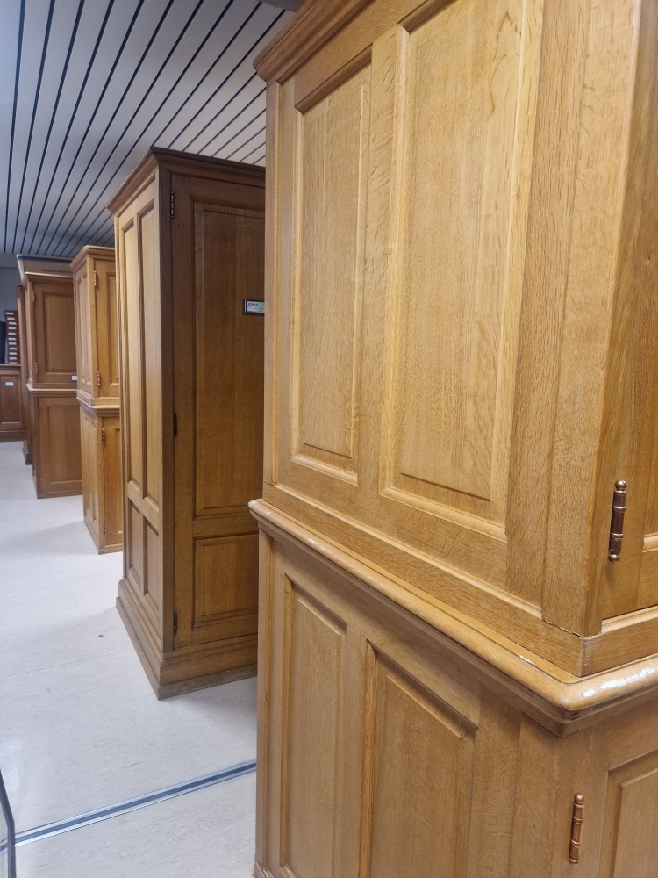
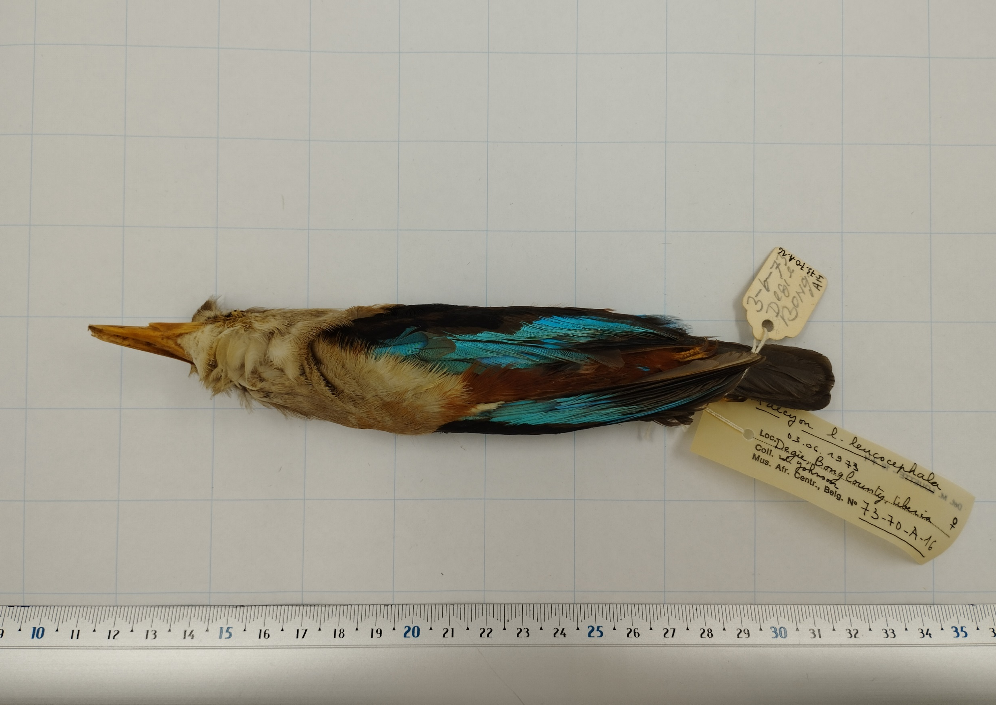
CS use case Africamuseum
Issue: Most items in scientific collections are never studied.
Solution: Improve collection accessibility by photographing specimens and transcribing labels.
Innovation: working with Ukrainian refugees and developing new democratic tools and methods for the digitization of collections.

Slide 9
Objectives: create a community of citizen scientists with gender balance and respect for diversity, and digitize 7000 collection items.

Slide 10
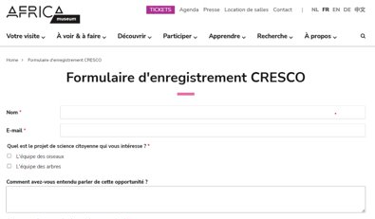
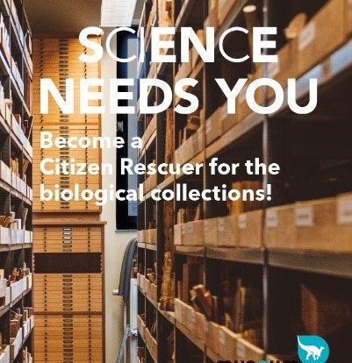
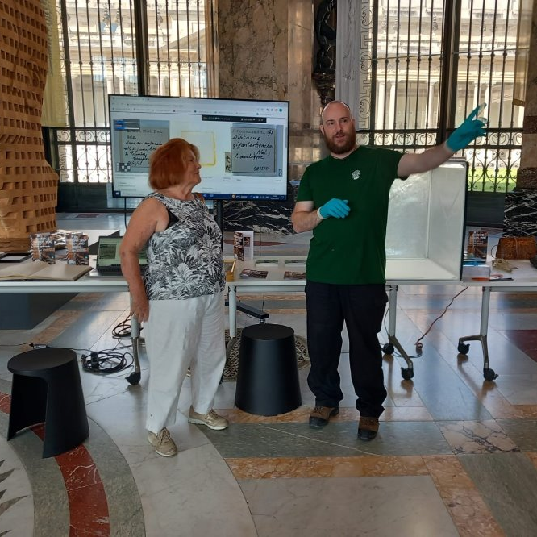
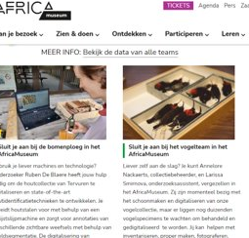
How we reached the target group
Communcation online and on-site

Slide 11
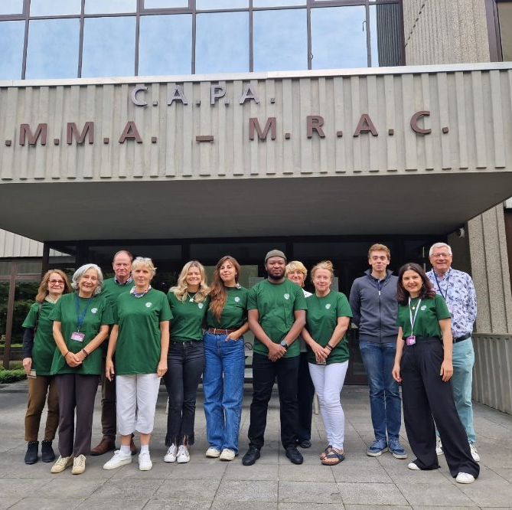
Social impact
26 citizen scientists (14 on site)​
50% women​
43% had a migrant background
171 event participants
56,000 on social media
On site​:
90% more confidence in the AfricaMuseum​
64% would register for nature conservation training
73% more skills in scientific research

Slide 12
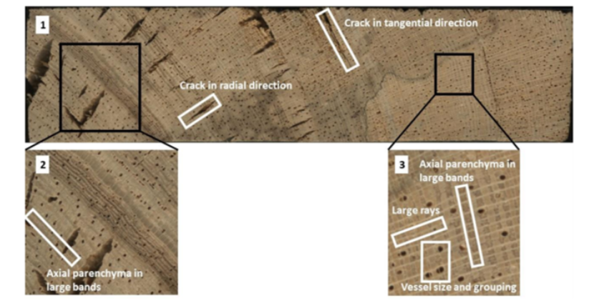
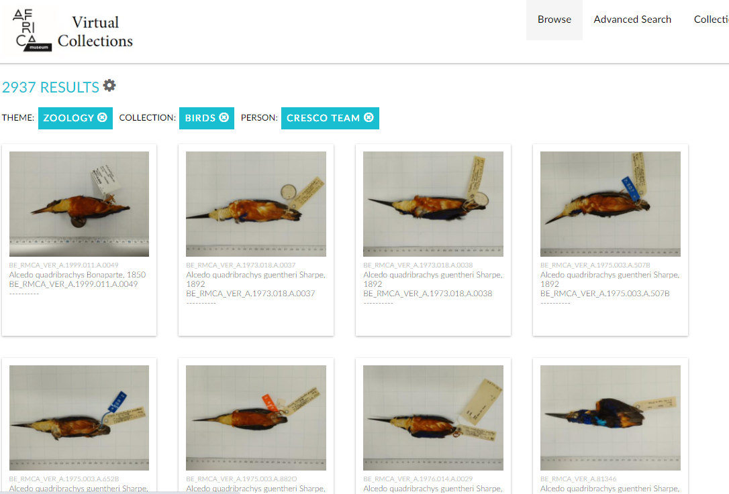
Scientific and economic impact
3 published datasets​
Contribution to SmartWoodID, the first reference database of wood samples for AI training
New methods for wood samples and for the digitization of glass slides
Minimum cost savings: €26,800

Slide 13
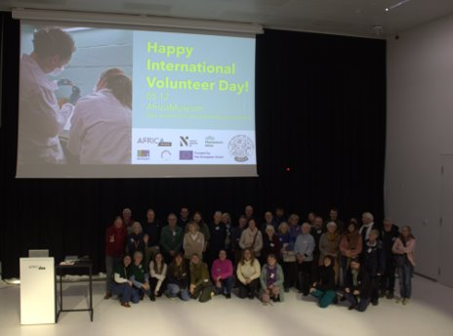
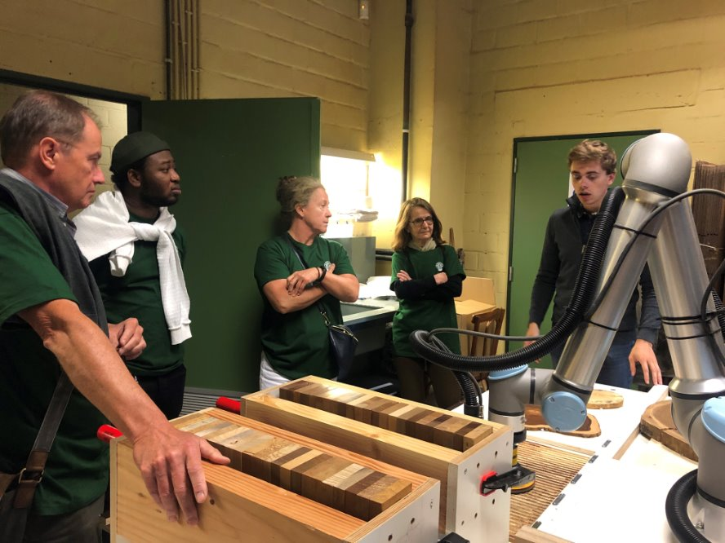
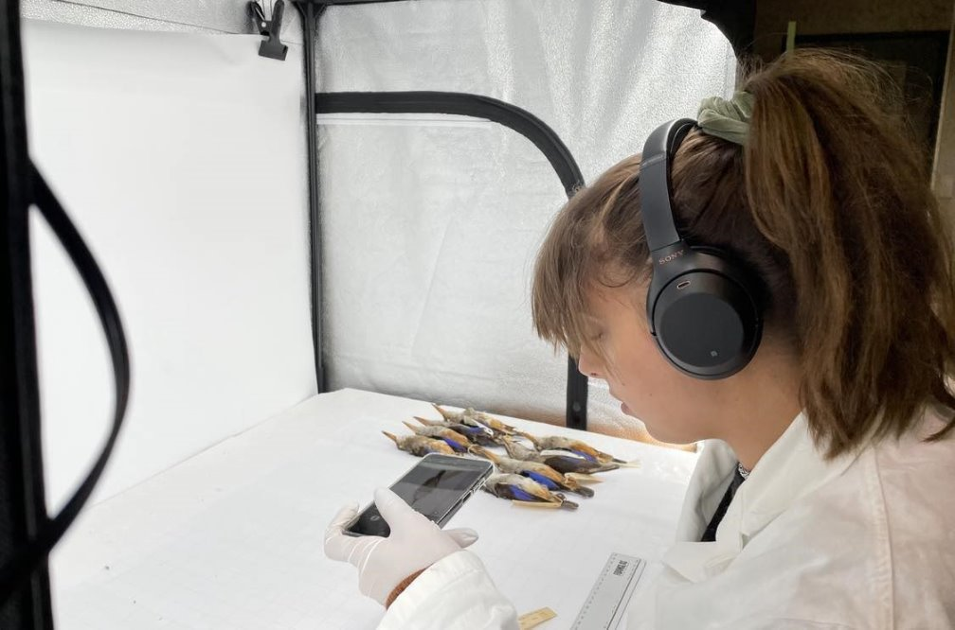
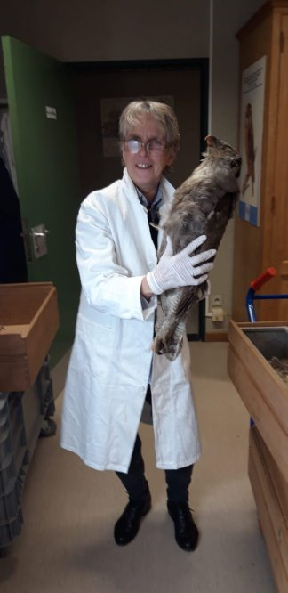
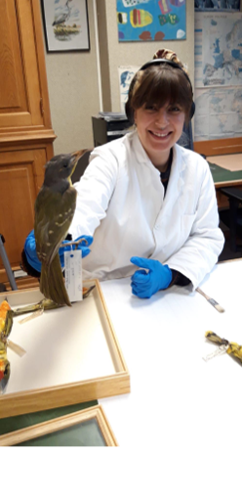
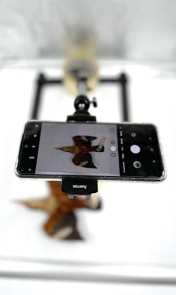
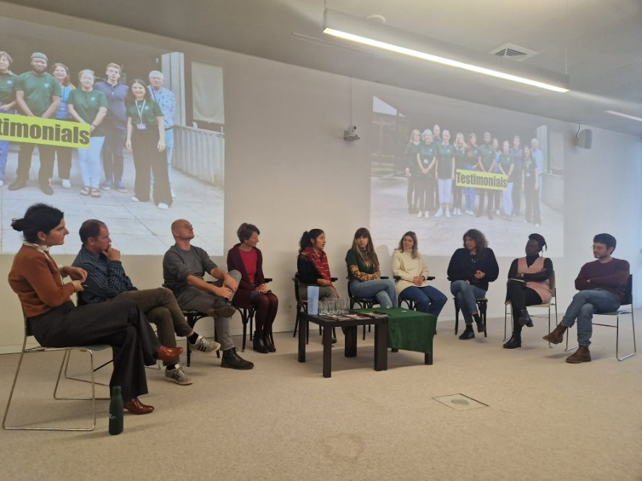
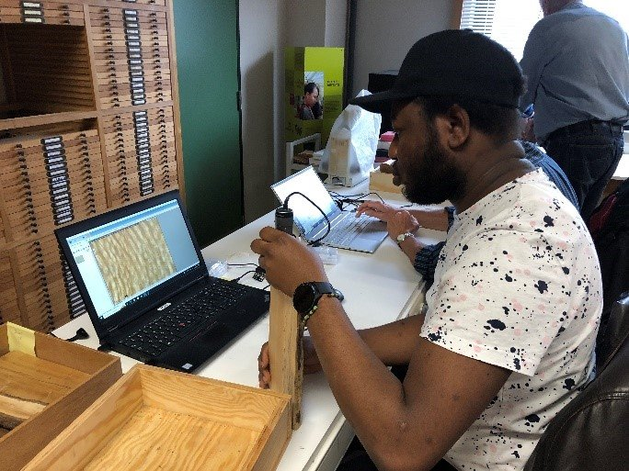
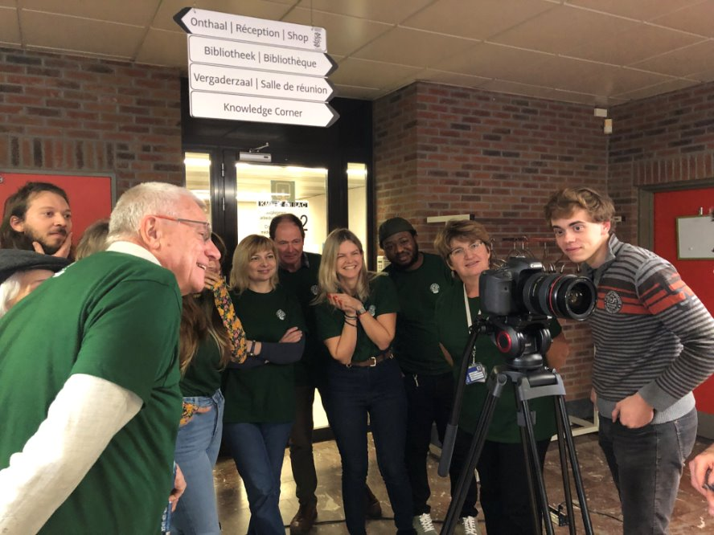
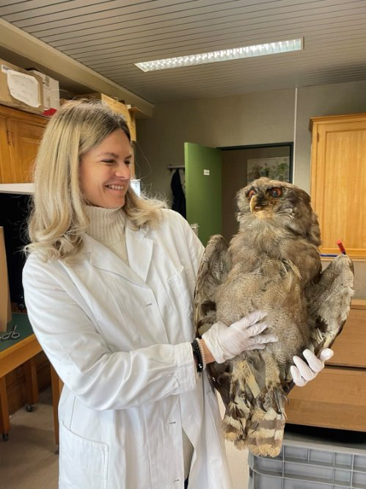
Some atmospheric photos: happy faces – the best reward!

Slide 14
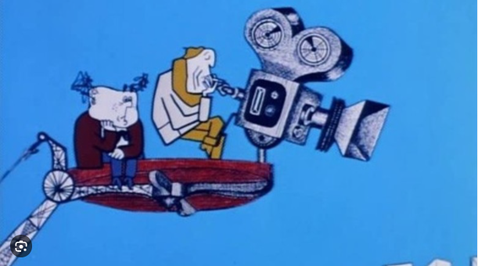
Film, film, film!

