Slide 1
Citizen-led Co-creation
of a Board-Game
for Sexual Violence Prevention
Danielle Fernandes, Vrije Universiteit Brussel

Slide 3
The Backstory

Slide 4
How to create safer cities for girls & women?
Better infrastructure
Facilitate girls claiming public spaces
Sensitisation about harassment

Slide 5
The Idea!
How can we sensitise people about sexual violence?
Bystander training though... a Game!
Bystander training is more effective through active learning & interaction.
Low-cost & independent resource.
Make learning fun.
Community-based by the community for the community

Slide 6
The Community
with funding
from:

Slide 7
The Co-creation aims
Of the Project
the aims & final goals
the engagement
what should the bystander training game teach? to whom?
what should citizen engagement look like?
Of the Intervention
design of the game
content & mechanics
what kind of game?
what should it teach? how?

Slide 8
The Co-creation process
JULY 2023
NOV 2023
Translating ideas
into game mechanics
Translating feedback
to final game package
MAY 2023
2024
Citizen scientist recruitment
Final development & dissemination
JUNE 2023
AUG 2023
SEPT - OCT 2023
DEC 2023
On-boarding training & co-creation workshops
Content
writing & design approval
Testing & iterative development
Evaluation

Slide 9
The Co-creation workshops
Understanding sexual violence topics
what does violence look like?
what is consent?
how does privilege & disadvantage influence?
how can bystanders respond?
Understanding educational games
what are game mechanics?
how can games teach?
Creating Games Through Games!

Slide 10
The Co-creation workshops

Slide 11
The Co-creation aims
Of the Project
the aims & final goals
the engagement
what should the bystander training game teach? to whom?
what should citizen engagement look like?
+ the core philosophy of the project!
Of the Intervention
design of the game
content & mechanics
what kind of game?
what should it teach? how?

Slide 12
A project that centers...
Inclusivity
“violence can happen to anyone...”
Intersectionality
“... but some groups are more vulnerable.”
Community
“we can learn from each other”
“we can make the community safer together”

Slide 13
A board-game that teaches...
How to identify violence
How to respond to violence
Diverse and intersectional perspectives
Motivate bystander action- Winning is a team effort!

Slide 14
The Co-creation process
JULY 2023
NOV 2023
Translating ideas
into game mechanics
Translating feedback
to final game package
MAY 2023
2024
Citizen scientist recruitment
Final development & dissemination
JUNE 2023
AUG 2023
SEPT - OCT 2023
DEC 2023
On-boarding training & co-creation workshops
Content
writing & design approval
Testing & iterative development
Evaluation

Slide 15
The Co-creation process

Slide 16
The evaluation

Slide 17
Project Update...
Funding from Equal.Brussels!

Slide 18
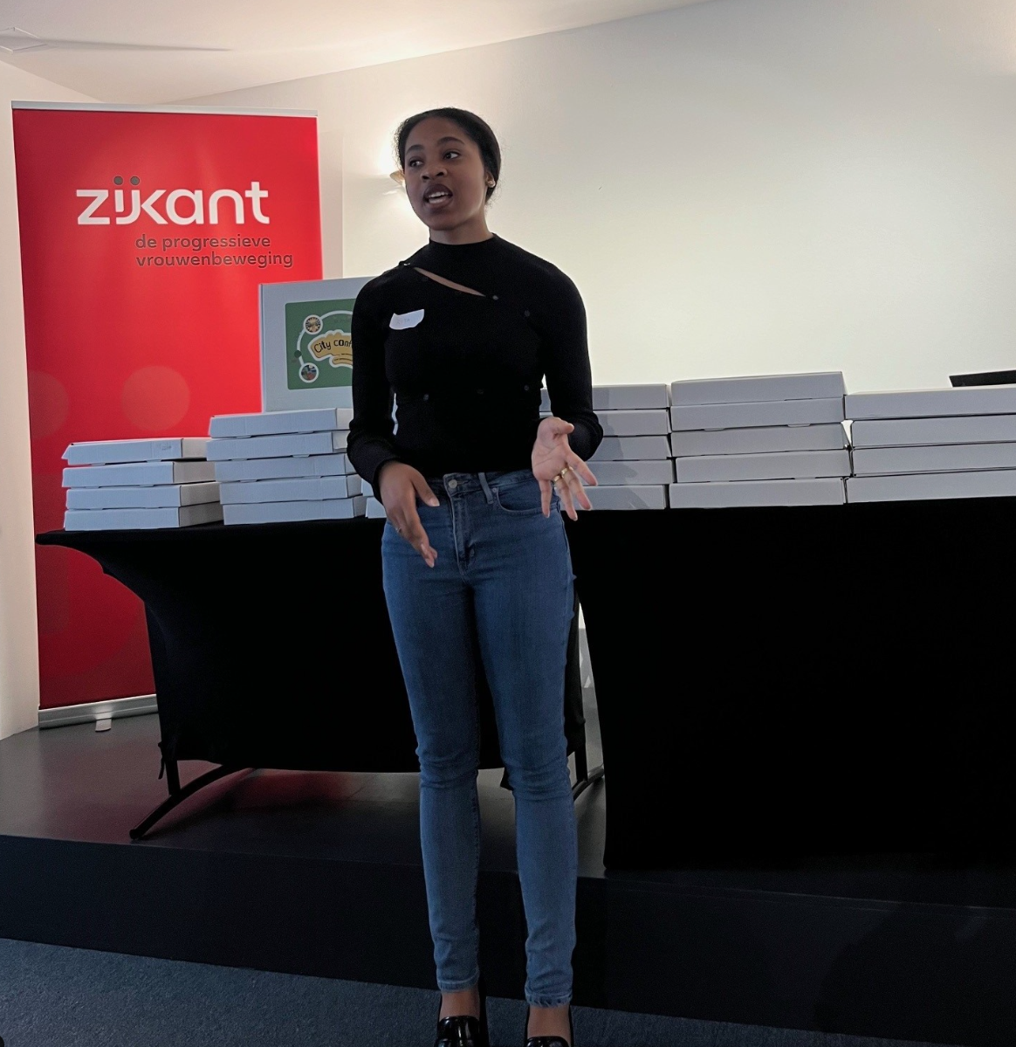
For Development & Dissemination

Slide 19
For Development & Dissemination

Slide 20
What Next?
Implementation - train-the-trainers & evaluate impact
Make a sustainable business plan
Youth-led sessions (with evaluation)

