Slide 1
Empowering weather watchers:
the impact of citizen meteorology on weather observation and crisis response
Maarten Reyniers
Inspiration day - Community engagement in citizen science

Slide 2
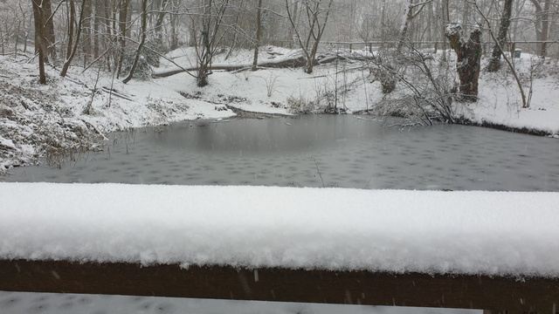
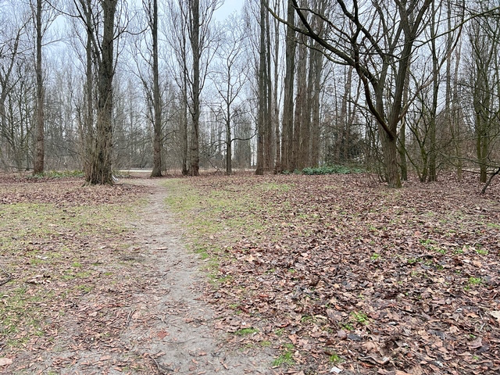
Small country, difficult to forecast
Snow episode 17.01.2024
Sint-Agatha-Berchem (Brussels)
17/01/2024 17:17
Antwerpen
17/01/2024 16:59

Slide 3
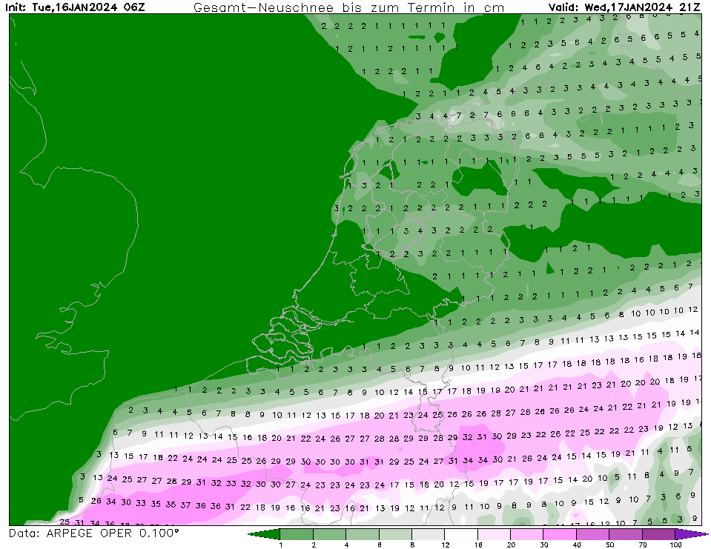
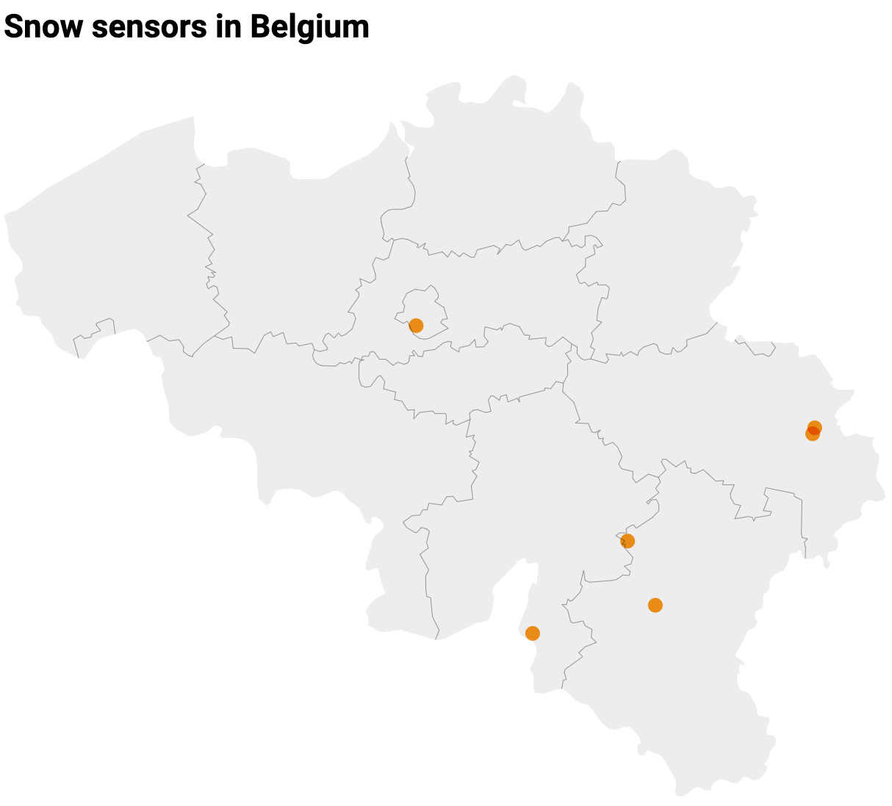
Small country, difficult to forecast
Snow episode 17.01.2024
Snow height model forecast
Automatic snow sensors

Slide 4
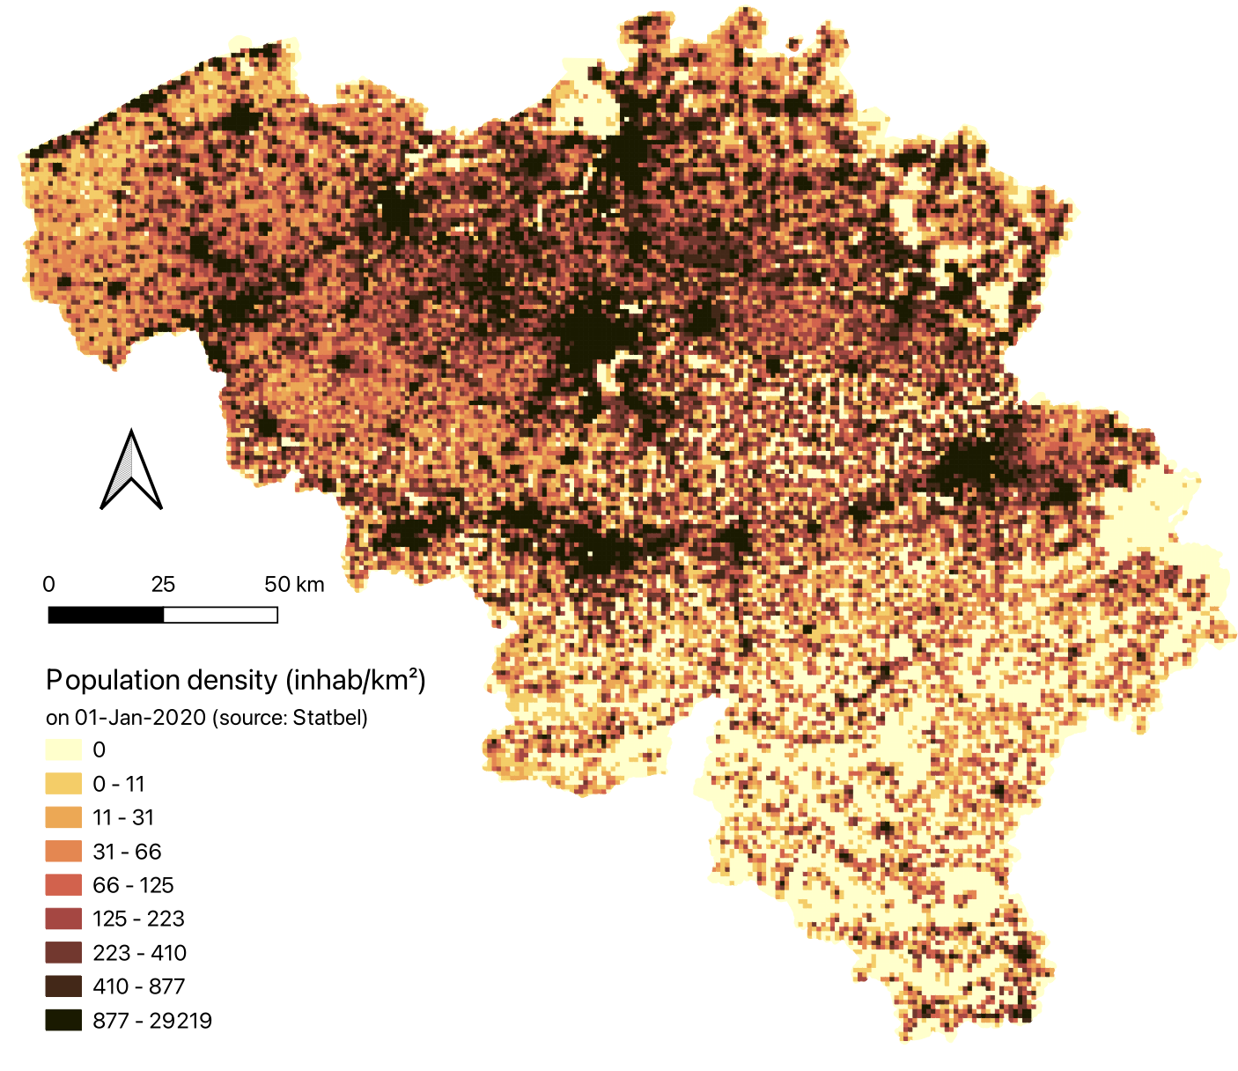
Small country, 11 mio potential observers
Snow episode 17.01.2024
Snow height model forecast
Population density

Slide 5
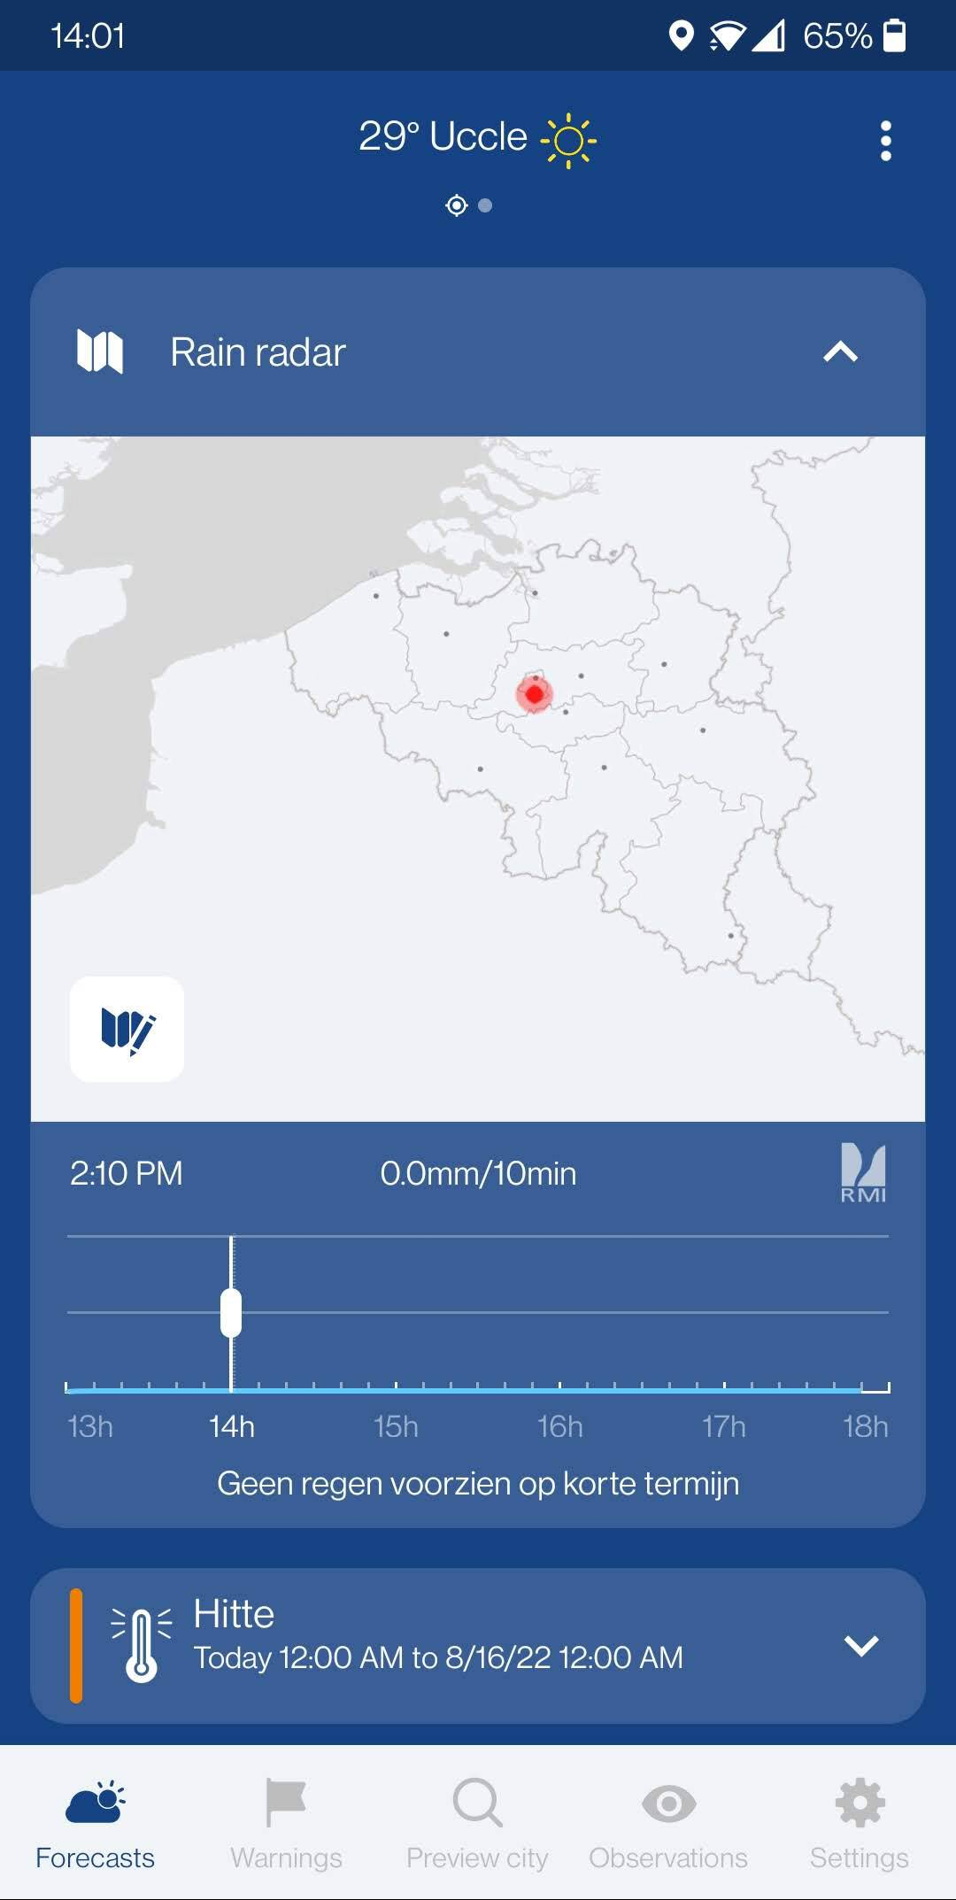
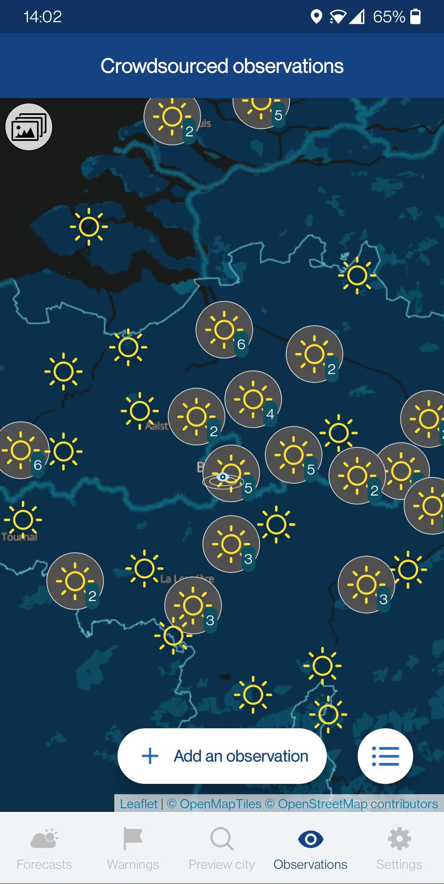
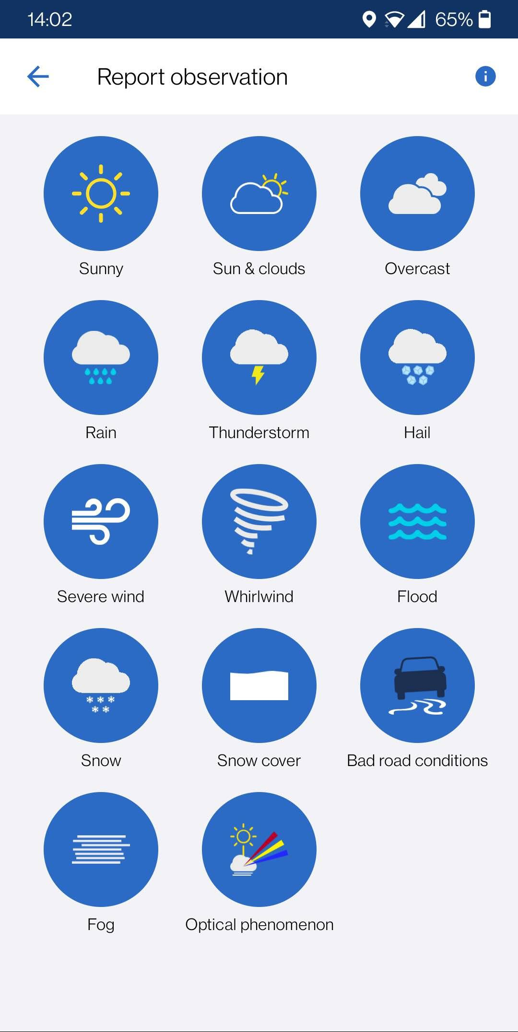
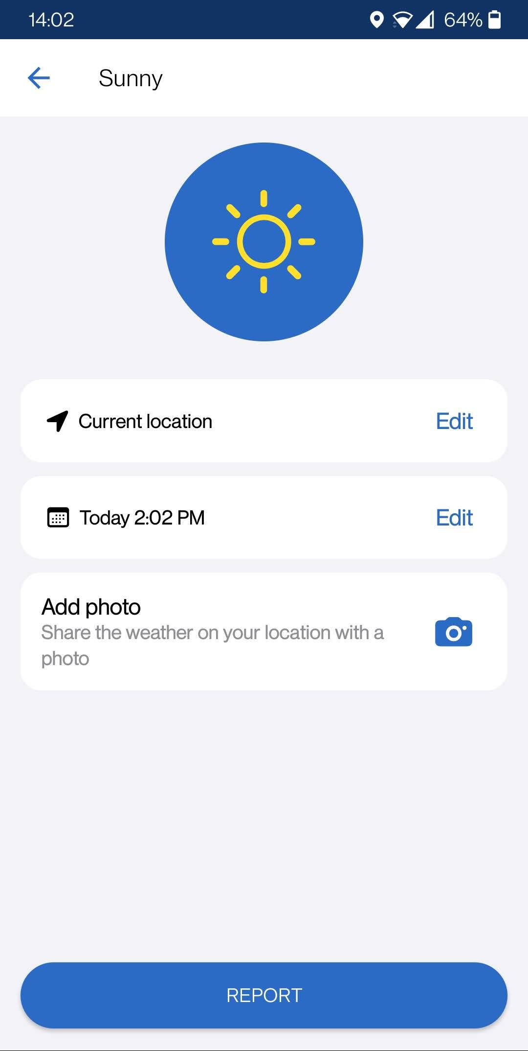
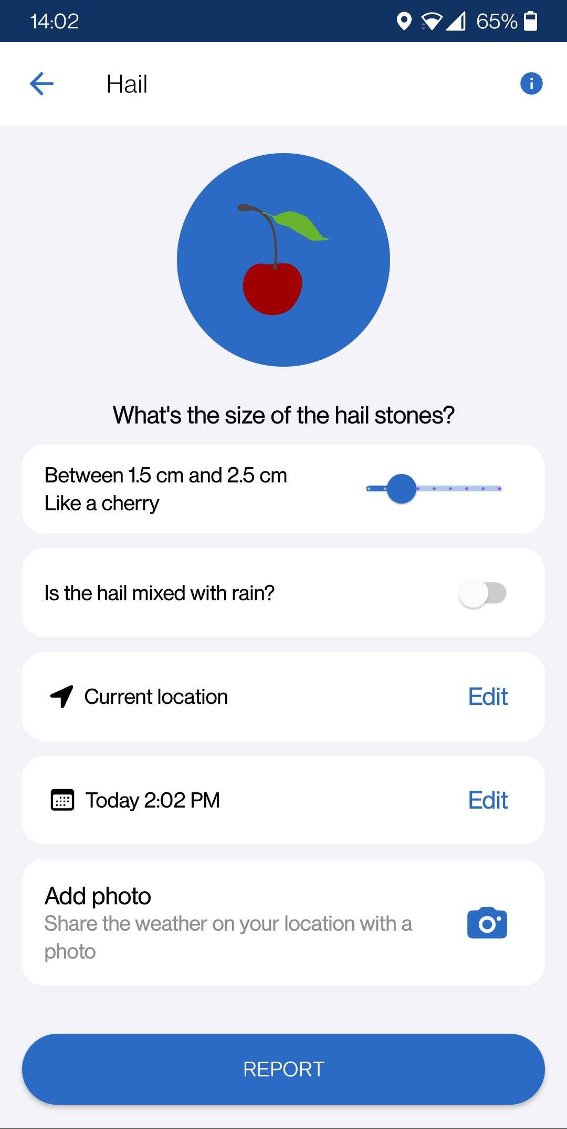
Smartphone app RMI
Reporting feature added to the RMI app in August 2019

Slide 6
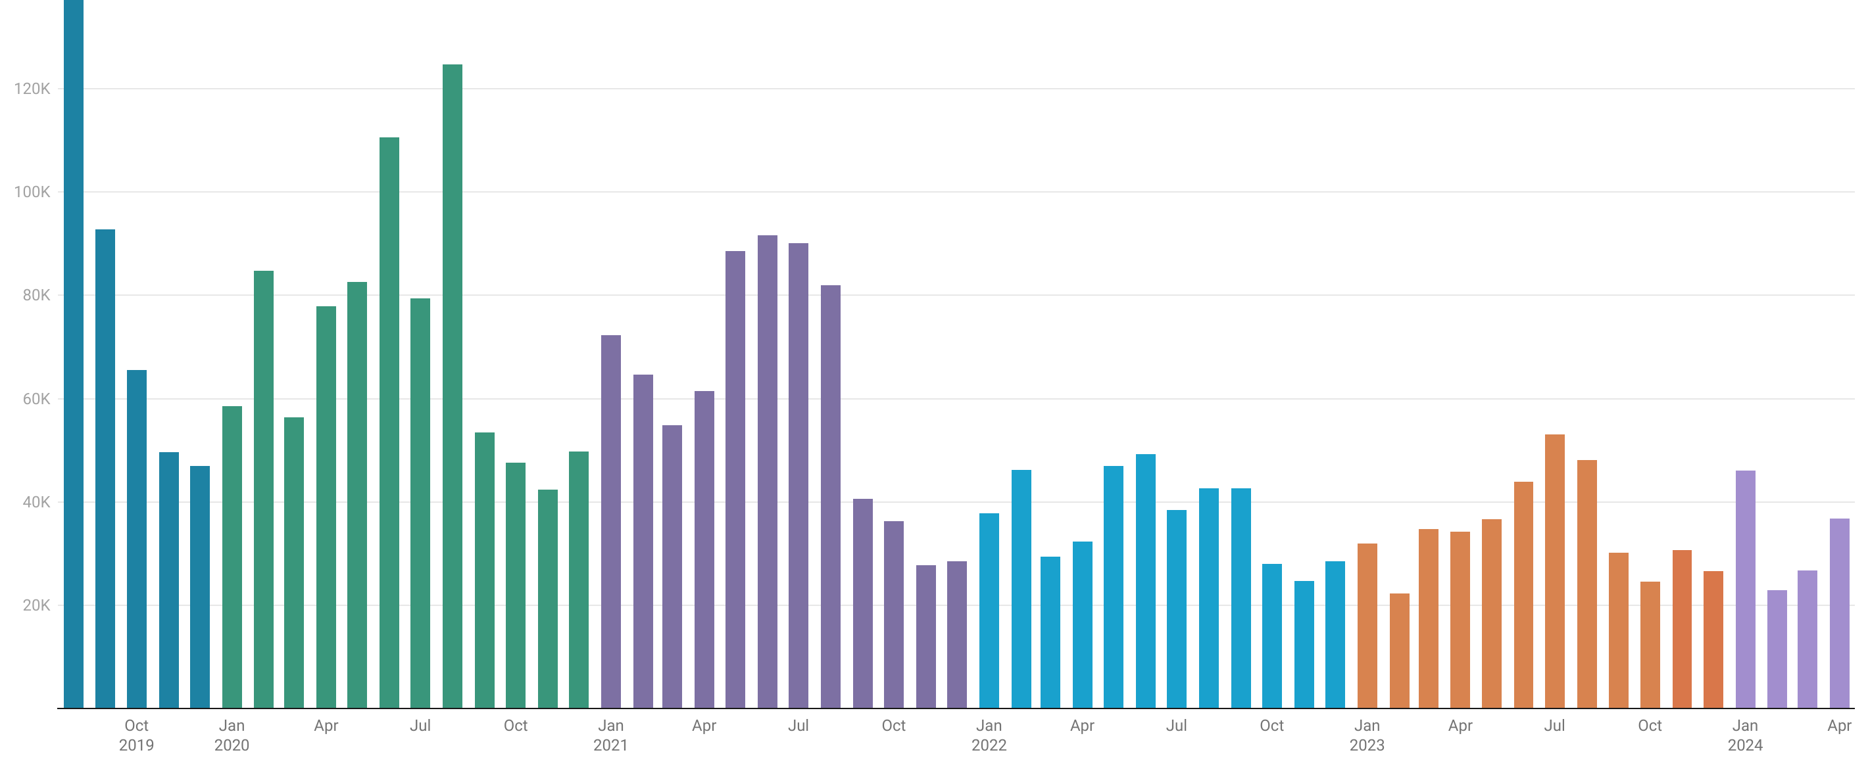
Total number of observations per month
More than 3 million observations received!
2019
2020
2021
2022
2023
2024

Slide 7
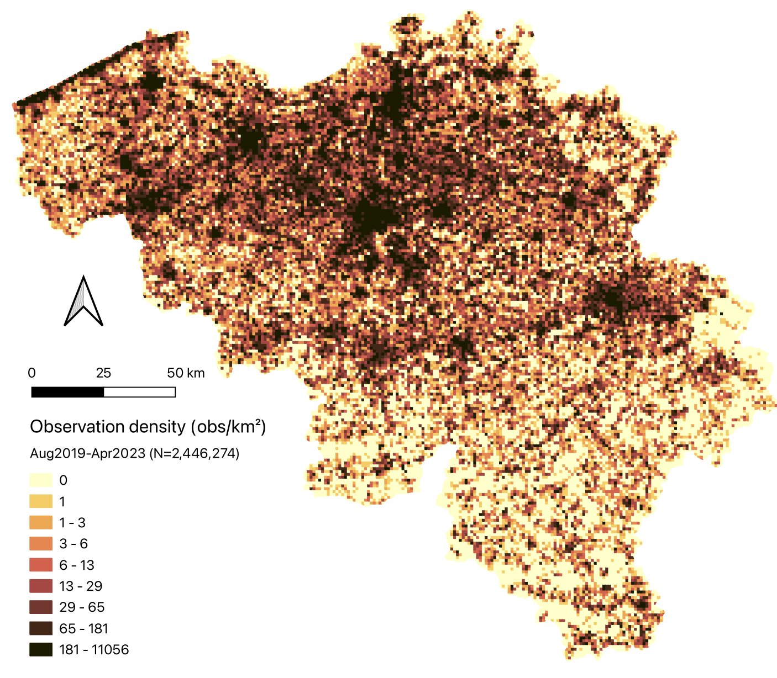
Spatial distribution of observations
Observations density Observations per km²
Population density
Inhabitants per km²

Slide 8
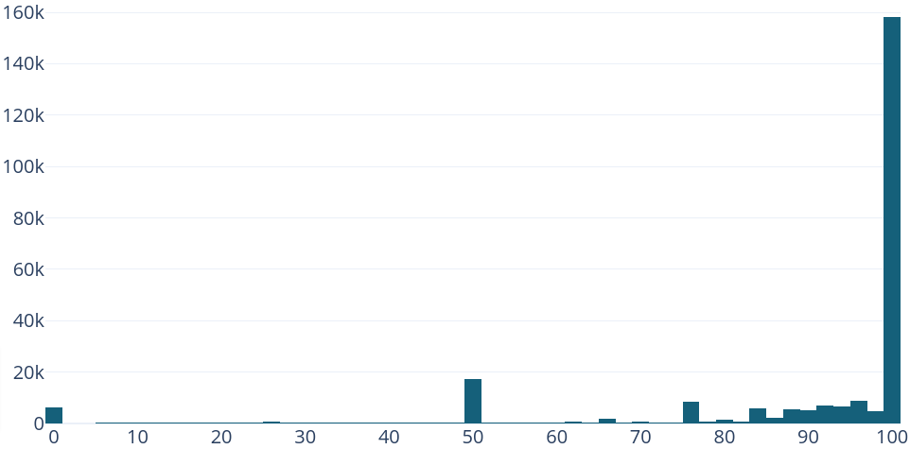
What about the quality?
For every user we keep an (anonymous) user reputation ∈ [0,100]
Histogram of user reputation scores
78% of the users have
a reputation score ≥ 90.
65% has score 100.
User reputation
Notes:
Distribution of number of obs.: are there signs of a loyal user base? I.e. users with one observation, was there more in the beginning?
Of course, these numbers also rely on the details of the plausibility check!

Slide 9
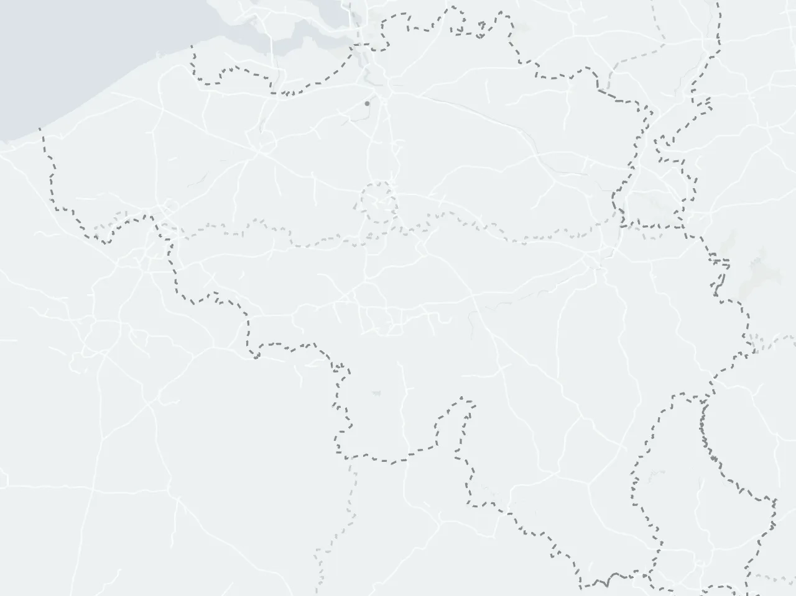
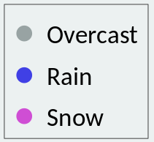
Snow
Snow episode 17.01.2024
Snow height model forecast
Citizen observations

Slide 10
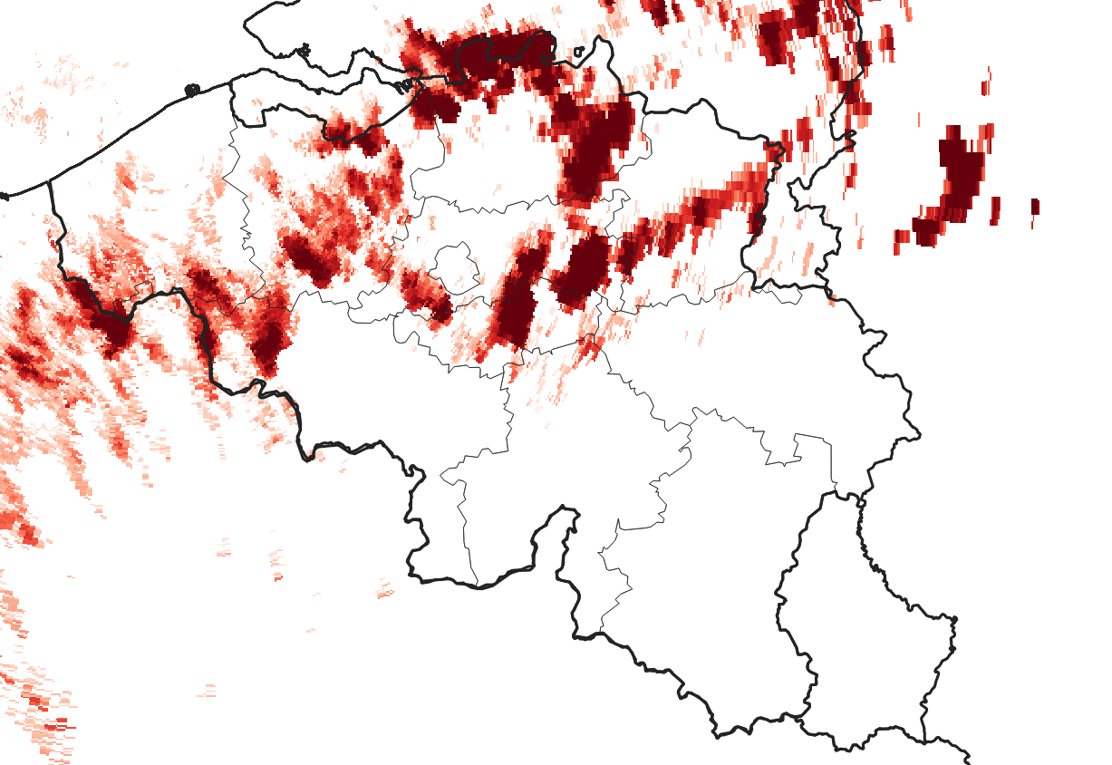
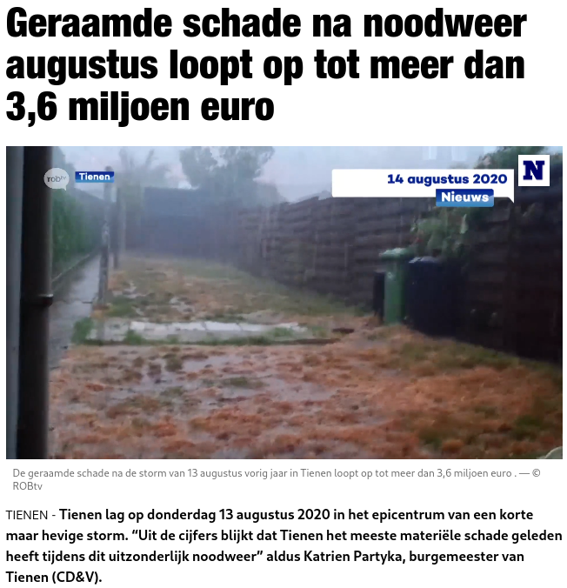
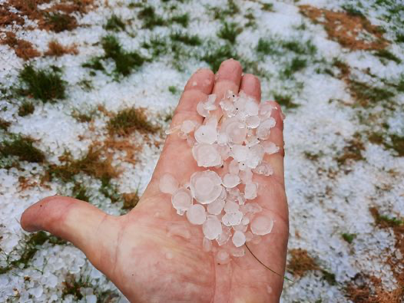
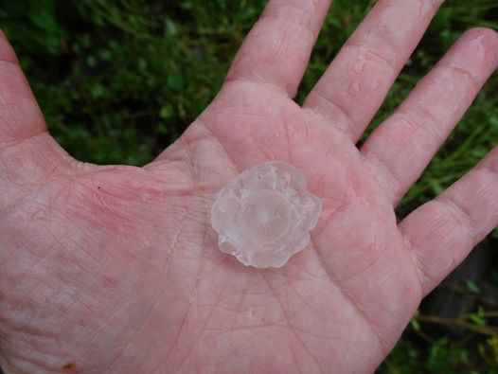
Hail with weather radar
13/08/2020
(foto’s:Facebook)
Weather radar: indirect measurement of hail

Slide 11
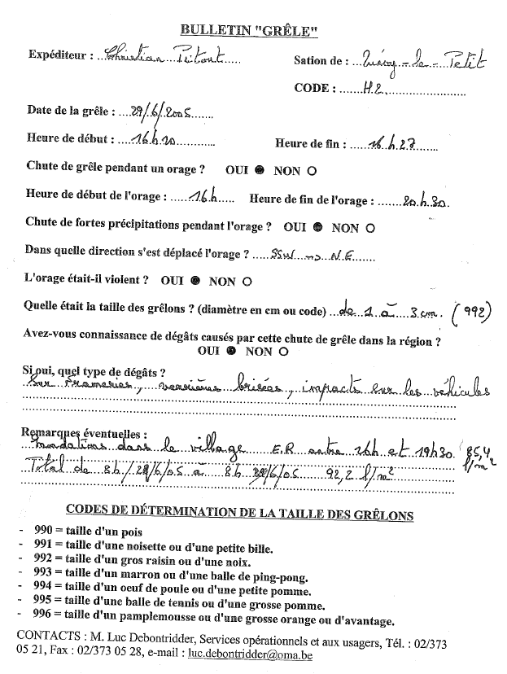
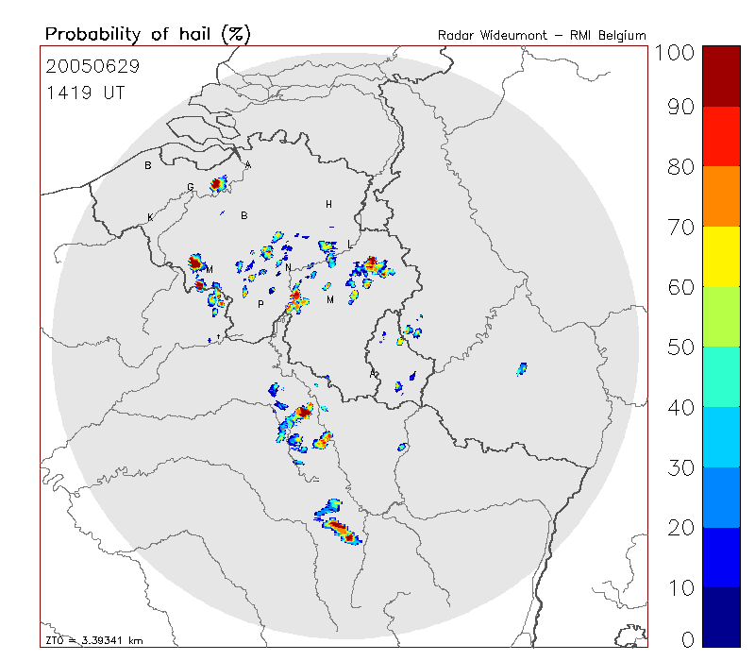
Hail verification in the past
83 reports

Slide 12
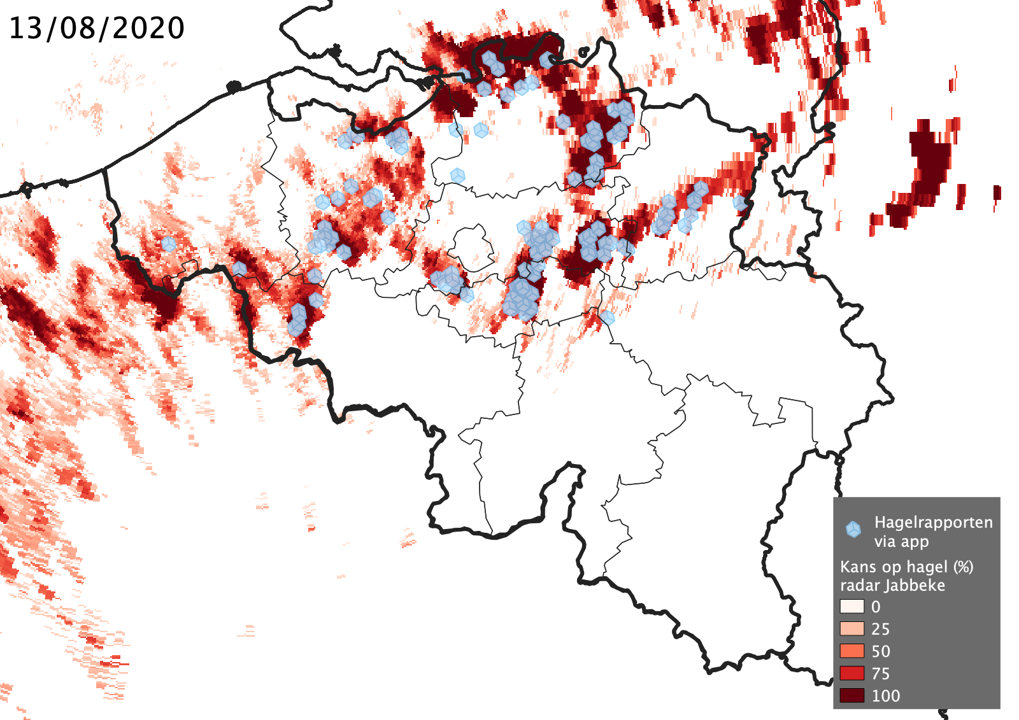
Hail verification with app reports
13/08/2020
Weather radar: indirect measurement of hail

Slide 13
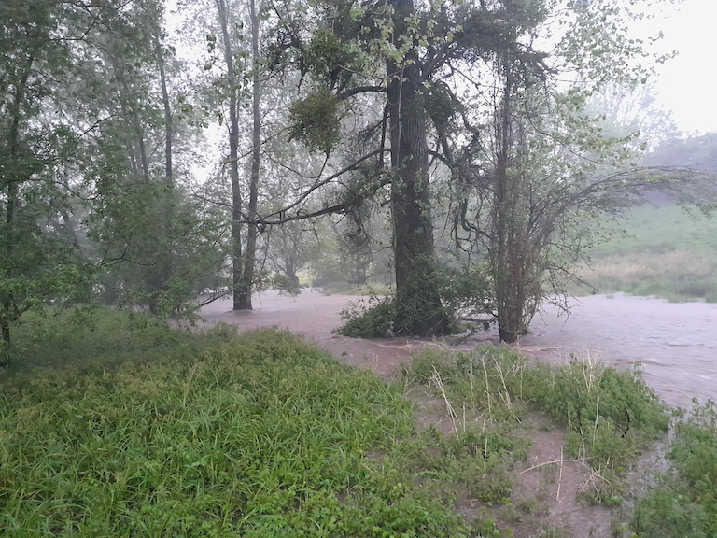
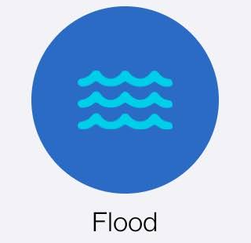
What about crisis response?
(1) Floods and photos per request of regional authorities for flood monitoring
1st extension
2nd extension
2020
2022
Addition of floods
Addition of photos
Herve
17/05/2024 21:15

Slide 14
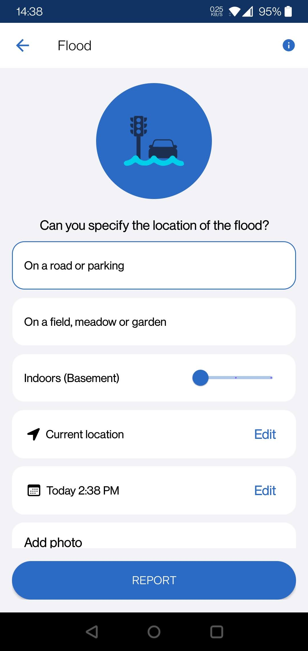
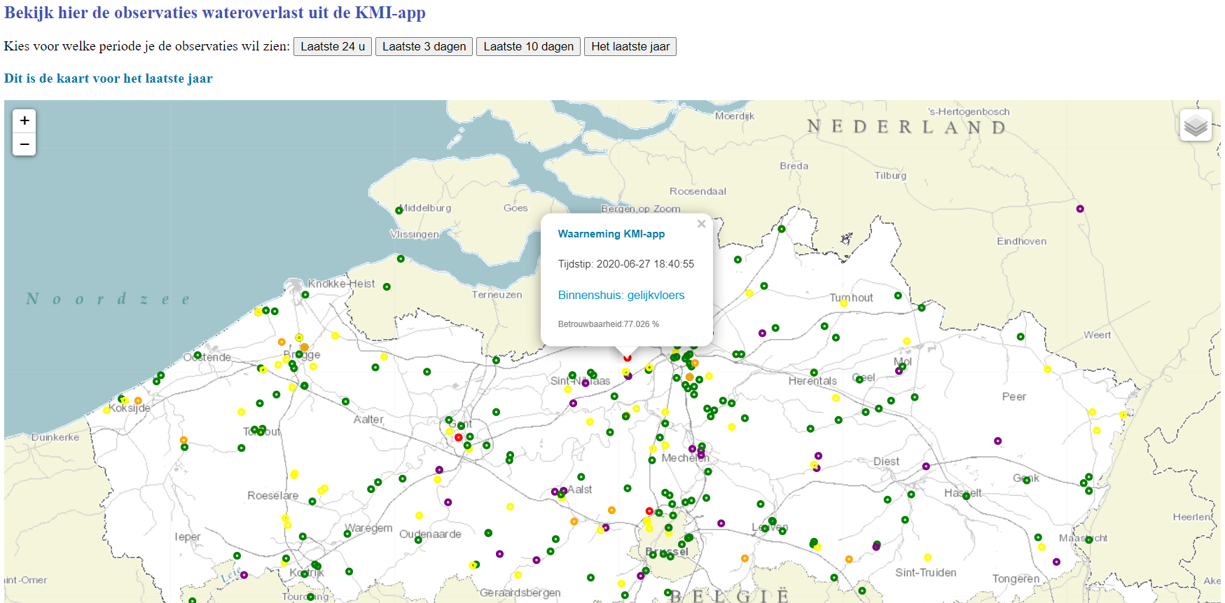
What about crisis response?
(1) Floods and photos per request of regional authorities for flood monitoring
Transferred to regional hydrological authorities for real-time consulation (here: VMM)

Slide 15
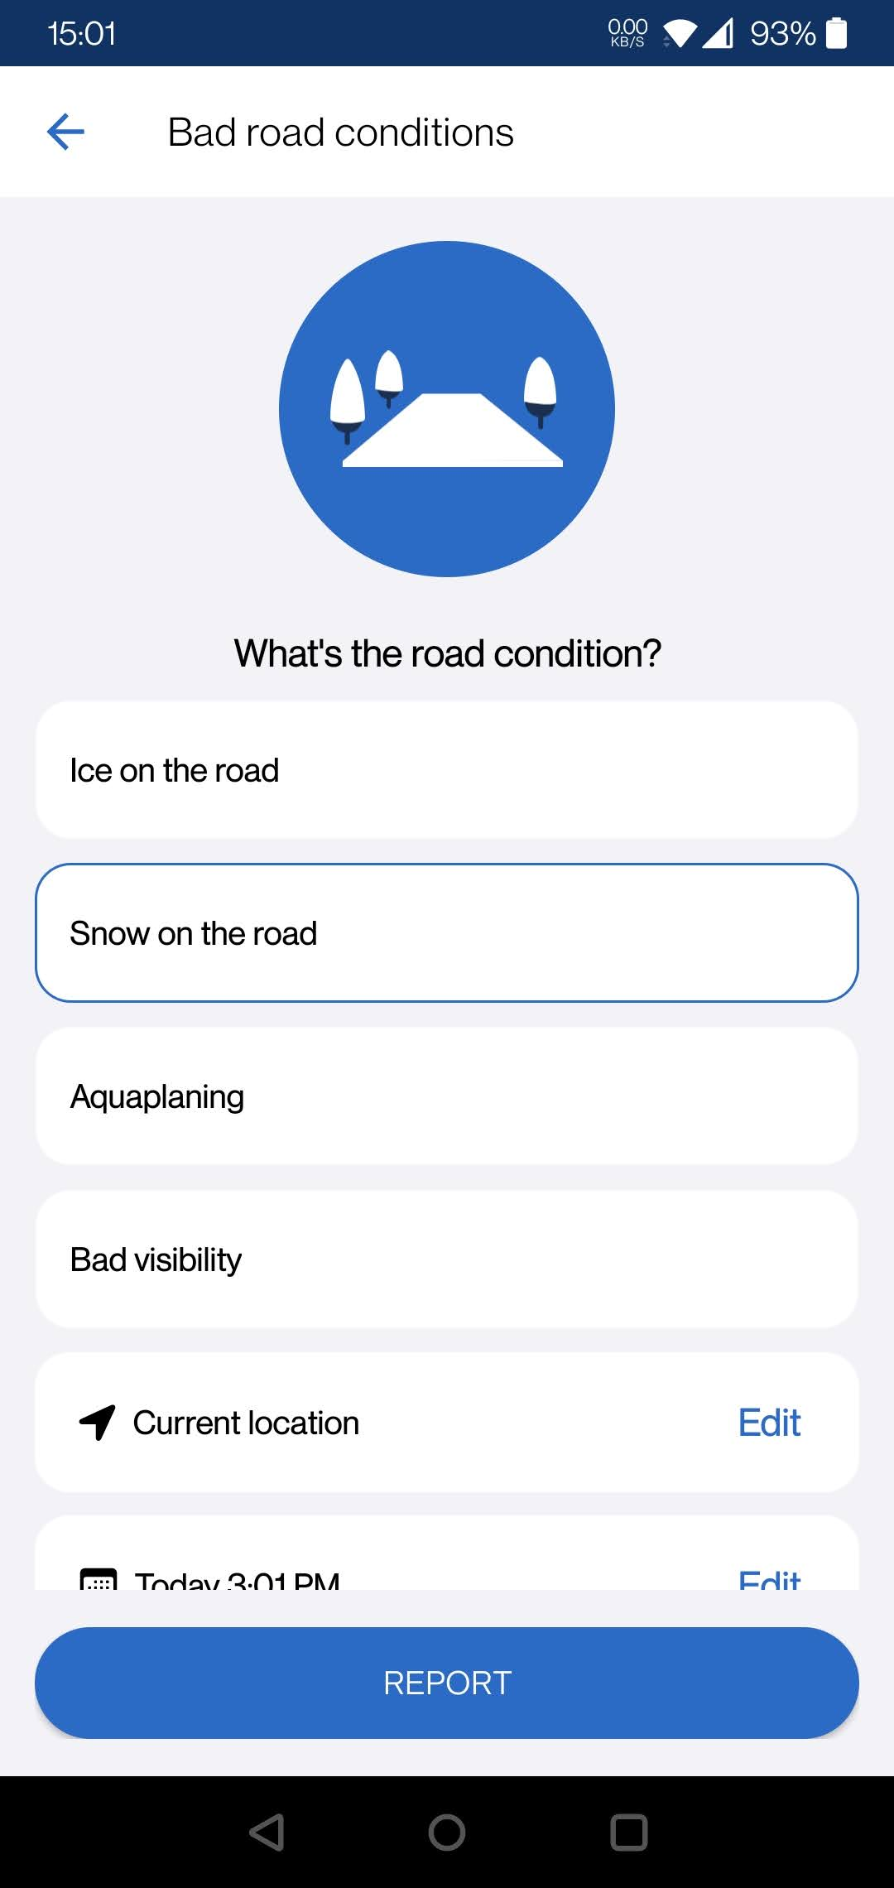
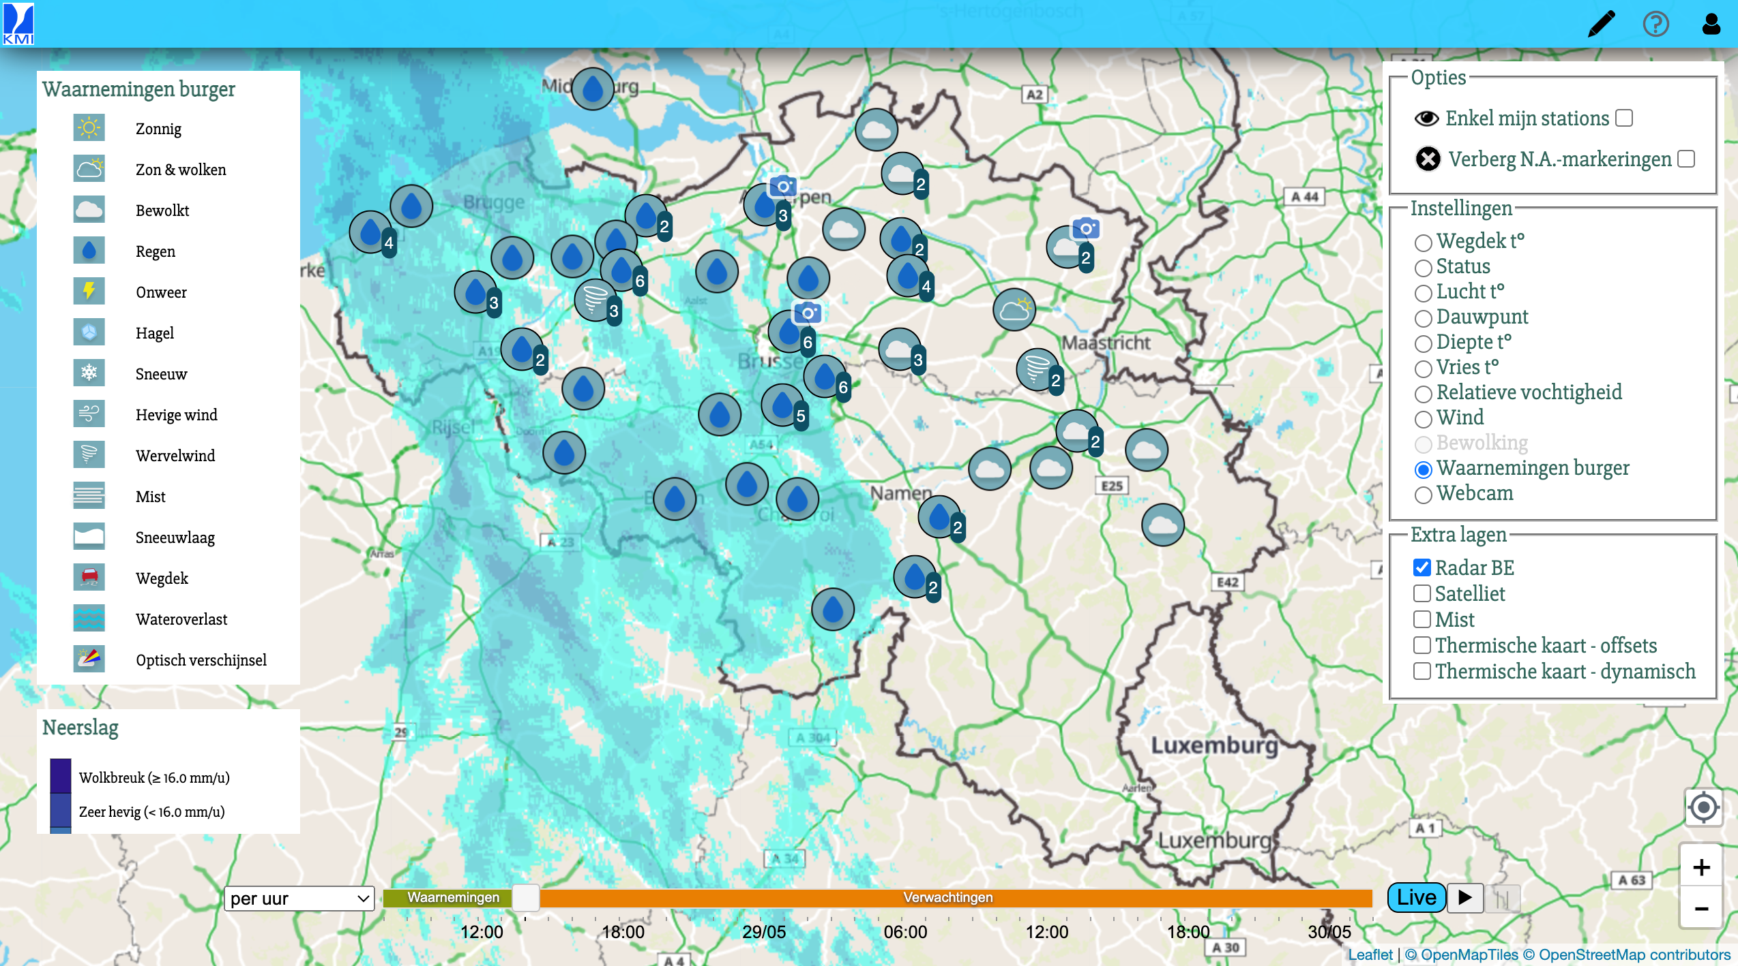
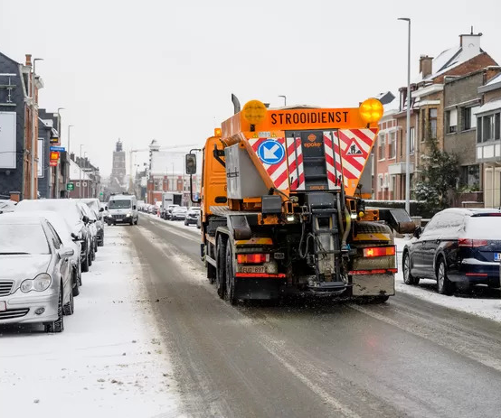
What about crisis response?
(2) Observations of dangerous road conditions & snow for road management
Transferred to regional road authorities for road management, e.g. road salt planning.

Slide 16
“Empowering” weather watchers
BETTER MODELS
RESPONSE HAZARDOUS WEATHER
Notes:
Reseach domain, long term
Real-time usage, already reality

