Slide 1
Federal Citizen Science Inspiration & Networking Day
Art: the gateway to science for everyone
Karolien Lefever
ROYAL BELGIAN INSTITUTE FOR SPACE AERONOMY

Slide 2
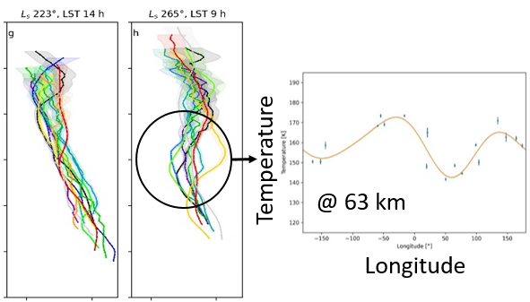
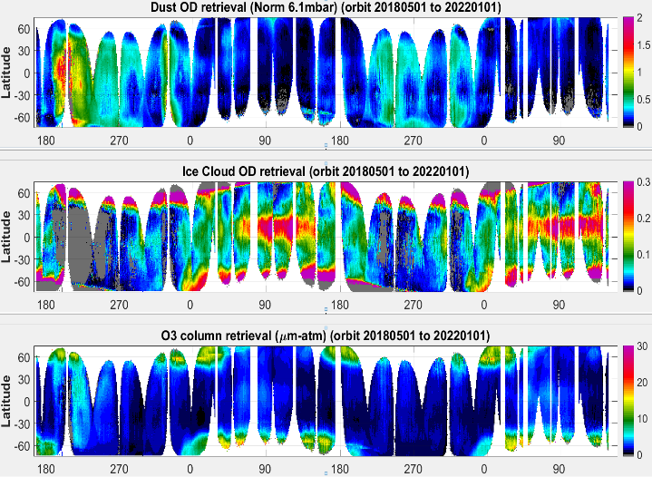
Planetary atmospheres are complex systems
Nadir climatologies
Spatial map of ice clouds
Spatial map of ozone
Seasonal maps of ice clouds, dust and ozone
Longitudinal variations in MY 35
Solar longitude
Ls = 0 – 20°
Ls = 0 – 20°
Willame et al. EPSC 2021

Slide 3
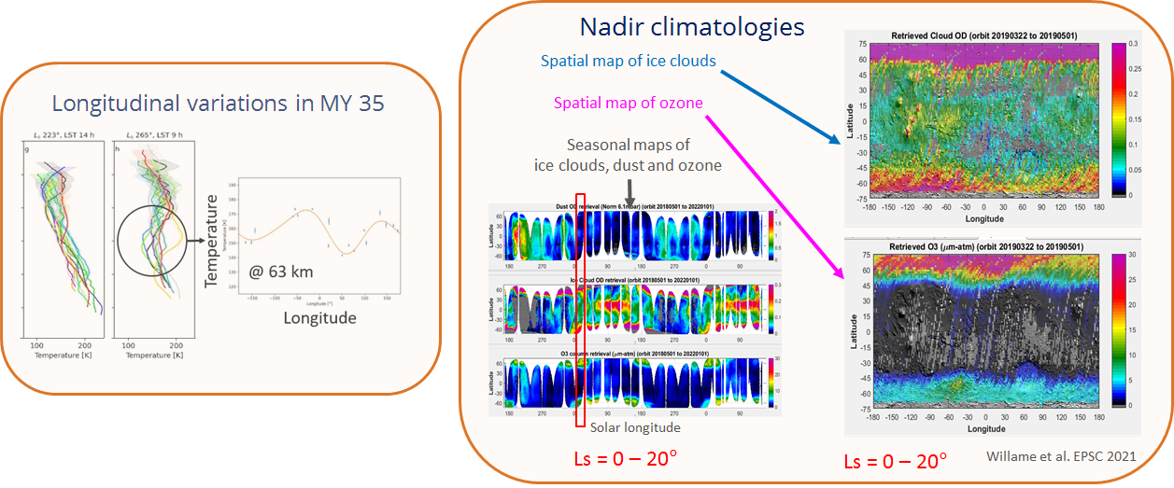
Planetary atmospheres are complex systems
The conventional way of representing atmospheric data has many limitations:
Scientists may miss the opportunities to see trends/patterns in the data that could appear by analyzing the data from a different perspective.
The general public may find it difficult to understand what the data is telling us.
People with visual disabilities are completely left out.
We need to think outside of the known boundaries and explore new territories between science and arts.
It is important to include art in the representation process in order to create new strategies, tools and resources that may provide people with special educational needs a participative learning place.

Slide 4
Making planetary research inclusive and accessible to all
3rd bachelor
“Media and Information Design”
H2020 RoadMap:
ROle and impAct of Dust and clouds in the Martian AtmosPhere: from lab to space
=> “Students learn to deal creatively with new media technologies and present information in a visually clear and attractive way.”
PROJECT WEEK: Students learn to interpret and present highly complex data
through artistic data representations. They create unique visual expressions that offer an unconventional way of experiencing the data.

Slide 5
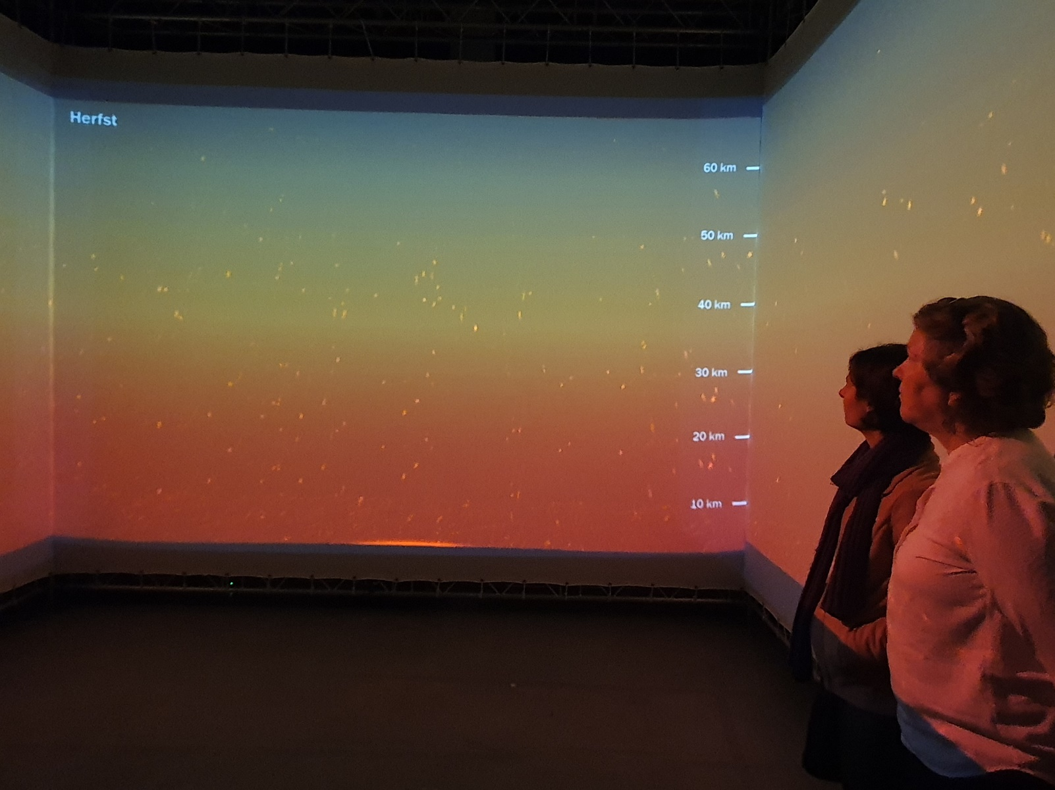
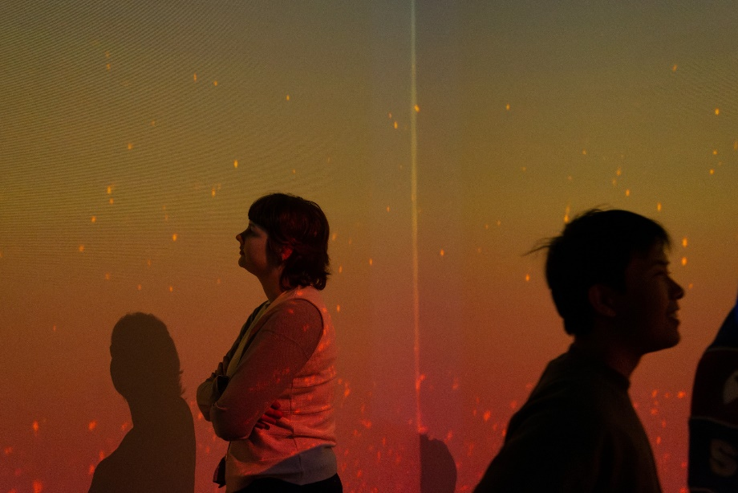
“Dust on Mars” - Digital projection
KEY MESSAGE - Dust is omnipresent on Mars. Its abundance varies by altitude and season.
Scientists from BIRA-IASB are being immersed in an environmental representation of aerosols in the Martian atmosphere.
The amount of aerosols is intuitively shown as particles, while their altitude is shown by their height, creating a unique and engaging experience that evokes standing on Mars surrounded by dust.
Artists: Hannelore Knaepen, Asad Masood, Tristan Van Garsse

Slide 6
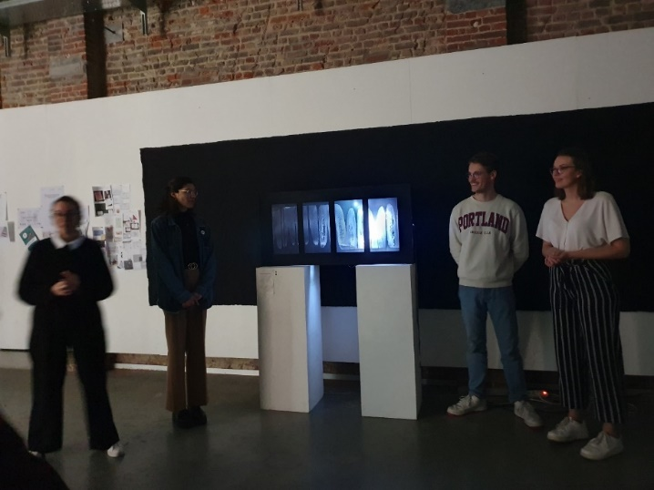
“Shine through Mars” – Physical box
KEY MESSAGE - Depending on the amount of dust and ice clouds in the Martian atmosphere, there may be less light reaching the planets surface.
The installation shows the amount of light that reaches Mars throughout the four seasons of one year.
Artists: Hannelore Knaepen, Asad Masood, Tristan Van Garsse

Slide 7
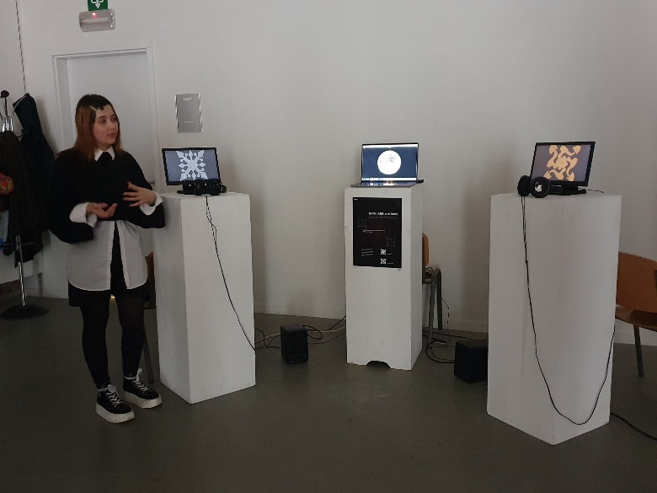
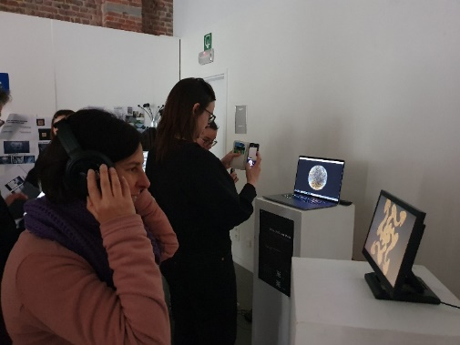
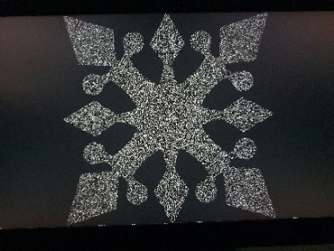
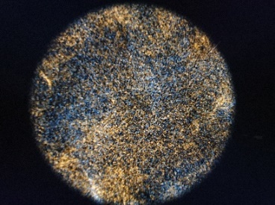
“Ice Clouds and Dust on The Red Planet” – An Acoustic Journey
KEY MESSAGE - Changing weather patterns on Mars (evolution of ice clouds and dust).
Each particle (ice and dust) has a unique sound and comes from either left or right, while the frequency of the sound represents the amount of that particle. As time progresses, the seasons change, resulting in a unique acoustic representation of the changing weather patterns on Mars.
Artists: Karina Gevorgyan, Nattakit Pheanklang, Dieter Roozeleer

Slide 8
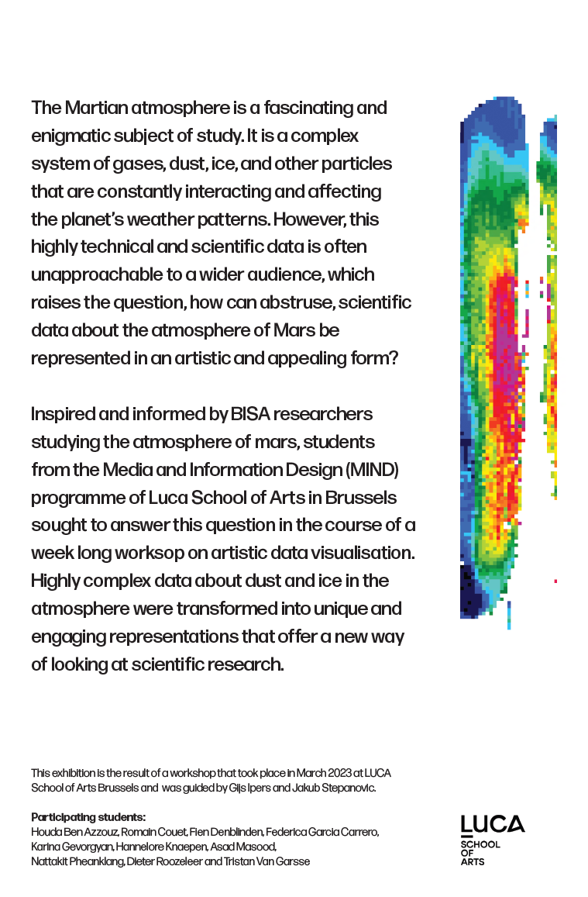
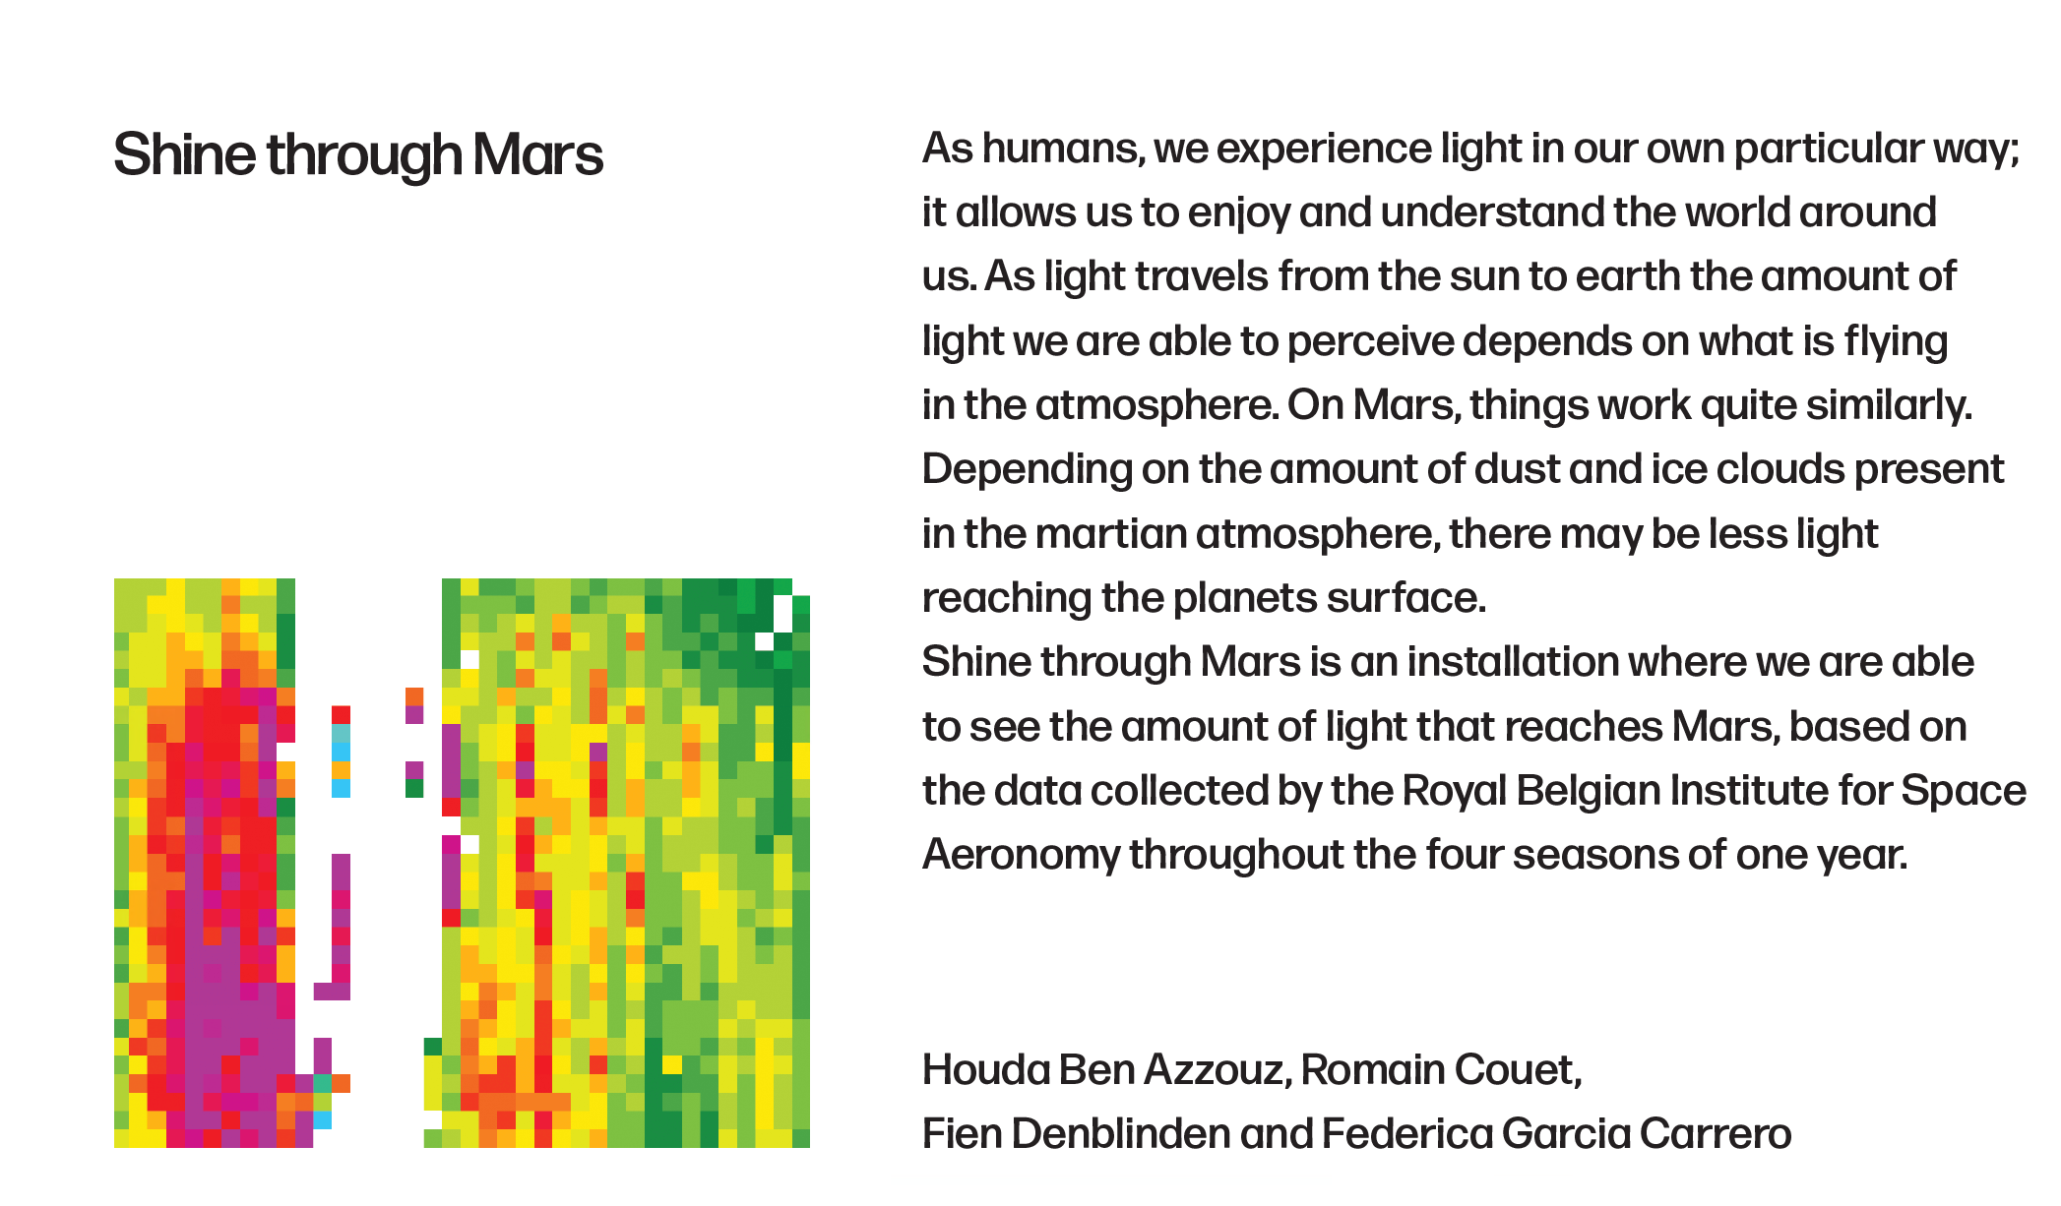
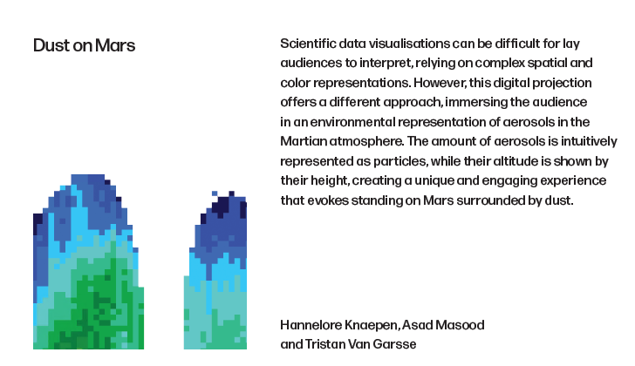
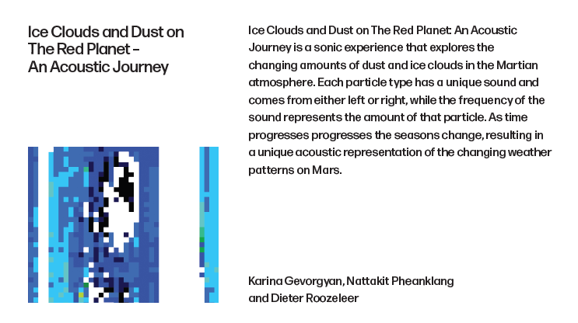
Explanatory exhibition panels
“I was inspired by the rainbow coloured data visualisations that are so prevalent in your field, as I find that they can be rather beautiful in some cases. I used Yannick’s seasonal dust data and recreated his visualisation. Then I took enlarged fragments from it and used those on the poster and cards. It is somewhat ironic since this workshop is about creating new, more artistic visualisations, but your visualisations have their own appeal.”

Slide 9
Questions to ask ourselves…
How to strengthen the link between science and communities?
How to make our science accessible to everyone?
How to engage youngsters for science?
=> Art: the gateway to science for everyone

Slide 10
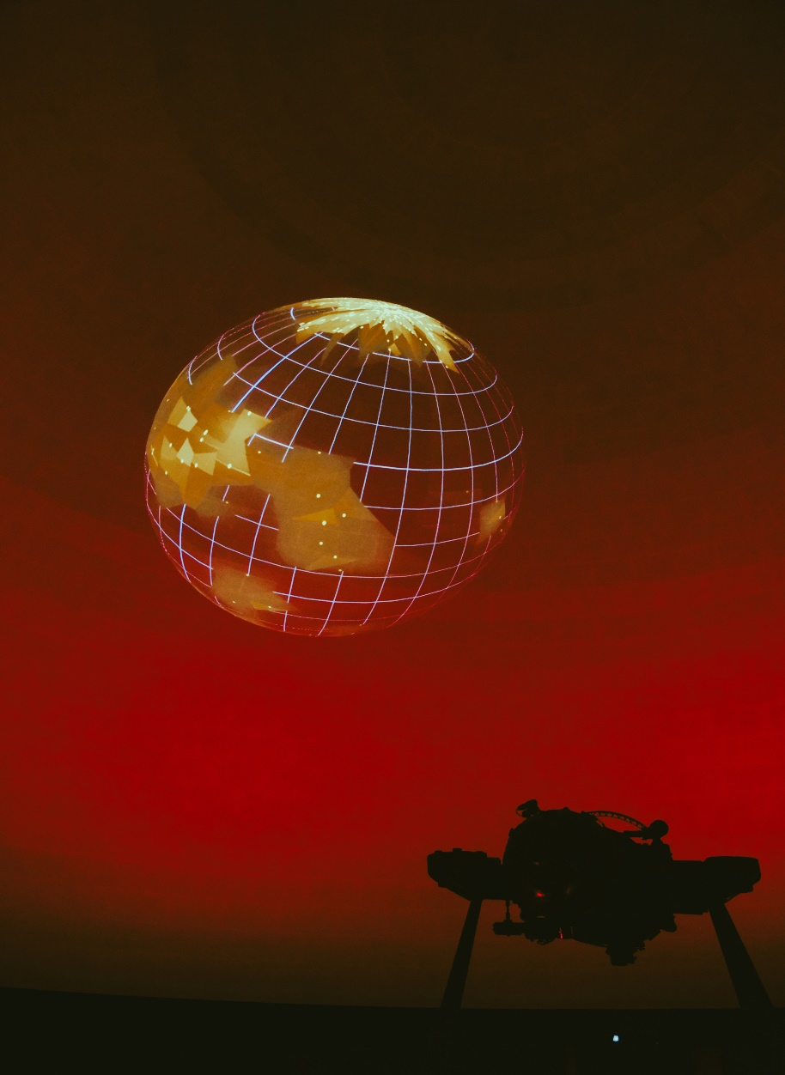
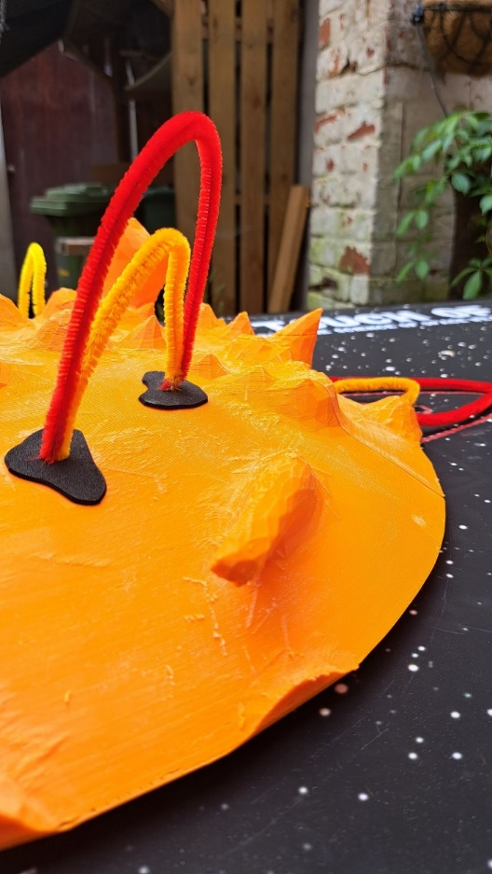
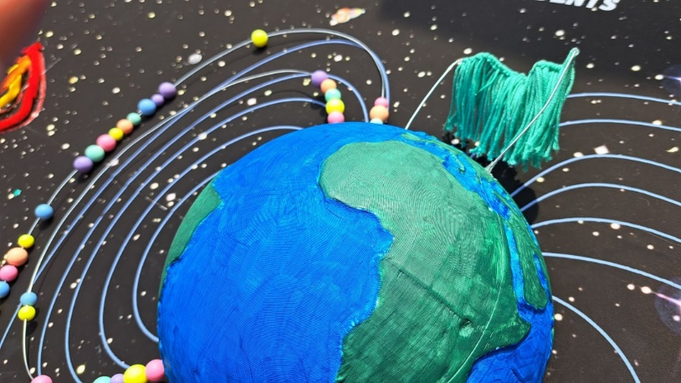
Other cross-disciplinary collaborations between scientists and artists
https://www.a-touch-of-space-weather.be/
https://vamos.aeronomie.be/

Slide 11
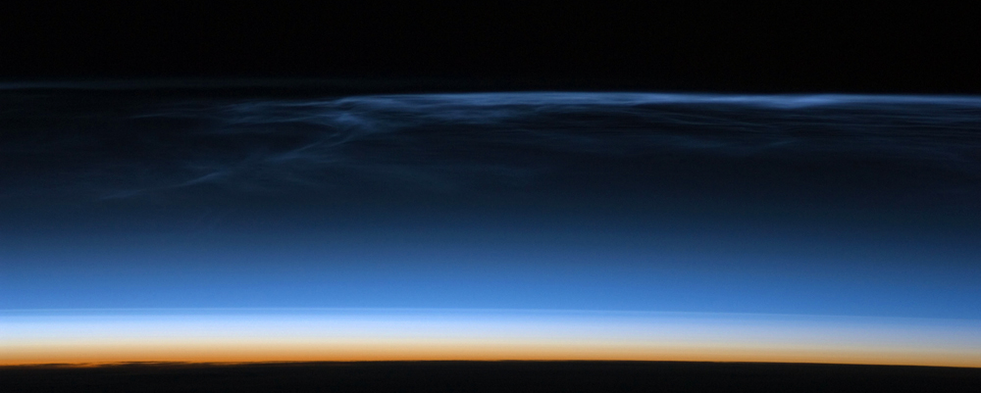
thank you! more info?
Karolien.Lefever@aeronomie.be

Slide 12
Our special thanks to
Ann Carine Vandaele
Yannick Willame
Lori Neary
Arianna Piccialli
Karolien Lefever
Gijs Ipers
Sandy Claes
Karolien Lefever
Gijs Ipers
Lucie Lamort
Jakub Stepanovic
Lenka Zychova
Image credits

